Slide 1
Influence Maximization Revisited: Efficient Reverse Reachable Set Generation with Bound Tightened
Qintian Guo, Sibo Wang, Zhewei Wei, Ming Chen
Notes:
Today, I am very glad to present our paper. I am Sibo from the Chinese University of Hong Kong. This is a joint work with Renmin University of China.

Slide 2
Influence Maximization (IM): Problem Definition
Given a social network $G$, a positive integer $k$,
Select $k$ seed nodes to maximize the expected number of influenced users under a certain cascade model.
Two widely adopted models in the literature [Kempe et al. KDD 2003]
Independent Cascade (IC) model (we focus on this model)
Linear-Threshold (LT) model
How the IC model works
Each (directed) edge $〈u,v〉$ has a probability $puv$ ( $puv∈[0,1]$ )
The seed nodes are activated.
Each newly activated node $u$ has one SINGLE chance to activate each of its outgoing neighbor $v$ with probability $puv$
It terminates when no node can activate other nodes
Notes:
Let’s first see the definition of influence maximization. We are given a social network G, and integer k, the goal is to select k uers that maximize the expected number of influenced users by the word-of-mouth effect. For example in this graph, assume that two users A and B attend SIGMOD and share with their friends that SIGMOD is great. Then, they share with their friends and their friends get influenced. Their friends further share others and further get influenced. Here, we need to formally define the word-of-mouth effect and how a user get influenced.

Slide 3
IC model: A Running Example
$$f$$
0.6
$$e$$
Inactive Node
0.2
Active Node
0.3
0.2
Newly active node
$$d$$
0.1
$$c$$
Successful attempt
0.5
0.6
0.2
Unsuccessful attempt
0.7
$$b$$
$$a$$
Notes:
Let’s see an example.

Slide 4
Existing Solutions
Influence Maximization (IM): NP-hard
State-of-the-art approximate solutions are based on the idea of Random Reverse Reachable Set [Borgs et al., SODA 2014]
Providing $(1−\frac{1}{e}−ε)$ approximation on expected influence
Almost linear expected time complexity: $O(k\left(n+m\right)\log{n}/ε^{2})$ [Tang et al. SIGMOD 2015, Tang et al. SIGMOD 2018]

Slide 5
Reverse Reachable Sets (RR sets)
A random RR set under IC model is generated as follows:
Randomly sample a target node as activated
Each activated node has one chance to activate its in-neighbors, i.e., following the reverse direction of the edges.
Repeat until no nodes can be activated
0.6
$$f$$
$$e$$
0.3
0.2
0.2
RR set = $\{e,f\}$
$$d$$
0.1
$$c$$
0.5
0.6
0.2
Intuition 1: the RR set from $e$ is a sampled set of nodes that can influence node $e$
$$b$$
0.7
$$a$$

Slide 6
RR sets-based IM algorithms
First sample a sufficient large number of random RR sets
$R_{1}=\left\{e,f\right\}, R_{2}=\left\{c,b,a,d\right\}, R_{3}=\left\{b,a\right\}, R_{4}=\left\{b,d,a\right\}, R_{5}=\{b,a\}$
We say that a set $S$ covers a RR set $R$ if $S∩R≠∅$
The expected influence of set $S$ is estimated as:
$n×$ the fractional of RR-sets that are covered by $S$.
Assume that $S=\{b,f\}$. Given random RR sets $\{R_{1},⋯,R_{5}\}$, the expected influence of $S$ is estimated as $6⋅1=6$
Then select the $k$ nodes that cover the most number of RR sets.
Apply the greedy algorithm
Intuition 2: Given a large number of random RR sets, the more RR sets a node set $S$ covers, the higher expected influence $S$ has.

Slide 7
RR set-based IM algorithms (cont.)
Existing algorithms:
RIS [Borgs et al., SODA 2014]: $O\left(k\left(n+m\right)⋅\log^{2}{n}/ε^{3}\right)$
TIM/TIM+ [Tang et al., SIGMOD 2014]:$O\left(k\left(n+m\right)⋅\log{n}/ε^{2}\right)$
IMM [Tang et al., SIGMOD 2015], SSA/D-SSA [Nguyen et al., SIGMOD 2016], OPIM-C [Tang et al., SIGMOD 2017]
Retain the same time complexity as TIM/TIM+
Deficiency of existing RR set-based IM algorithms
All these solutions focus on reducing the number of RR sets
Sharing the same RR set generation algorithm.
Existing RR set-based IM algorithms suffer from prohibitive computational cost under high influence networks
Reason: The expected size of a random RR set becomes too large

Slide 8
Our Contribution
SUBSIM: An efficient RR set generation algorithm
Achieving an order of magnitude improvement over alternatives.
Can be integrated into all existing RR set-based IM algorithms
Improved time complexity
For any node $v$, the sum $μ_{v}$ of the weights of its incoming edges can be bounded by a constant $c$: $O(k⋅n⋅\log{n}/ε^{2})$
For any node $v$, $μ_{v}$ can be bounded by $O\left(\log{d_{in}\left(v\right)}\right)$: $O(k⋅n⋅\log\left(\frac{m}{n}\right)⋅\log{n}/ε^{2})$
HIST: An efficient framework to handle high influence networks
Achieving 2 orders of magnitude improvement over alternatives
Providing the same theoretical guarantee as alternatives

Slide 9
SUBSIM
$$v_{1}$$
Deficiency of the existing RR set generation algorithm
Need to examine the in-neighbor of an activated node.
Generate a random number for each edge.
SUBSIM:
When all weights are equal: geometric sampling
Generate a random integer $X\sim G(0.1)$
If $X=7$. Then, we skip 6 edges and directly sample the $7$-th edge
The expected cost can be bounded by $O(1+μ_{v})$. Here $μ_{v}$ is the sum of the weights of the incoming edges of node $v$.
For an arbitrary distribution, we can still use the idea of geometric sampling.
Expected cost: still $O(1+μ_{v})$. Check our paper for the details!
$$v_{2}$$
0.1
0.1
$$v_{3}$$
$$s$$
0.1
$$v_{4}$$
0.1
$$⋯$$
0.1
$$v_{10}$$

Slide 10
Effectiveness of SUBSIM
Varying k: Running time of IM algorithms under WC model.

Slide 11
Improved Time Complexity
The time complexity of all previous IM algorithms includes the term $m$
Why? We need to examine all incoming edges of a node $v$ to sample the newly activated incoming neighbors.
Now, we can “jump” to activated incoming neighbors.
The cost is proportional to the expected number $μ_{v}$ of activated incoming neighbors
If the expected number $μ_{v}$ can be bounded by a constant or $O\left(\log{d_{in}\left(v\right)}\right)$.
We can improve the time complexity to $O(k⋅n⋅\log{n}/ε^{2})$ or $O(k⋅n⋅\log\left(\frac{m}{n}\right)⋅\frac{\log{n}}{ε^{2}})$.

Slide 12
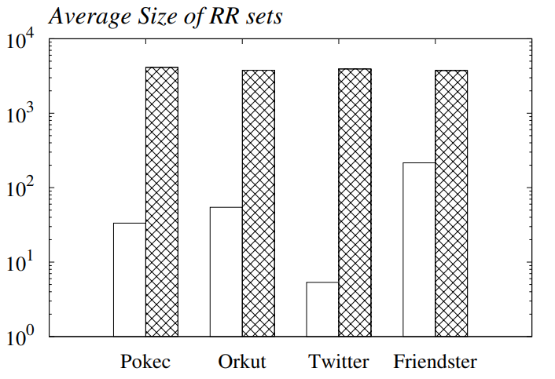
HIST: Handling High Influence Networks
Main idea of HIST:
First select a set of $b$ sentinel nodes
with a small number of random RR sets.
Then, select the remaining $k−b$ nodes.
Terminate the RR set generation
as soon as a sentinel node is hit.
The average size of random RR
sets tends to reduce
Average size of RR sets
Main challenge: Retaining the approximation guarantee.
Check our paper for the details.

Slide 13
Effectiveness of HIST
Varying the average size of random RR sets
WC variant: for each node $v$, the weight of its incoming edges is $\min\left\{\frac{θ}{d_{in}\left(v\right)}, 1\right\}$
Tune $θ$ such that the average size is 50, 400, …, 32,000
Varying $θ$: Running time under WC variant setting.

Slide 14
Conclusion
SUBSIM: Efficient RR set generation with bound tightened.
HIST: reducing the average size of random RR sets.

Slide 15
Thanks
Download our code at: https://github.com/qtguo/subsim

Slide 16
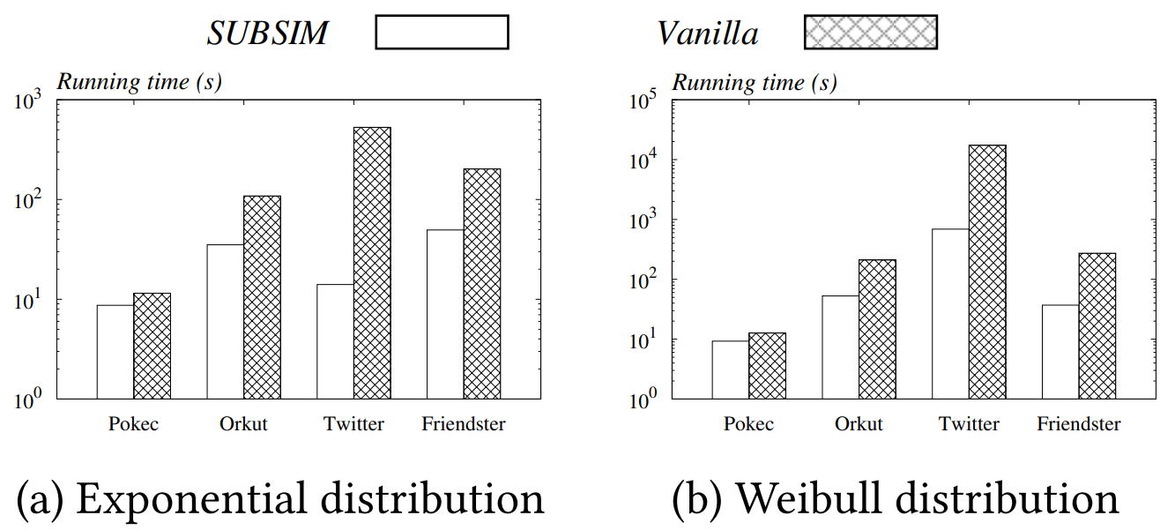
Skew distributions
Skewed distribution: RR set generation cost.

Slide 17
Effectiveness of HIST
Impact of $k$
Varying k: Running time under WC variant setting.

