Slide 1
SEEM4570: XAMPP, Eclipse , Summary of Html
Kangfei Zhao
Room 711,ERB
Email: kfzhao@se.cuhk.edu.hk

Slide 2
Outline
XAMPP
XAMPP Install
Put php and HTML documents
Windows and Mac Version
Security
Eclipse
Introduction
Setup
Install Plug-in
New and Run a Project on an Emulator
Eclipse

Slide 3
Introduction
A web application requires
A web server
A database
A interpreter
XAMPP: A free and open source cross-platform web server solution stack package
X: Cross-platform
A: Apache HTTP Server
M: MySQL database
P: PHP (the interpreter)
P: Perl (the interpreter)
Download from:
http://www.apachefriends.org/en/xampp-windows.html
XAMPP 5.5 Installer

Slide 4
Environment
XAMPP v1.8.3
Windows
Reminder
Use corresponding version for Mac and Linux

Slide 5
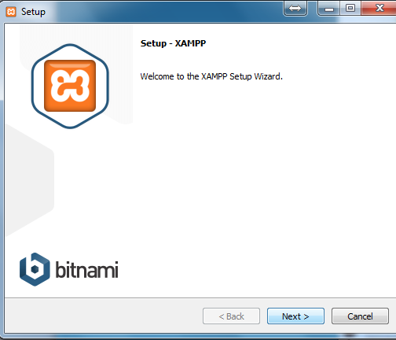
Installation
Only download and unzip
No installer
Start with
Assume the unzip directory is: c:\xampp
Run C:\xampp\xampp-control

Slide 6
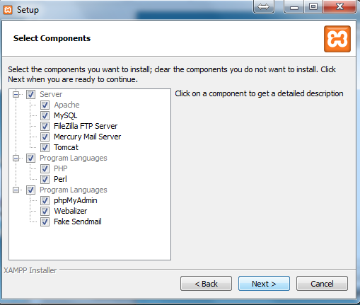
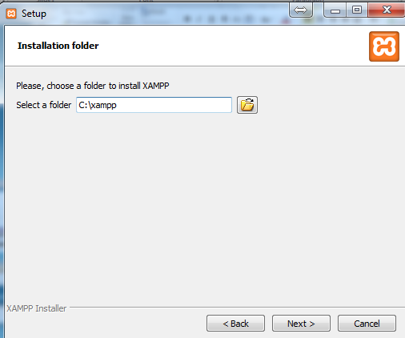

Slide 7
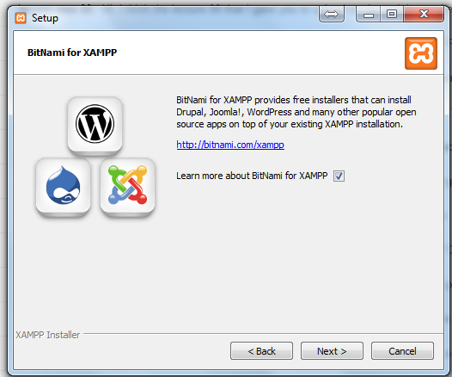
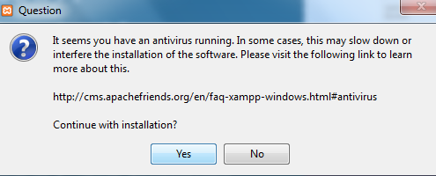
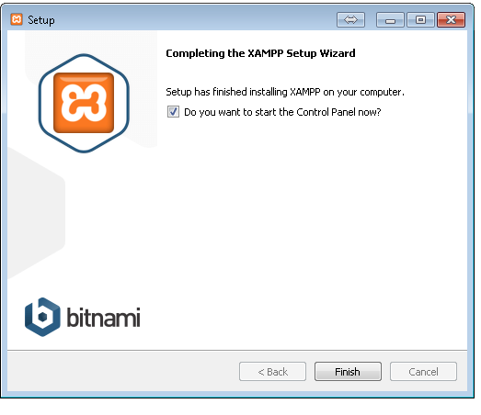

Slide 8
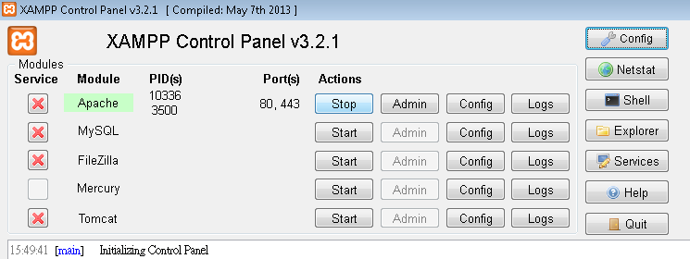

Slide 9
Run Programs
Run PHP
Needs the Microsoft Visual C++ 2008 Redistributable package
http://www.microsoft.com/en-us/download/details.aspx?id=5582
PHP (*.php), Perl (*.cgi) and others
located in => C:\xampp\htdocs\

Slide 10
Security
XAMPP
Not meant for production use
Only for developers in a development environment
A list of missing security
The MySQL administrator (root) has no password
The MySQL daemon is accessible via network
phpMyAdmin is accessible via network
Fix most of the security weaknesses
http://localhost/security/
The root password for MySQL and phpMyAdmin
a XAMPP directory protection

Slide 12
Outline
XAMPP
XAMPP Install
Put php and HTML documents
Windows and Mac Version
Security
Eclipse
Introduction
Setup
Install Plug-in
New and Run a Project on an Emulator
Eclipse

Slide 13
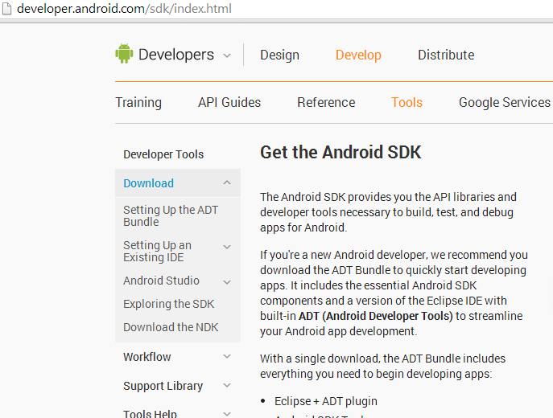
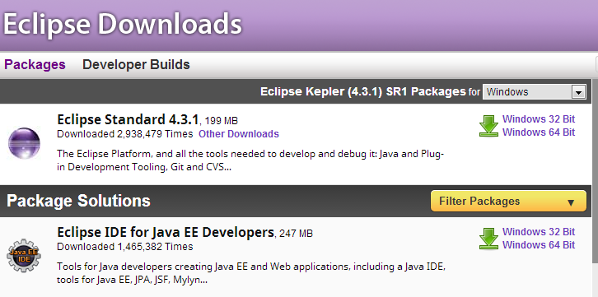
Introduction
An Integrated Development Environment (IDE)
A standalone software
Support multiple languages such as Java, C, HTML, CSS3, php, etc.
Android Development Tools (ADT) Bundle
http://developer.android.com/sdk/index.html
Eclipse + ADT plugin
Android SDK Tools
Android Platform-tools, etc
Java EE IDE
Eclipse Java EE IDE for Web Developers
http://www.eclipse.org/downloads/
Unzip the file to any place as convenience
Remember to install Java SDK
http://www.oracle.com/technetwork/java/javase/downloads/jdk7-downloads-1880260.html

Slide 14
Environment
Setup in tutorial
Windows platform
Eclipse
Android
You can use another setting for the course like
Mac, Linux
Netbeans

Slide 15
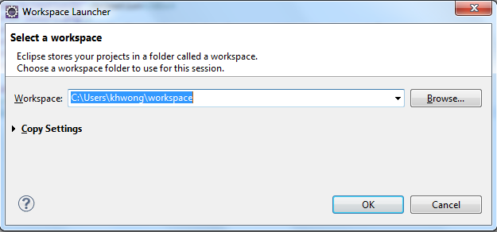
Setup
Choose a workspace
A directory used by Eclipse to store your source codes
If you are first starting, Eclipse will ask you to specify the workspace to use

Slide 16
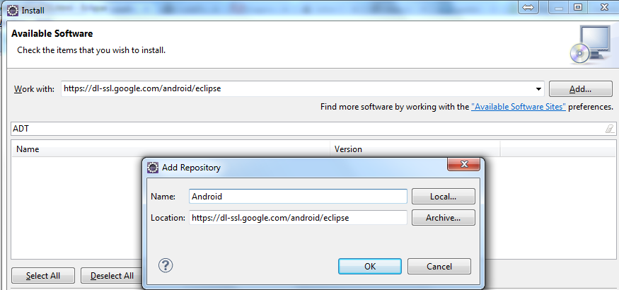
Install Android Plug-in
Must install Android SDK before (no need if installed ADT bundle)
http://dl.google.com/android/installer_r22.3-windows.exe
Eclipse: Help → Install New Software
Add the repository
https://dl-ssl.google.com/android/eclipse

Slide 17
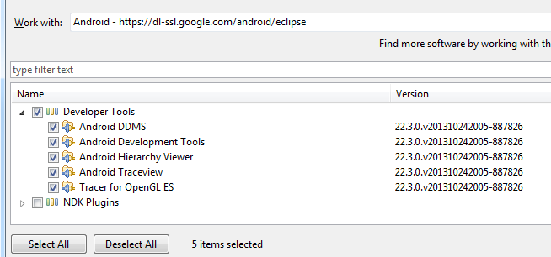
Select ADT plugin
Select all items under developer tools
Next

Slide 18
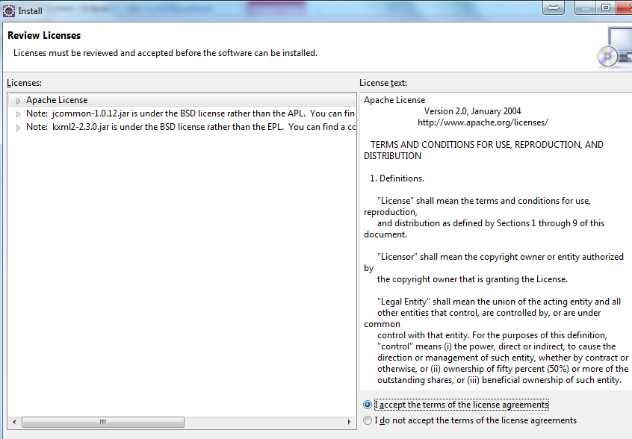
Accept the Agreement
Accept the license agreement
Restart Eclipse

Slide 19
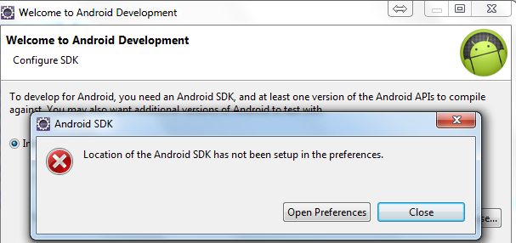
Setup the Android SDK
Click “OK” for security warning
Click “Open Preferences” to setup the Android SDK

Slide 20
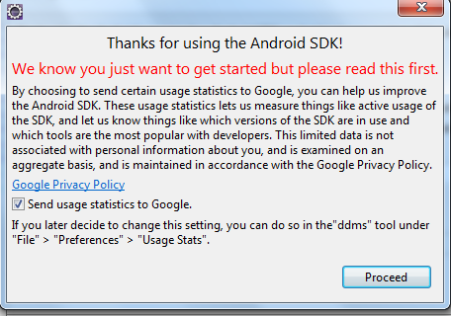
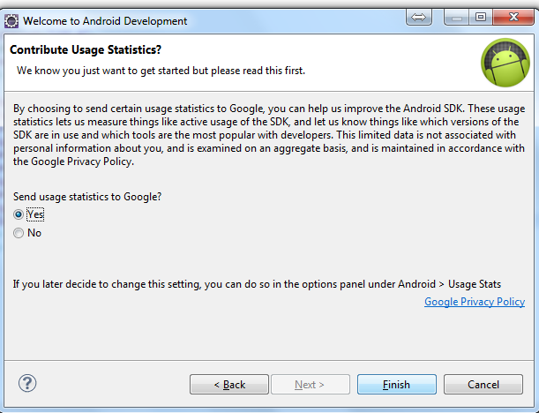
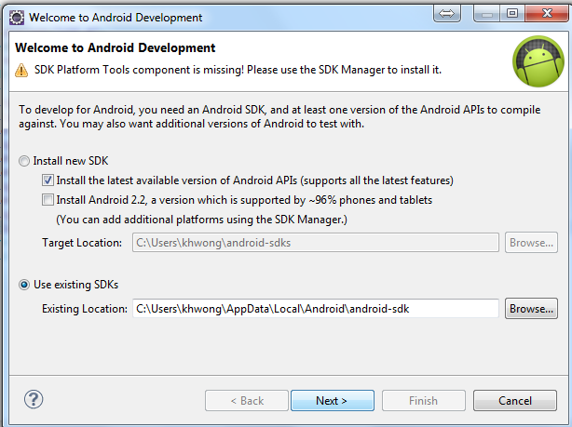
Setup the Android SDK
Click “Proceed”
Select the Android SDK if you separate install Eclipse and Android SDK

Slide 21
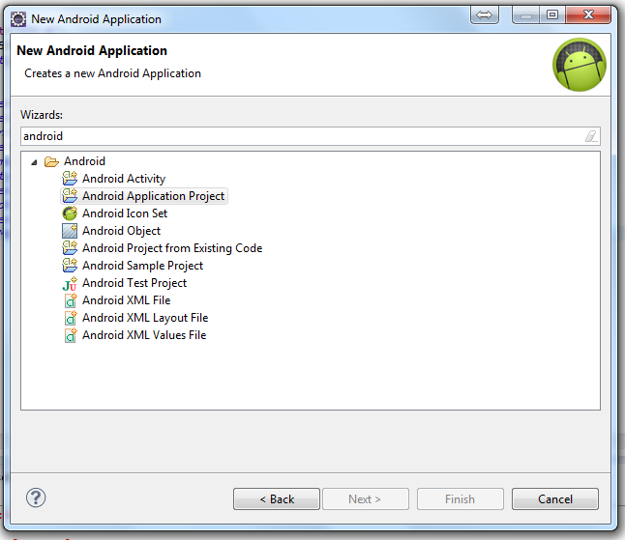
Create an Android Project
New → Other…→Android
Android Application Project

Slide 22
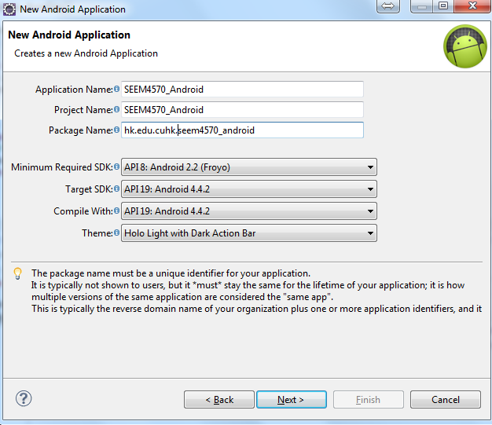
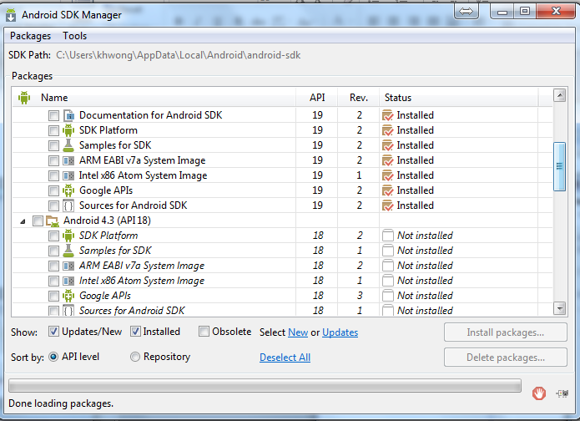
Basic information
Input application name and others
Select target SDK: API19
Install the corresponding SDK version on the Android SDK manager if an error in theme

Slide 23
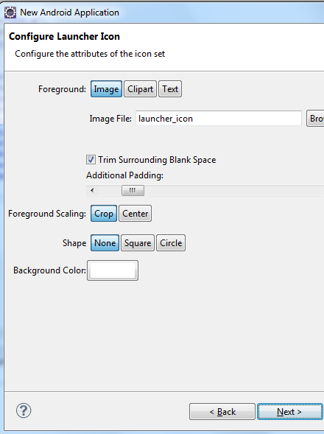
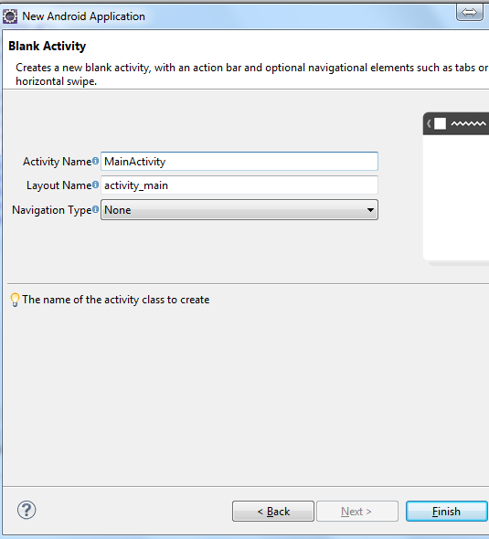
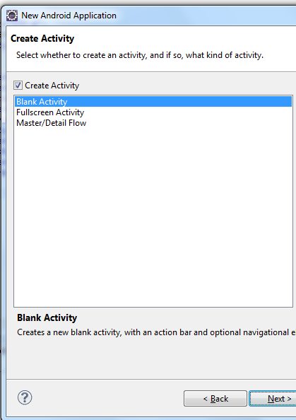
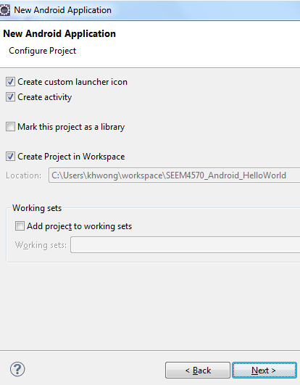
Continue to Create
Click “Next” for following steps
“Finish”

Slide 24
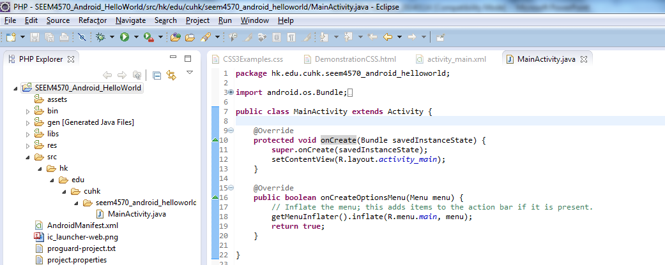
Initial Codes
If the MainActivity shows error, please try:
Project → Clean→Clean all projects

Slide 25
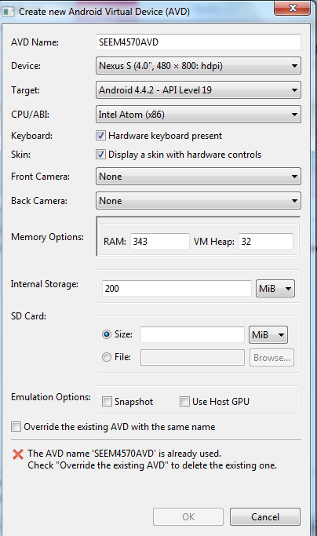
Android Virtual Device
If no Android Virtual Device (AVD), an AVD need to be created
Open the Android Virtual Device Manager (or Eclipse will open it automatically) → New
Select device, target API version and CPU
Remember that you have install those API version before
For memory, please ensure the computer has enough memory. Otherwise, the emulator cannot start

Slide 26
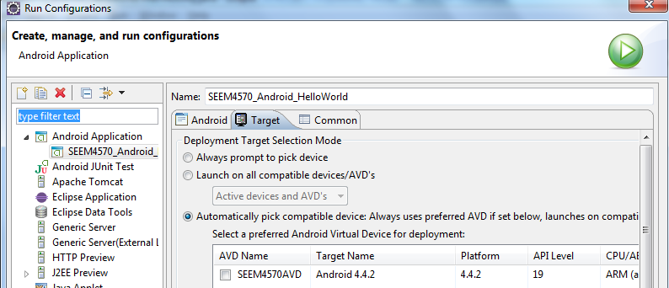
Run the Project
Right click the project folder
Run As → Android Application
In the first time, you may need to setup the AVD
Run As → Run Configuration → Android Application → Target

Slide 27
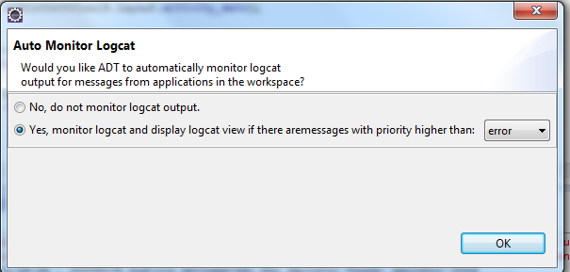
Debug message
Unlike console program, the log need to be re-direct out of the emulator
Choose “Yes” for auto monitor logcat

Slide 28
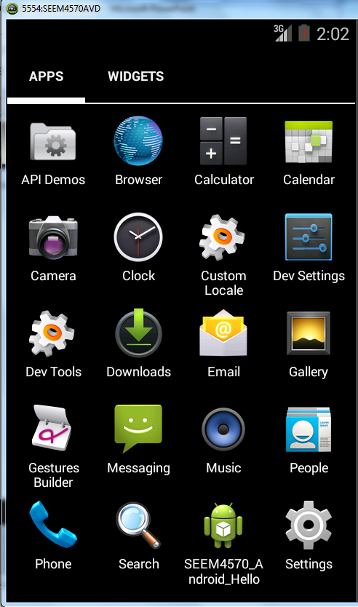

Slide 29
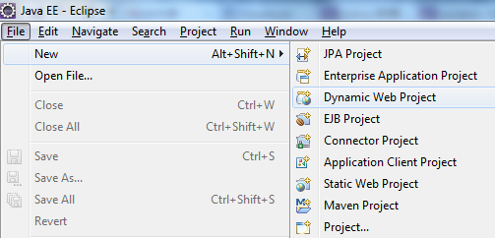
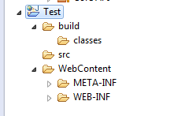
Create a New HTML and CSS Project
Eclipse: File → New → Project → Web→ Dynamic Web project

Slide 30
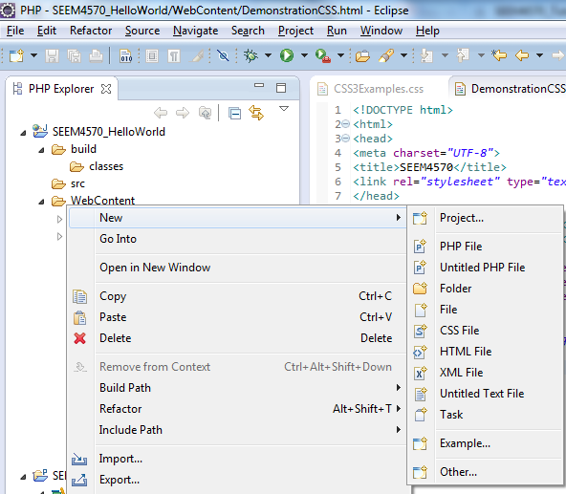
Create New HTML pages
Right click the project → New → HTML File
Create CSS file in similar way

Slide 31
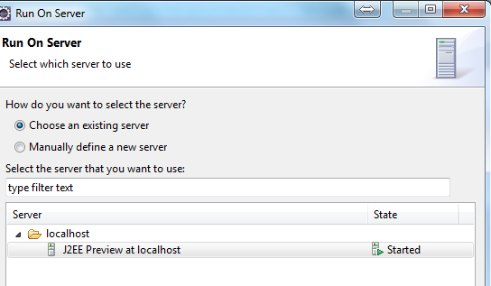
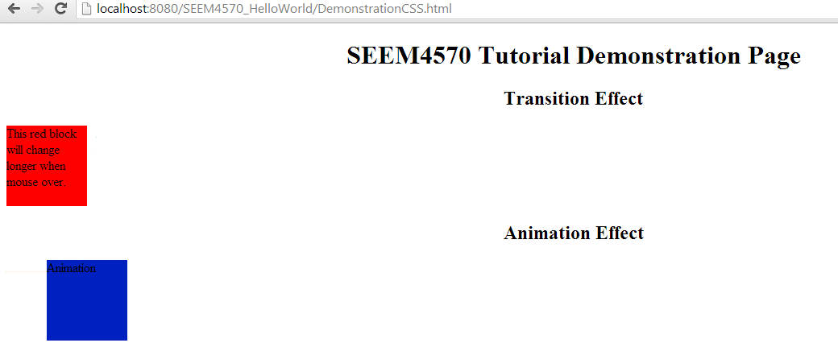
Deploy the Webpage
Use J2EE Preview at localhost
After running the server, we can view in other browsers

