Slide 1
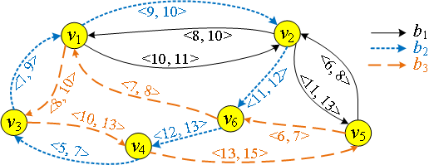
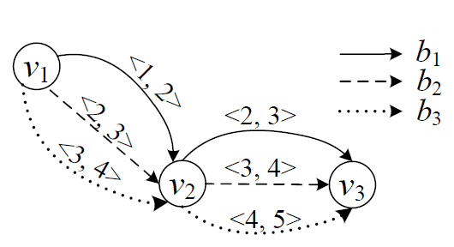
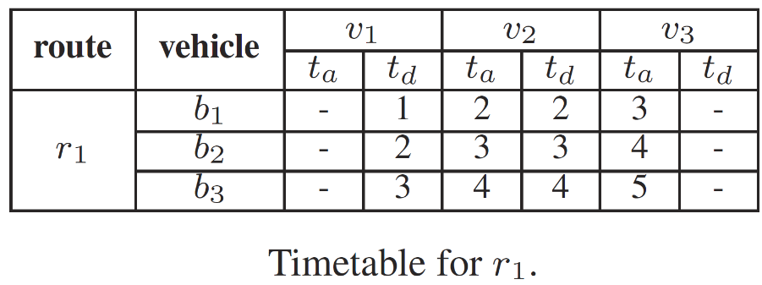
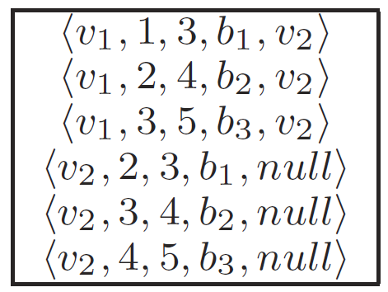
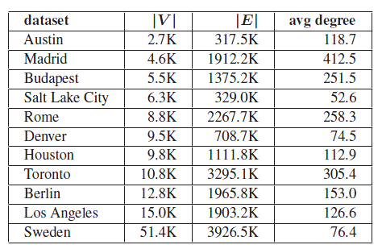
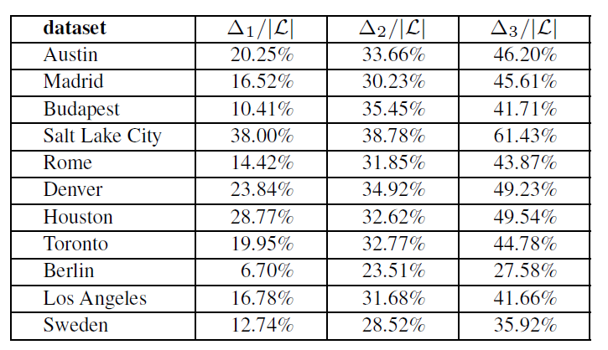
Efficient Route Planning on Public Transportation Networks: A Labelling Approach Sibo Wang‡, Wenqing Lin†, Yi Yang§, Xiaokui Xiao‡, and Shuigeng Zhou§
‡
†
§
1. Problem Definition
3. Query Processing
Public Transportation Network
Each edge $\left\langle u,v, t_{d}, t_{a}, b\right\rangle$ denotes that the bus $b$ departures from station $u$ at timestamp $t_{d}$ and arrives at station $v$ at timestamp $t_{a}$.
Route Planning Queries
↘ Earliest Arrival Path (EAP) ↘ Latest departure Path (LDP) ↘ Shortest Duration Path (SDP)
Phase 1: Candidate Generation.
Consider the paths from $u$ to $v$.
Given $l_{1}=〈w,t_{d},t_{a}, ⋅, ⋅〉∈L_{out}\left(u\right) and l_{2}=〈w, t_{d}^{′},t_{a}^{′}, ⋅, ⋅ 〉∈L_{in}\left(v\right) where t_{a}≤t_{d}^{′}$.
Concatenating path pertinent to $l_{1} and l_{2}$, add ${〈l}_{1}, l_{2}〉$ to candidate set $S_{uv}$.
Worst case complexity: $\left|L_{out}\left(u\right)\right|⋅|L_{in}(v)|$.
Pruning techniques: node rank, departure time, and dominated paths.
Phase 2: Refinement and Path Reconstruction.
Bus $b_{1}$
Dep. Station | Arr. Station | Dep. Time | Arr. Time
$$v_{5}$$ | $$v_{2}$$ | 6 | 8
$$v_{2}$$ | $$v_{1}$$ | 8 | 10
……
Bus $b_{2}$
Dep. Station | Arr. Station | Dep. Time | Arr. Time
$$v_{4}$$ | $$v_{3}$$ | 5 | 7
$$v_{3}$$ | $$v_{1}$$ | 7 | 9
……
Bus $b_{3}$
Dep. Station | Arr. Station | Dep. Time | Arr. Time
$$v_{5}$$ | $$v_{6}$$ | 6 | 7
$$v_{6}$$ | $$v_{1}$$ | 7 | 8
……
$$v_{4}$$
$$〈v_{1}, 5, 9,b_{2},v_{3}〉$$
$$〈v_{3}, 5, 7,b_{2},null〉$$
$$〈v_{1}, 9, 10,b_{2},null〉$$
$$〈v_{1}, 10, 11,b_{1},null〉$$
$$v_{2}$$
$$L_{out}\left(v_{4}\right)$$
$$L_{in}\left(v_{2}\right)$$
$$S_{v_{4}v_{2}}$$
$$〈 〈v_{1}, 5, 9,b_{2},v_{3}〉\text{, }〈v_{1}, 9, 10,b_{2},null〉 〉$$
$$〈 〈v_{1}, 5, 9,b_{2},v_{3}〉\text{,} 〈v_{1}, 10, 11,b_{1},null〉 〉$$
$$〈v_{1}, 5, 9,b_{2},v_{3}〉$$
$$〈v_{1}, 9, 10,b_{2},null〉$$
Departure from $v_{5}$ after time 6, how to arrive at $v_{1}$ ASAP?
Arrive at $v_{4}$ before time 13, how to departure from $v_{1}$ ALAP?
Departure from $v_{5}$ at time 6, how to arrive at $v_{1}$ before time 10, with shortest duration?
$$〈v_{3}, 5, 7,b_{2},null〉$$
$$〈v_{1}, 7, 9,b_{2},null〉$$
$$v_{1}\frac{b_{2}}{ }v_{2}$$
$$v_{4}\frac{b_{2}}{ }v_{3}$$
$$v_{3}\frac{b_{2}}{ }v_{1}$$
$$v_{4}\frac{ b_{2} }{ } v_{3}\frac{ b_{2} }{ } v_{1}\frac{ b_{2} }{ }v_{2}$$
$$v_{5} \frac{ b_{3} }{ } v_{6}\frac{ b_{3} }{ }v_{1}$$
$$v_{1}\frac{ b_{1} }{ } v_{2}\frac{ b_{2} }{ } v_{6}\frac{ b_{2} }{ }v_{4}$$
$$v_{5} \frac{ b_{3} }{ } v_{6}\frac{ b_{3} }{ }v_{1}$$
4. Preprocessing
2. Timetable Labelling
Index Construction
Choose $v$ with highest rank.
Forward EAP traversal.
from largest timestamp t: non-dominance guarantee $→P_{t}$.
Next largest timestamp $t^{′}$: not dominated by $P_{t}→$ non-dominance guarantee.
Backward LDP traversal, from smallest timestamp.
Node Ordering
An $√m$-Approximation Algorithm.
Adaptive coverage $R_{i}\left(v\right):$ # of non-dominated paths not covered by ordered vertices $u_{1},u_{2}, u_{i−1}$
Node with maximum $R_{i}\left(v\right)$, we have $o\left(v\right)=i, {i.e., u}_{i}=v$.
Time complexity: $O(n^{2}⋅m)$.
A Heuristic algorithm
Estimate adaptive coverage with sampling.
Node order $o$
A total ordering: for any $u$ and $v$, we have $o\left(u\right)>o\left(v\right)$ or $o\left(u\right)<o\left(v\right)$.
$u$ has a higher rank than $v$ if $o\left(u\right)<o\left(v\right)$.
Each node $v$ has an in-label set $L_{in}\left(v\right)$ and an out-label set $L_{out}\left(v\right)$. Each label $l=〈x, t_{d}, t_{a}, b,p〉$ in $L_{out}\left(u\right)$ or $L_{in}\left(v\right)$, where $x$is determined as follows:
$if o\left(u\right)>o\left(v\right), x=v, l∈L_{out}(u)$;
$otherwose, x=u, l∈L_{in}(v)$.
$$〈v_{1}, 10, 13, null,v_{2}〉$$
$$〈v_{2}, 11, 13,b_{2},v_{6}〉$$
$$〈v_{3}, 10, 13,b_{3},null〉$$
$$v_{4}$$
$$〈v_{1}, 5, 9,b_{2},v_{3}〉$$
$$〈v_{3}, 5, 7,b_{2},null〉$$
$$R_{1}\left(v_{1}\right)=6, R_{1}\left(v_{2}\right)=9, R_{1}\left(v_{3}\right)=6;$$
$$L_{in}\left(v_{4}\right)$$
$$L_{out}\left(v_{4}\right)$$
Leading to $o\left(v_{2}\right)=1$
5. Optimizations and Extensions
Label Compression
Route-based compression
label with vehicle info
Pivot-based compression
$o\left(u\right)<o\left(p\right)<o(v)$
Consider $l_{1},l_{2},l_{3}∈L_{in}\left(v\right)$.
$l_{1}=〈u, t_{d}, t_{a}, null,p 〉,$
$l_{2}=〈u, t_{d}^{′}, t_{a}^{′}, null,p 〉,$
$l_{3}=〈u, t_{d}^{∗}, t_{a}^{∗}, null,p 〉$
Compress to $l_{c}=〈u, null, null, null, p〉$
$l_{1},l_{2},l_{3}$ recover from $L_{in}(p)$, $l_{in}(u)$
Label dependency can be used to build a weighted dependency graph.
NP-hard: maximum-weight independent set
Concise Representation of Query Results
Consider G in Figure 1.
$P=〈 〈v_{3},v_{1},7,9, b_{2}〉,$ $〈v_{1},v_{2},9,10, b_{2}〉,$ $〈v_{2},v_{5},11, 13,b_{1}〉 〉$
$P$ can be denoted by a concise path $P_{c}$, as follows:
$P_{c}=〈 〈v_{3}, 7,b_{2}〉, 〈v_{2}, 11, b_{1}〉 〉$
Reduce path unfolding cost.
Improving query performance.
$$〈v_{1}, 1,2, b_{1}, null〉$$
$$〈v_{1}, 2,3, b_{2}, null〉$$
$$〈v_{1}, 3,4, b_{3}, null〉$$
$$L_{in}(v_{2})$$
$$〈v_{1},null,null, r_{1}, v_{2}〉$$
$$〈v_{2}, null,null, r_{1}, null〉$$
$L_{in}(v_{3})$ after compression
$$L_{in}(v_{3})$$
$$〈v_{1},null,null, r_{1}, null〉$$
$L_{in}(v_{3})$ after compression
6. Experiments
Datasets
Competitors
CSA [Dibbelt et al. SEA’13, Wu et al. VLDB’14]
CHT [Geisberger et al. SEA’10]
Exp-1: Query Performance.
Exp-2: Index Size.
Exp-3: Preprocessing Time.
Exp-4: Compression Ratios.
$∆_{1}$: Route-based compression.
$∆_{2}$: Pivot-based compression.
$∆_{3}$: Route-based and Pivot-based compression.

