Slide 1
SEEM3430 Information Systems Analysis and Design
Entity Relationship Diagram (ERD)
Chen, Qianyu
Department of Systems Engineering and Engineering Management
The Chinese University of Hong Kong
November 6, 2024
Notes:
Today we'll be learning about Entity Relationship Diagrams, or ERDs. In this lecture, we'll cover the definition of ERDs, their basic building blocks, how to draw them, and we'll work through a practical example. We'll also learn about database normalization.

Slide 2
Overview
What is ERD?
Definition
Building blocks
How to draw ERDs
An example
Database Normalization
Summary
Notes:
Today we'll be learning about Entity Relationship Diagrams, or ERDs. In this lecture, we'll cover the definition of ERDs, their basic building blocks, how to draw them, and we'll work through a practical example. We'll also learn about database normalization.

Slide 3
Definition
An approach for data modeling
A database is divided into two logical parts:
Entities
Relationships
Diagrams created to design entities and relationships are called entity-relationship diagrams
Notes:
What is an ERD? It's an approach to data modeling where we divide a database into two logical parts: entities and relationships. When we design these entities and the relationships between them, we create what we call entity-relationship diagrams. These diagrams help us visualize and design database structures effectively."

Slide 4
Symbol Sets

Slide 5
An ERD Example

Slide 6
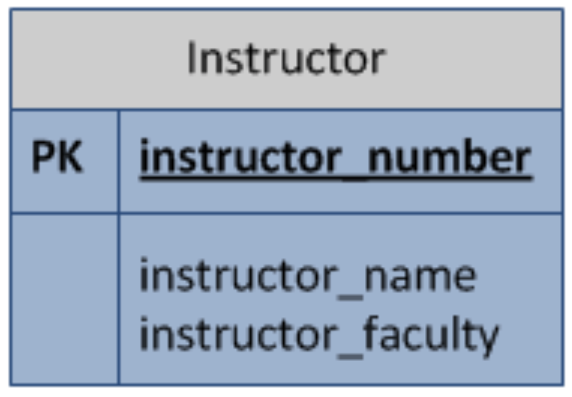
Entity
Real-world objects, e.g., student, book
Entity instance: a particular entity, e.g., Harry Potter
Represented by a named rectangle
Attributes and identifiers
Notes:
Let's start with the most fundamental concept in ERDs: entities. An entity represents a real-world object, such as a student or a book. When we talk about a specific instance of an entity, like the student 'Harry Potter', we call this an entity instance. In our diagrams, we represent entities using named rectangles. Each entity has attributes and identifiers, which we'll discuss next.

Slide 7
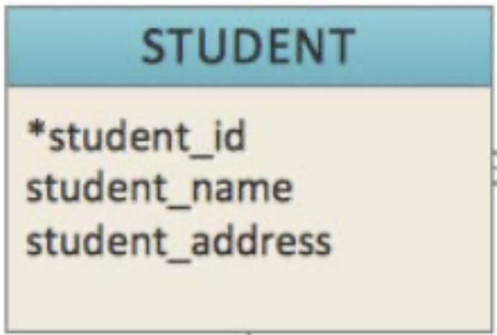
Attribute
Attribute describes the characteristics of an entity.
Primary key.
A key attribute is unique, distinguishing characteristic of the entity.
Identifier: One or more attributes that can uniquely identify one instance of an entity, which noted by an asterisk next to the attribute name.
Notes:
Attributes describe the characteristics of an entity. Among these, the primary key is particularly important. A primary key is a key attribute that must be unique and can distinguish one entity instance from another. In our ERDs, we mark identifiers with an asterisk. An identifier can be a single attribute or a combination of attributes, as long as it uniquely identifies one entity instance.、

Slide 8
Relationship
A relationship is an association among entities.
Relationships can be thought of as verbs, linking two or more nouns.
Examples: an “owns” relationship between a company and a computer, a “performs” relationship between an artist and a song.
Notes:
Relationships are associations between entities. Think of relationships as verbs that connect two or more nouns (entities). For example, a company 'owns' a computer, or an artist 'performs' a song. These relationships help us understand how different entities interact with each other in our database system.

Slide 9
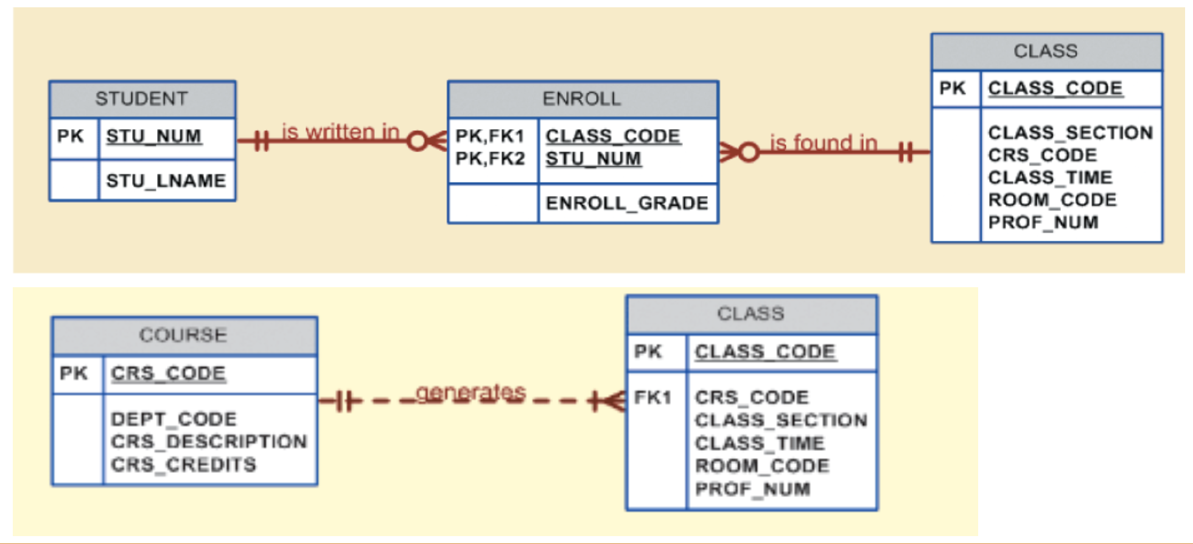
Relationship
Strong Relationships(solid lines ): the FK (foreign key) of the related table is also involved in its PK (primary key), along with being the PK of another table.
Weak Relationships(dashed line): the relationship is not strong. E.g. Class had CRS_CODE(the COURSE PK) as a FK, which is not its PK.
Notes:
Relationships can be either strong or weak. Strong relationships, shown with solid lines, indicate that the foreign key of the related table is also part of its primary key. Weak relationships, shown with dashed lines, indicate a less rigid connection. For example, when a Class table has a course code (CRS_CODE) as a foreign key but not as part of its primary key, this is a weak relationship

Slide 10
Cardinality
Cardinality specifies how many instances of an entity relate to one instance of another entity.
1:1 relationship: one instance of the parent entity is associated with one instance of the child entity.
1:N relationship: a single instance of a parent entity is associated with many instances of a child entity.
M:N relationship: many instances of a parent entity can relate to many instances of a child entity.
Notes:
Cardinality specifies how many instances of one entity can relate to instances of another entity. We have three main types:
One-to-one (1:1): one instance of the parent entity relates to exactly one instance of the child entity
One-to-many (1:N): one instance of the parent entity can relate to multiple instances of the child entity
Many-to-many (M:N): multiple instances of the parent entity can relate to multiple instances of the child entity For example, in our course and class relationship, one course can have multiple classes, demonstrating a one-to-many relationship.

Slide 11
Cardinality
One course can have multiple classes. Some courses may not have classes.
One course can have multiple classes. Each course must have at least one class.
Notes:
Cardinality specifies how many instances of one entity can relate to instances of another entity. We have three main types:
One-to-one (1:1): one instance of the parent entity relates to exactly one instance of the child entity
One-to-many (1:N): one instance of the parent entity can relate to multiple instances of the child entity
Many-to-many (M:N): multiple instances of the parent entity can relate to multiple instances of the child entity For example, in our course and class relationship, one course can have multiple classes, demonstrating a one-to-many relationship.

Slide 12
Example
Prof. McGonagall found that the modern student information management system convenient
She would like to build up one for students in Hogwarts too. But she has been in the magic world for too long. Can you help her draw the ERD?
Basic entities:
Students (SID, SNAME, HOUSE, COURSE, GRADE)
Courses (CID, CNAME, TEACHER)
Houses (HNAME, HEAD)
Notes:
Let's look at a practical example. Professor McGonagall wants to build a modern student information management system for Hogwarts. We need to help her design an ERD. The basic entities include:
Students (with attributes: SID, SNAME, HOUSE, COURSE, GRADE)
Courses (with attributes: CID, CNAME, TEACHER)
Houses (with attributes: HNAME, HEAD)"

Slide 13
solution
Notes:
And here is the solution

Slide 14
Database Normalization
Definition:
Normalization is the process of organizing data in a database. This includes creating tables and establishing relationships between those tables according to rules designed both to protect the data and to make the database more flexible by eliminating redundancy and inconsistent dependency.
Notes:
Database normalization is the process of organizing data efficiently in a database. It aims to protect data and increase database flexibility by eliminating redundancy and inconsistent dependencies. Normalization involves three main steps:
First Normal Form (1NF): Ensures each attribute contains a single value; no repeating attributes
Second Normal Form (2NF): Removes partial dependencies, ensuring non-key attributes fully depend on the entire primary key
Third Normal Form (3NF): Eliminates transitive dependencies, ensuring all attributes directly depend on the primary key

Slide 15
Normalization Process
Notes:
Database normalization is the process of organizing data efficiently in a database. It aims to protect data and increase database flexibility by eliminating redundancy and inconsistent dependencies. Normalization involves three main steps:
First Normal Form (1NF): Ensures each attribute contains a single value; no repeating attributes
Second Normal Form (2NF): Removes partial dependencies, ensuring non-key attributes fully depend on the entire primary key
Third Normal Form (3NF): Eliminates transitive dependencies, ensuring all attributes directly depend on the primary key

Slide 16
Normalization Process
Notes:
Database normalization is the process of organizing data efficiently in a database. It aims to protect data and increase database flexibility by eliminating redundancy and inconsistent dependencies. Normalization involves three main steps:
First Normal Form (1NF): Ensures each attribute contains a single value; no repeating attributes
Second Normal Form (2NF): Removes partial dependencies, ensuring non-key attributes fully depend on the entire primary key
Third Normal Form (3NF): Eliminates transitive dependencies, ensuring all attributes directly depend on the primary key

Slide 17
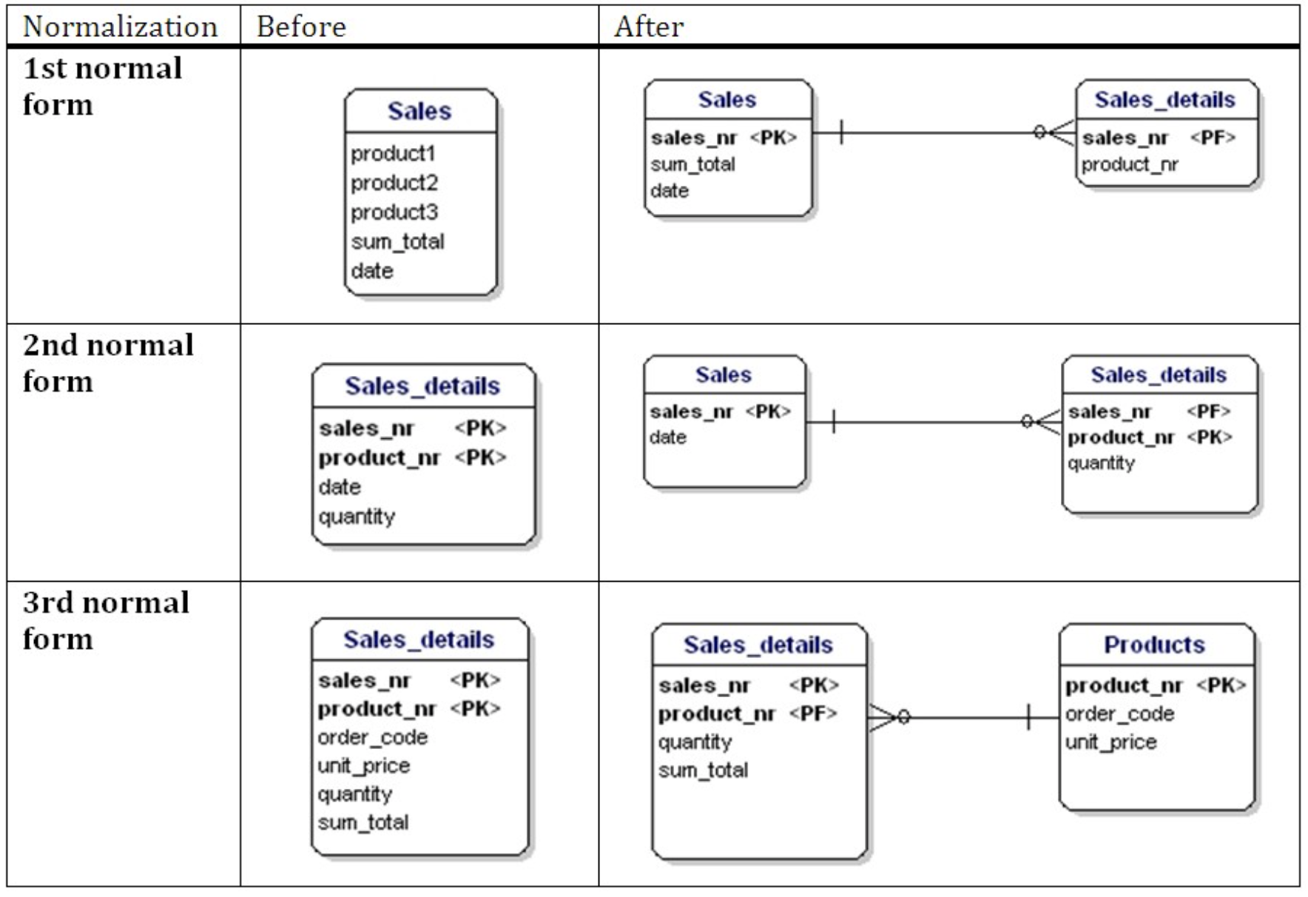
Normalization Process
After 1st Norm, the repeated attributes (product1, product2, product3) was moved to a new table, Sales was created.
After 2nd Norm, the partial dependency of date on sales nr was removed and Sales table was created.
After 3rd Norm, the transitive dependency of order code and unit price on product nr was removed and Products table was created.
Notes:
Database normalization is the process of organizing data efficiently in a database. It aims to protect data and increase database flexibility by eliminating redundancy and inconsistent dependencies. Normalization involves three main steps:
First Normal Form (1NF): Ensures each attribute contains a single value; no repeating attributes
Second Normal Form (2NF): Removes partial dependencies, ensuring non-key attributes fully depend on the entire primary key
Third Normal Form (3NF): Eliminates transitive dependencies, ensuring all attributes directly depend on the primary key

Slide 18
Normalization Process
1NF: A single attribute is not allowed to contain multiple values; no repeating/duplicated attributes.
2NF: If an attribute depend on the primary key, then it must depend on the entire primary key (or super key), i.e. no partial dependencies on a concatenated primary key. But it does not ensure all attributes depend on the primary key.
3NF: All attributes must directly depend on the entire primary key (or super key), i.e. no dependencies on non-key attributes.
Notes:
Database normalization is the process of organizing data efficiently in a database. It aims to protect data and increase database flexibility by eliminating redundancy and inconsistent dependencies. Normalization involves three main steps:
First Normal Form (1NF): Ensures each attribute contains a single value; no repeating attributes
Second Normal Form (2NF): Removes partial dependencies, ensuring non-key attributes fully depend on the entire primary key
Third Normal Form (3NF): Eliminates transitive dependencies, ensuring all attributes directly depend on the primary key

Slide 19
Summary
Identify Entities for your data modeling problem
Add Attributes for each entity and determine the primary key
Establish Relationships between entities
Check the Cardinalities
Normalize your database via 1NF, 2NF, 3NF
Review your E-R diagram and Refine it
Notes:
Let's summarize the steps for designing an ERD:
Identify the entities in your data modeling problem
Add attributes for each entity and determine the primary keys
Establish relationships between entities
Check the cardinalities
Normalize your database through 1NF, 2NF, and 3NF
Review and refine your E-R diagram
Following these steps will help you design a clear and efficient database system.

Slide 20
Thank you

