Slide 1
SEEM3430 Information Systems Analysis and Design
Qianyu Chen
Department of Systems Engineering and Engineering Management
The Chinese University of Hong Kong
socqyc@link.cuhk.edu.hk
October 23, 2024

Slide 2
Overview
What is use case?
How to do use case analysis?
Use case diagram
Identify use case
Write a use case
Conclusion
Questions

Slide 3
Big picture

Slide 4
USE CASE
What is a Use Case?
A use case represents how a system interacts with its environment.
It shows the activities performed by users and the system's responses.
They are an essential tool for understanding user needs and system behavior.
Why Use Cases?
Captures user requirements effectively.
Focuses on user interactions with the system.
Helps in identifying the functional behavior of the system.
When are Use Cases Used?
Primarily used in the Analysis Phase.
Helps to clarify what the system should do before moving to design and implementation.
Key Benefits of Use Cases
Enhances communication between stakeholders and developers.
Simplifies understanding of system requirements.
Acts as a foundation for further development stages.

Slide 5
Use case techniques
Key Use Case Techniques:
Visual Modeling
Textual Documentation
Combining Visual and Textual:
Use case diagrams give a clear overview.
Textual use cases add depth and detail for precise understanding.
Visual Modeling
Use Case Diagram:
A visual representation of the system’s use cases.
Typically used alongside textual descriptions to give context.
Provides a higher-level view of the system.
Often referred to as "blueprints for your system"
Textual Documentation
Written in detailed templates to describe the system’s behavior in various scenarios
Textual use cases provide in-depth detail about every possibility.
Complements use case diagrams by offering specific interactions and exceptions.
Use Case Diagrams vs Textual Use Cases
Use Case Diagram: Offers a simplified, graphical view of what the system must do.
Textual Use Case: Provides the complete and detailed documentation of system interactions.

Slide 6
Use Case Diagram
Visual Representation: A use case diagram is used to graphically depict a subset of the use-case model, simplifying communication.
Main Purpose: It helps illustrate user interactions with the system, providing a clear and concise view of system functionality.
Textual Specifications: While use case diagrams are visual, much of the use case model is actually textual. Each use case has detailed event flow specifications that describe how the system responds to user actions.
Summary: The use case diagram gives an overview, while the textual specifications provide details. Together, they facilitate better communication and ensure accuracy in system design.

Slide 7
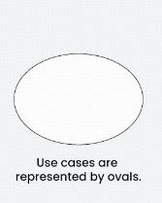
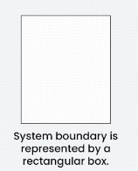
Textual and Symbol
Actors are external entities that interact with the system. These can include users, other systems, or hardware devices.
Use cases are like scenes in the play. They represent specific things your system can do.
The system boundary is a visual representation of the scope or limits of the system you are modeling. It defines what is inside the system and what is outside.

Slide 8
Relation representation
Relationship
The Association Relationship represents a communication or interaction between an actor and a use case. It is depicted by a line connecting the actor to the use case. This relationship signifies that the actor is involved in the functionality described by the use case.
The Include Relationship indicates that a use case includes the functionality of another use case. It is denoted by a dashed arrow pointing from the including use case to the included use case. This relationship promotes modular and reusable design.
The Extend Relationship illustrates that a use case can be extended by another use case under specific conditions. It is represented by a dashed arrow with the keyword “extend.” This relationship is useful for handling optional or exceptional behavior.
The Generalization Relationship establishes an “is-a” connection between two use cases, indicating that one use case is a specialized version of another. It is represented by an arrow pointing from the specialized use case to the general use case.

Slide 9
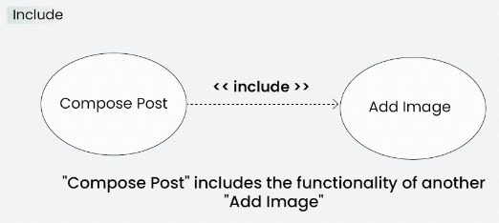
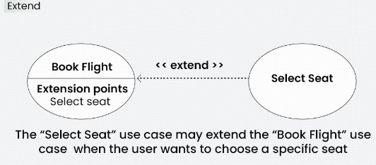
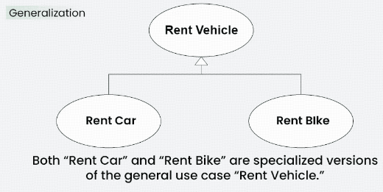
example
Example: Online Banking System
Actor: Customer
Use Case: Transfer Funds
Association: A line connecting the “Customer” actor to the “Transfer Funds” use case, indicating the customer’s involvement in the funds transfer process.
Example: Social Media Posting
Use Cases: Compose Post, Add Image
Include Relationship: The “Compose Post” use case includes the functionality of “Add Image.” Therefore, composing a post includes the action of adding an image.
Example: Flight Booking System
Use Cases: Book Flight, Select Seat
Extend Relationship: The “Select Seat” use case may extend the “Book Flight” use case when the user wants to choose a specific seat, but it is an optional step.
Example: Vehicle Rental System
Use Cases: Rent Car, Rent Bike
Generalization Relationship: Both “Rent Car” and “Rent Bike” are specialized versions of the general use case “Rent Vehicle.”

Slide 10
Written form use case
Identify use case
Main parts in template
Main steps writing a use case
Tips

Slide 11
How to identify use cases?
There are two ways to identify Use Cases :
Using the user goal technique
ask users to describe their goals for using the new or updated system. The analyst first identifies all the users and then conducts a structured interview with each user. A user goal can be thought of as a piece of work, or a task, that the user must complete.
Using event-decomposition technique
begins by identifying all the business events that will cause the information system to respond, and each event leads to a use case. Starting with business events helps the analyst define each use case at the right level of detail.

Slide 12
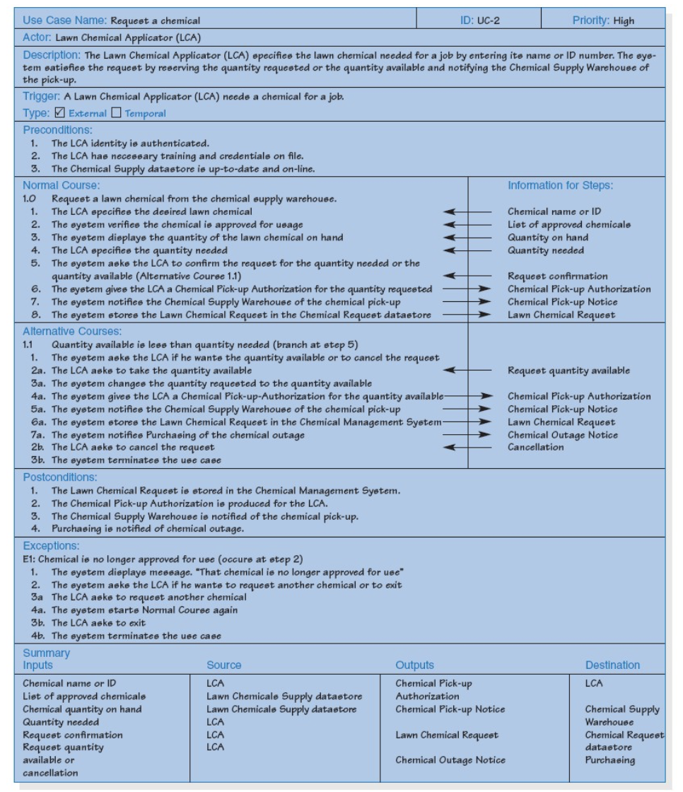
Main Parts of a template
Preconditions
Normal Course
Alternative Courses
Postconditions
Exceptions
Summary

Slide 13
Main Parts of a template
1.Preconditions
List any activities that must take place, or any conditions that must be true, before the use case can be started. Number each precondition. Examples:
User’s identity has been authenticated.
User’s computer has sufficient free memory available to launch task.

Slide 14
Main Parts of a template
2. Normal Course

Slide 15
Main Parts of a template
3. Alternative Courses

Slide 16
Main Parts of a template
4. Postconditions
Describe the state of the system at the conclusion of the use case execution. Number each postcondition. Examples:
Document contains only valid SGML tags.
Price of item in database has been updated with new value.

Slide 17
Main Parts of a template
5. Exceptions
Describe any anticipated error conditions that could occur during execution of the use case, and define how the system is to respond to those conditions. Also, describe how the system is to respond if the use case execution fails for some unanticipated reason. Number each exception using the Use Case ID as a prefix, followed by “EX” to indicate “Exception”. Example: X.Y.EX.1.

Slide 18
Main Parts of a template
6. Summary

Slide 19
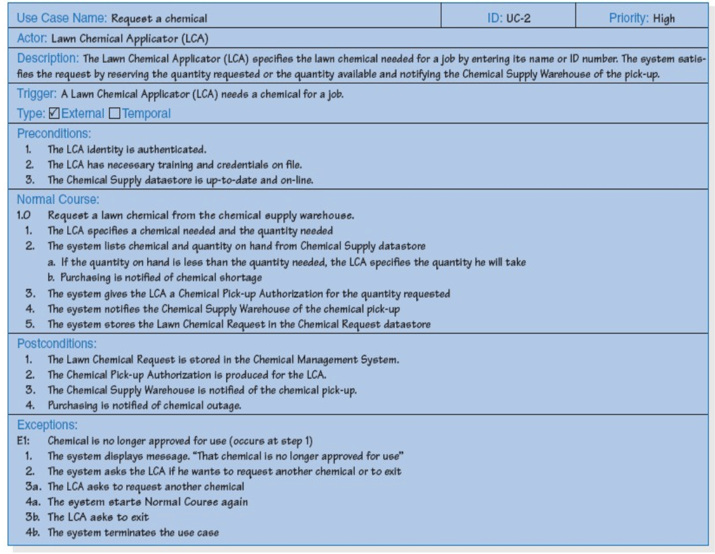
Alternative form use case
Major parts:
1. Preconditions
2. Normal course
3. Postconditions
4. Exceptions

Slide 20
Steps for writing a use case
Describe your system
Start by describing your system, or the product or service you and your team will build. Focus your description on what your system does for users
Identify the actors
Actors generally refer to users and customers but can apply to any outside force that engages with your system. Your actor needs well-defined behaviors explaining how and why actors use your system.
Define your actors’ goals
Use cases highlight the outcome actors want from a system. Remember to focus on your actors’ wants over the system’s capabilities to understand why users come to your system.
Create a scenario
In a use case, scenarios are the sequence of actions customers take when using a system and the flow of effects from that interaction. Your basic flows cover scenarios where a system works as intended. A user approaches the system, enters the right inputs, and your system helps them reach their goals.
Consider alternate flows
After writing a successful scenario, write alternate flows that lead to different outcomes. Typically, alternate flows involve the misuse of a system that keeps actors from reaching their goals. However, you can also note internal errors that cause a system to break down or unintended ways systems can reach goals.

Slide 21
Final tips
1. Based on a goal.
A use case describes how an actor uses the system to achieve a goal.
2. Complete or not complete.
When an actor has performed the steps in a use case, the goal should be either 100% complete or 0% complete.
3. One person, one place, one time, one event.
Try to write use cases that describe how one actor responds to one event in one place at one time.
4. Six to ten steps.
Try to keep the main success scenario of a use case between six and ten steps. Use cases should make requirements easier to comprehend.

Slide 22
Take away message
A use case contains all the information needed to build one part of a process model, expressed in an informal, simple way .
When writing a use case,
identify the triggering event,
develop a list of the major steps,
identify the input(s) and output(s) for every step,
have the users role,
play the use case to verify.

Slide 23
Questions?

Slide 24
Thank you!

