Slide 1
SEEM4540 Tutorial 3
jQuery
Wong Wai Chung

Slide 2
What is jQuery
jQuery is a lightweight, "write less, do more", JavaScript library
The purpose of jQuery is to make it much easier to use JavaScript on your website
jQuery simplifies many lines of JavaScript code into single line of code

Slide 3
Downloading and adding jQuery
There are two ways to download jQuery:
  Download the jQuery library from jQuery.com
    http://jquery.com/download/
  Include jQuery directly from a Content Delivery Network(CDN), like Google or Microsoft

Slide 4
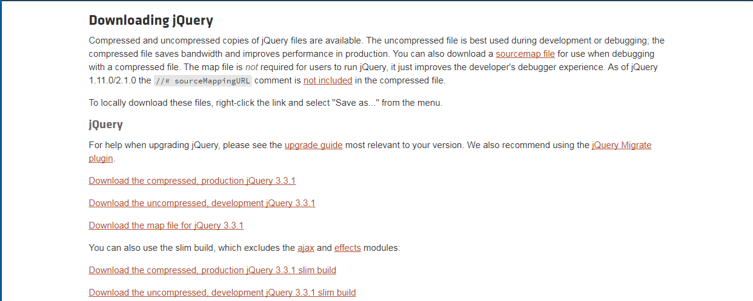
Downloading and adding jQuery
Visit http://jquery.com/download/
  Choose “Download the compressed, production jQuery”

Slide 5
Downloading and adding jQuery
Then, we need to add the single JavaScript file with <script> and place it inside <head> in our HTML
For example,
  <head>
  <script src="jquery-3.3.1.min.js"></script>
  </head>
Note: Please pay attention to the file directory

Slide 6
Downloading and adding jQuery
We can add jQuery directly from a CDN in our HTML
For example, Google CDN:
  <head>
  <script src="https://ajax.googleapis.com/ajax/libs/jquery/3.3.1/jquery.min.js"></script>
  </head>
Microsoft CDN:
  <head>
  <script src="https://ajax.aspnetcdn.com/ajax/jQuery/jquery-3.3.1.min.js"></script>
  </head>

Slide 7
Writing jQuery
Basic syntax:
  $(selector).action()
A $ sign to define/access jQuery
A (selector) to "query (or find)" HTML elements
A jQuery action() to be performed on the element(s)

Slide 8
Writing jQuery
jQuery methods should be placed inside the document ready event:
    $(document).ready(function(){
    // jQuery methods go here...
    });
Prevent any jQuery code from running before the document is finished loading (is ready)

Slide 9
jQuery Selectors
There several types of selector
Some commonly used selector:
  element selector
  #id selector
  .class selector

Slide 10
jQuery Selectors
element selector allows us to select elements based on the element name
E.g.
  $("p")
    select all <p> elements on the page
  $("a")
    select all <a> elements on the page

Slide 11
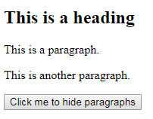

Example
<!DOCTYPE html>
<html>
<head>
<script src="jquery-3.3.1.min.js"></script>
<script>
$(document).ready(function(){
$("button").click(function(){
// here, hide() use to hide the element
$("p").hide();
});
});
</script>
</head>
<body>
<h2>This is a heading</h2>
<p>This is a paragraph.</p>
<p>This is another paragraph.</p>
<button>Click me to hide paragraphs</button>
</body>
</html>

Slide 12
jQuery Selectors
#id selector uses the id attribute of an HTML tag to find the specific element
  id should be unique within a page
E.g.
  $("#test")
    find an element with id = "test" on the page
  $("#demo")
    find an element with id = "demo" on the page

Slide 13
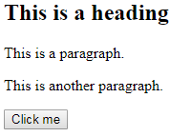
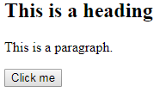
Example
<!DOCTYPE html>
<html>
<head>
<script src="jquery-3.3.1.min.js"></script>
<script>
$(document).ready(function(){
// here, click() is an event
$("button").click(function(){
// here, hide() use to hide the element
$("#test").hide();
});
});
</script>
</head>
<body>
<h2>This is a heading</h2>
<p>This is a paragraph.</p>
<p id="test">This is another paragraph.</p>
<button>Click me</button>
</body>
</html>

Slide 14
jQuery Selectors
class selector use the class attribute to find all elements with a specific class
E.g.
  $(".test")
    find all elements with class = "test"
Note: id is unique for a HTML element but class is not! Two or more HTML elements belong to same class is allowed

Slide 15
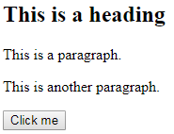

Example
<!DOCTYPE html>
<html>
<head>
<script src="jquery-3.3.1.min.js"></script>
<script>
$(document).ready(function(){
// here, click() is an event
$("button").click(function(){
// here, hide() use to hide the element
$(".test").hide();
});
});
</script>
</head>
<body>
<h2 class="test">This is a heading</h2>
<p class="test">This is a paragraph.</p>
<p>This is another paragraph.</p>
<button>Click me</button>
</body>
</html>

Slide 16
jQuery Selectors
You can find out more jQuery selectors here:
  https://www.w3schools.com/jquery/jquery_ref_selectors.asp

Slide 17
jQuery Events
Event represents the precise moment when something happens
E.g.
  moving a mouse over an element
  selecting a radio button
  clicking on an element

Slide 18
jQuery Events
The following table shows some common events:
Mouse Events | Keyboard Events | Form Events | Document/Window Events
click | keypress | submit | load
dblclick | keydown | change | resize
mouseenter | keyup | focus | scroll
mouseleave |  | blur | unload

Slide 19
jQuery Events
Basic syntax for Events:
  $(selector).event()
E.g.
  $("p").click( … );
  $("#test").dblclick( … );
  …

Slide 20


Example (click)
The function will be executed when the user clicks on the HTML element
<!DOCTYPE html>
<html>
<head>
<script src="jquery-3.3.1.min.js"></script>
<script>
$(document).ready(function(){
$("p").click(function(){
// here, keyword “this” refer to element that triggered the action,
// i.e. the particular "<p>" that triggered the event
$(this).hide();
});
});
</script>
</head>
<body>
<p>If you click on me, I will disappear.</p>
<p>Click me away!</p>
<p>Click me too!</p>
</body>
</html>

Slide 21
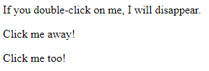
Example (dblclick)
Same as click, but this time require double-clicks on the HTML element
<!DOCTYPE html>
<html>
<head>
<script src="jquery-3.3.1.min.js"></script>
<script>
$(document).ready(function(){
$("p").dblclick(function(){
// here, keyword “this” refer to element that triggered the action,
// i.e. the particular "<p>" that triggered the event
$(this).hide();
});
});
</script>
</head>
<body>
<p>If you double-click on me, I will disappear.</p>
<p>Click me away!</p>
<p>Click me too!</p>
</body>
</html>

Slide 22
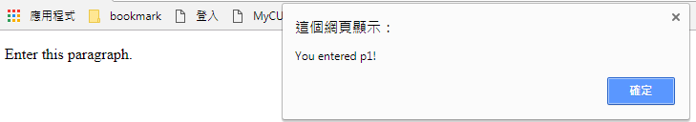

Example (mouseenter)
The function will be executed when the mouse pointer enters the HTML element
<!DOCTYPE html>
<html>
<head>
<script src="jquery-3.3.1.min.js"></script>
<script>
$(document).ready(function(){
$("#p1").mouseenter(function(){
alert("You entered p1!");
});
});
</script>
</head>
<body>
<p id="p1">Enter this paragraph.</p>
</body>
</html>

Slide 23

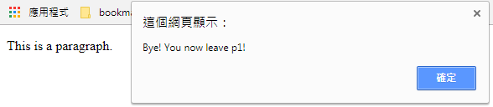
Example (mouseleave)
Opposite of mouseenter, the function will be executed when the mouse pointer leaves the HTML element
<!DOCTYPE html>
<html>
<head>
<script src="jquery-3.3.1.min.js"></script>
<script>
$(document).ready(function(){
$("#p1").mouseleave(function(){
alert("Bye! You now leave p1!");
});
});
</script>
</head>
<body>
<p id="p1">This is a paragraph.</p>
</body>
</html>

Slide 24
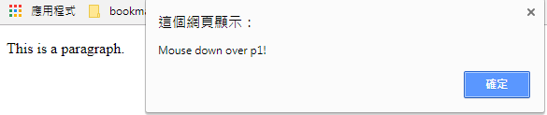
Example (mousedown)
The function will be executed, when the left, middle or right mouse button is pressed down, while the mouse is over the HTML element
<!DOCTYPE html>
<html>
<head>
<script src="jquery-3.3.1.min.js"></script>
<script>
$(document).ready(function(){
$("#p1").mousedown(function(){
alert("Mouse down over p1!");
});
});
</script>
</head>
<body>
<p id="p1">This is a paragraph.</p>
</body>
</html>

Slide 25
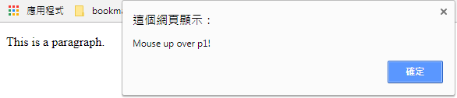
Example (mouseup)
Similar with mousedown, but the function will be executed when mouse button is released
<!DOCTYPE html>
<html>
<head>
<script src="jquery-3.3.1.min.js"></script>
<script>
$(document).ready(function(){
$("#p1").mouseup(function(){
alert("Mouse up over p1!");
});
});
</script>
</head>
<body>
<p id="p1">This is a paragraph.</p>
</body>
</html>

Slide 26
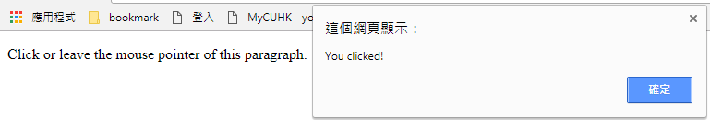
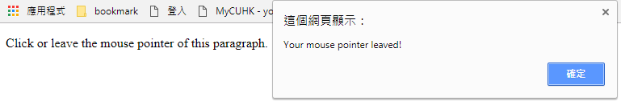
Example (on)
Using on() method to define one or more events for the selected elements
<!DOCTYPE html>
<html>
<head>
<script src="jquery-3.3.1.min.js"></script>
<script>
$(document).ready(function(){
$("p").on({
click: function(){
alert("You clicked!");
},
mouseleave: function(){
alert("Your mouse pointer leaved!");
}
});
});
</script>
</head>
<body>
<p>Click or leave the mouse pointer of this paragraph.</p>
</body>
</html>

Slide 27
jQuery Events
You can find out more jQuery events here:
  https://www.w3schools.com/jquery/jquery_ref_events.asp

Slide 28
Getting and Setting HTML using jQuery
We can access the content of HTML element or even change their content using jQuery
Typically, the three useful methods are:
  text() - Sets or returns the text content of selected elements
  html() - Sets or returns the content of selected elements (including HTML markup)
  val() - Sets or returns the value of form fields
We can also access the attribute of HTML element using attr()

Slide 29

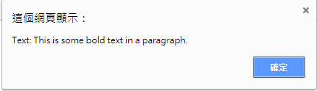
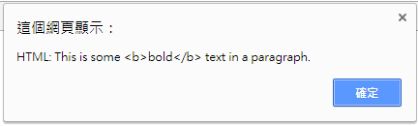
Example (text/html)
This example shows getting the content of HTML
<!DOCTYPE html>
<html>
<head>
<script src="jquery-3.3.1.min.js"></script>
<script>
$(document).ready(function(){
$("#btn1").click(function(){
alert("Text: " + $("#test").text());
});
$("#btn2").click(function(){
alert("HTML: " + $("#test").html());
});
});
</script>
</head>
<body>
<p id="test">This is some <b>bold</b> text in a paragraph.</p>
<button id="btn1">Show Text</button>
<button id="btn2">Show HTML</button>
</body>
</html>

Slide 30

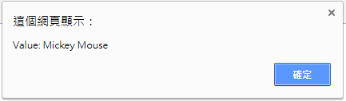
Example (val)
This example shows getting the value of form field
<!DOCTYPE html>
<html>
<head>
<script src="jquery-3.3.1.min.js"></script>
<script>
$(document).ready(function(){
$("button").click(function(){
alert("Value: " + $("#test").val());
});
});
</script>
</head>
<body>
<p>Name: <input type="text" id="test" value="Mickey Mouse"></p>
<button>Show Value</button>
</body>
</html>

Slide 31

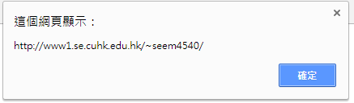
Example (attr)
This example shows getting the attribute of HTML element
<!DOCTYPE html>
<html>
<head>
<script src="jquery-3.3.1.min.js"></script>
<script>
$(document).ready(function(){
$("button").click(function(){
alert($("#website").attr("href"));
});
});
</script>
</head>
<body>
<p><a href="http://www1.se.cuhk.edu.hk/~seem4540/" id="website">SEEM4540</a></p>
<button>Show href Value</button>
</body>
</html>

Slide 32
Getting and Setting HTML using jQuery
To change the content of HTML, we can simply place what we want inside ()
E.g.
  $("#test").text("Hello world!");
  $("#test").text("<b>Hello world!</b>");
  $("#website").attr("href", "http://www1.se.cuhk.edu.hk/~seem4540/?Lecture_Notes");

Slide 33
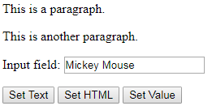
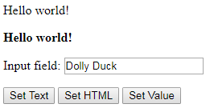
Example (text/html/val)
<!DOCTYPE html>
<html>
<head>
<script src="jquery-3.3.1.min.js"></script>
<script>
$(document).ready(function(){
$("#btn1").click(function(){
$("#test1").text("Hello world!");
});
$("#btn2").click(function(){
$("#test2").html("<b>Hello world!</b>");
});
$("#btn3").click(function(){
$("#test3").val("Dolly Duck");
});
});
</script>
</head>
<body>
<p id="test1">This is a paragraph.</p>
<p id="test2">This is another paragraph.</p>
<p>Input field: <input type="text" id="test3" value="Mickey Mouse"></p>
<button id="btn1">Set Text</button>
<button id="btn2">Set HTML</button>
<button id="btn3">Set Value</button>
</body>
</html>

Slide 34


Example (attr)
For attr(), we can set multiple attributes at the same time
<!DOCTYPE html>
<html>
<head>
<script src="jquery-3.3.1.min.js"></script>
<script>
$(document).ready(function(){
$("button").click(function(){
$("#website").attr({
"href" : "http://www1.se.cuhk.edu.hk/~seem4540/?Lecture_Notes",
"title" : "SEEM4540 Lecture Notes"
});
});
});
</script>
</head>
<body>
<p><a href="http://www1.se.cuhk.edu.hk/~seem4540/" title="SEEM4540 Home page" id="website">SEEM4540</a></p>
<button>Change href and title</button>
</body>
</html>

Slide 35
Reference
jQuery
  https://www.w3schools.com/jquery/

