Slide 1
SQL Review
FU Zihao
2019.03

Slide 2
Contents
Database and SQL
Some useful tools to practice with SQL
Some Basic operations in SQL
Some Advanced operations in SQL
Table Management commands in SQL

Slide 3
Database and SQL

Slide 4

Database
A database is a collection of information that is organized so that it can be easily accessed, managed and updated.
Data is organized into rows, columns and tables, and it is indexed to make it easier to find relevant information. Data gets updated, expanded and deleted as new information is added. Databases process workloads to create and update themselves, querying the data they contain and running applications against it.

Slide 5
SQL (Standard Query Language)
SQL is a standard language for storing, manipulating and retrieving data in databases.
SQL is not a programming language, but is a language to communicate
with a Database Management System (DBMS)
You can use it in almost all kinds of programming languages such as C++, Python, PHP, javascript, etc.
It helps users to focus on their own task rather than dealing with data format, parallel processing, and data sharing.

Slide 6
Some useful tools to practice with SQL

Slide 7
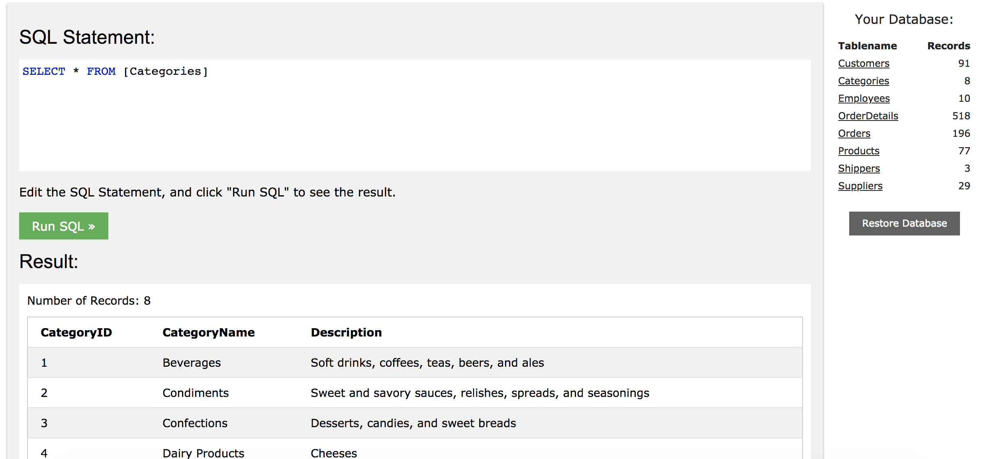
w3schools
Provide a simple and easy to use interface to practice with SQL commands
Pre defined several table and we do not need to upload our own data
Give some simple but illustrative examples to help user to learn
Have a try: https://www.w3schools.com/sql/

Slide 8
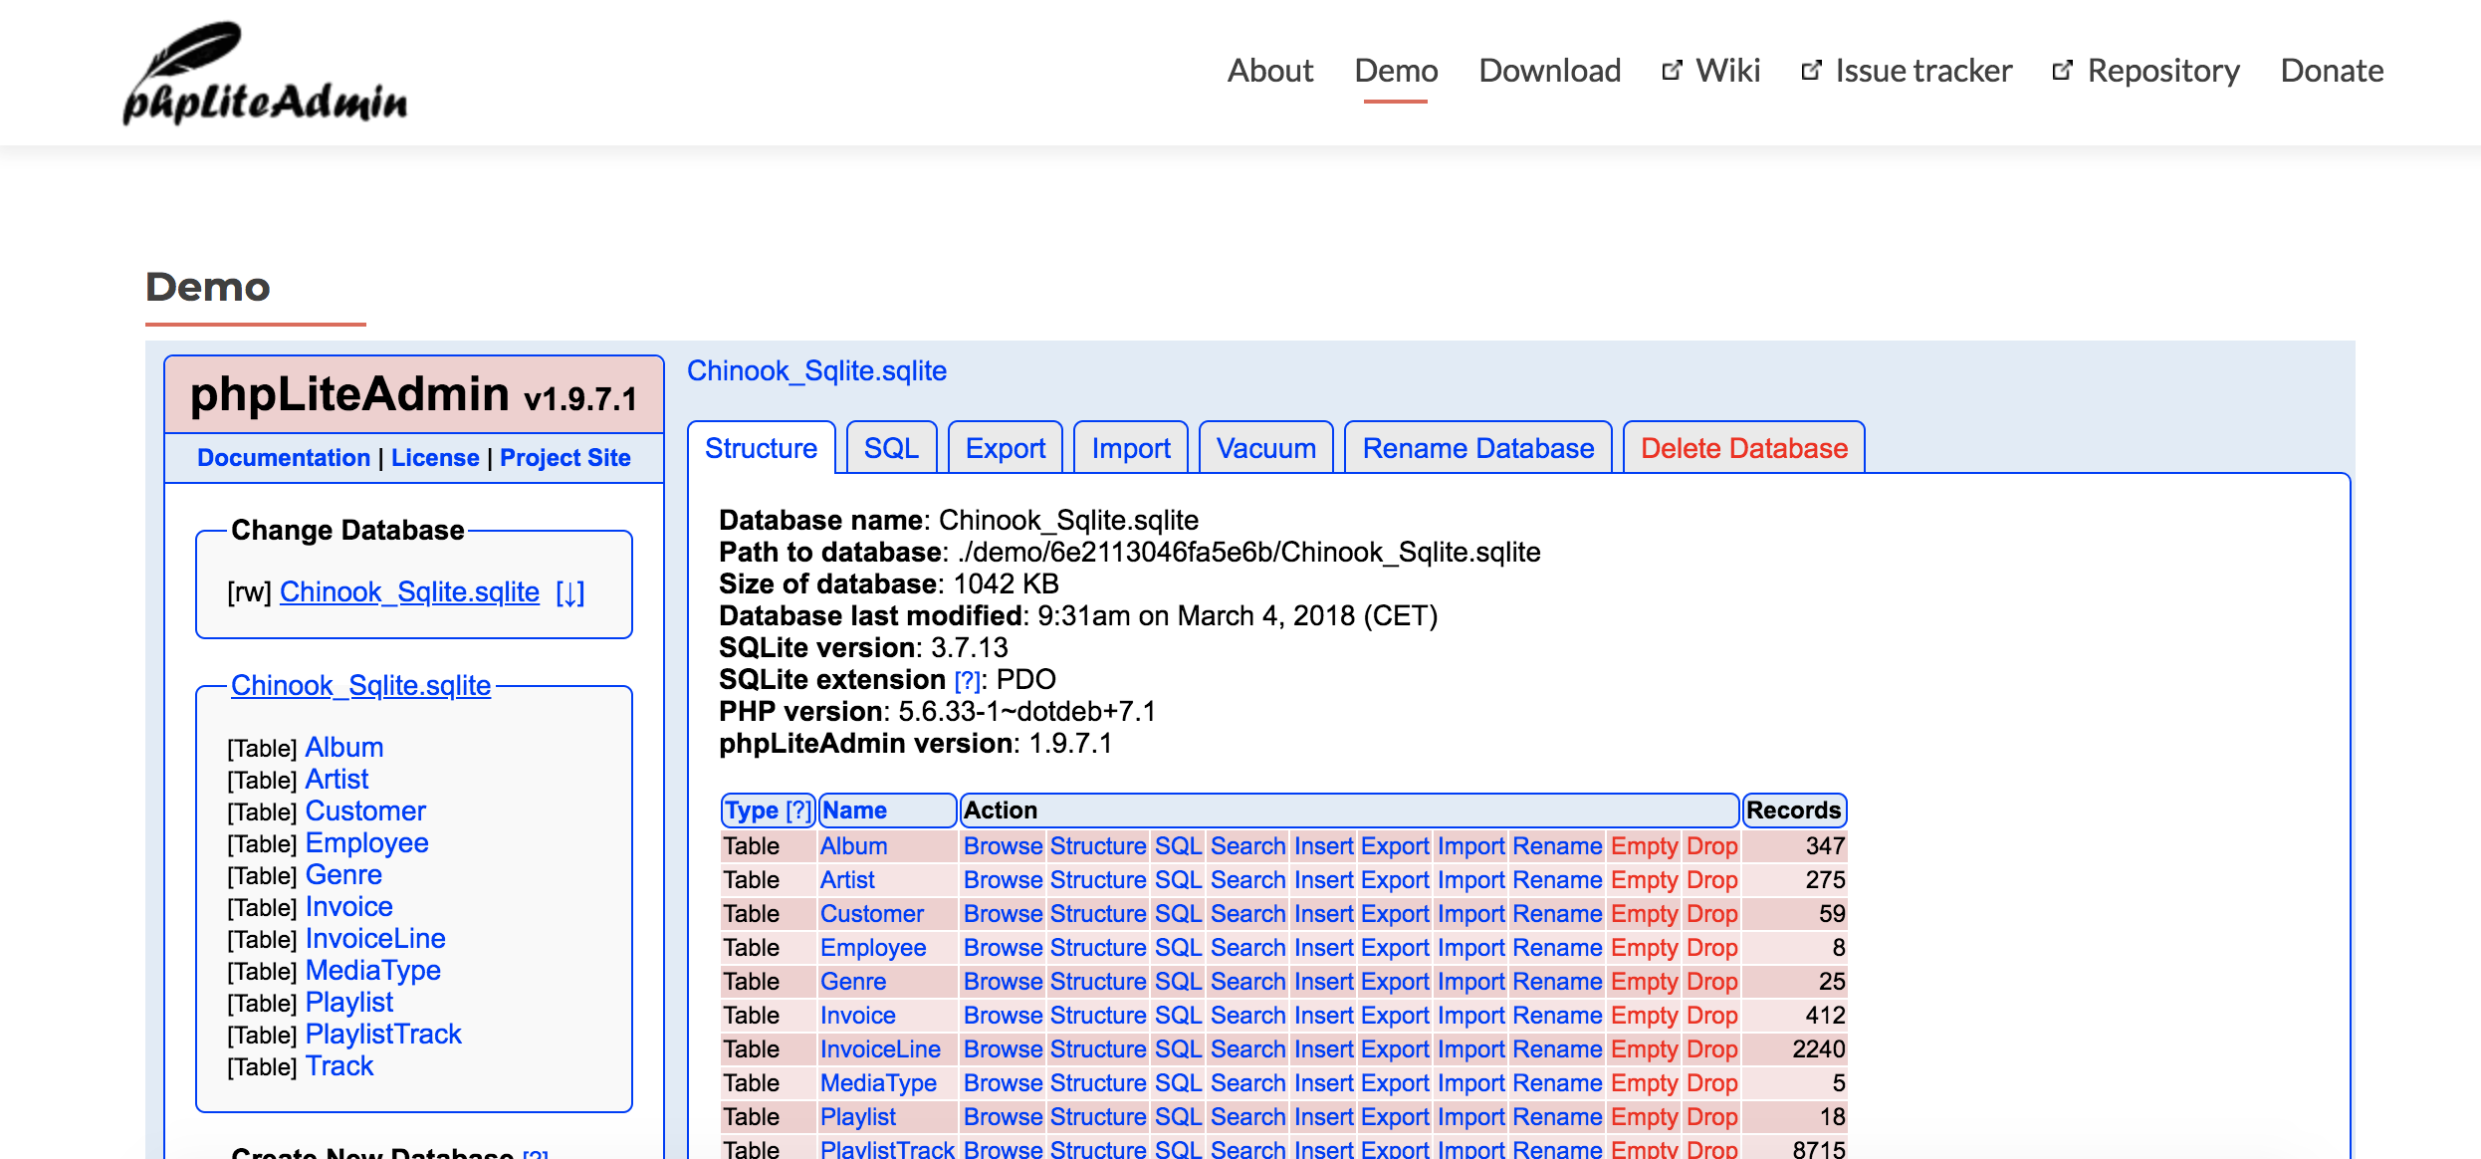
phpliteadmin
Powerful than w3school
Provide user interface to manipulate data
Can upload user’s own data and provide a simple edit GUI
Have a try: https://www.phpliteadmin.org/demo/

Slide 9
MySQL
Powerful and can handle huge amount of data
Widely used in a lot of contemporary information systems
You can access SEEM department MariaDB (you may consider as another branch of MySQL). Please refer to your project account memo for detail

Slide 10
Some Basic operations in SQL

Slide 11
Select
Select operation can get some columns from the database with respect to some conditions
Usage:
SELECT column1, column2, ...
FROM table_name;
Practice: https://www.w3schools.com/sql/trysql.asp?filename=trysql_select_columns

Slide 12
Select Distinct
We can remove dumplicate rows with distinct keywords
Usage:
SELECT DISTINCT column1, column2, ...
FROM table_name;
Practice: https://www.w3schools.com/sql/trysql.asp?filename=trysql_select_distinct

Slide 13
Select Distinct
if you have multiple columns, then the distinct mean the whole row but NOT any one single column.
select distinct id, name from data
id | name | goods
0 | Alice | apple
0 | Alice | pear
1 | Bob | cherry
id | name
0 | Alice
0 | Alice
1 | Bob
id | name
0 | Alice
1 | Bob

Slide 14
Select Where
We can select data if they fulfil some specified conditions
Usage:
SELECT column1, column2, ...
FROM table_name
WHERE condition;
Practice: https://www.w3schools.com/sql/trysql.asp?filename=trysql_select_where

Slide 15
Select with AND, OR and NOT Operators
We can use “and”, “or”, “not” in where conditions
Usage:
SELECT column1, column2, ...
FROM table_name
WHERE condition1 AND condition2 AND condition3 ...;
Practice: https://www.w3schools.com/sql/trysql.asp?filename=trysql_select_where_and

Slide 16
Select with Order by
We can use “order by” to sort the results
Usage:
SELECT column1, column2, ...
FROM table_name
ORDER BY column1, column2, ... ASC|DESC;
Practice: https://www.w3schools.com/sql/trysql.asp?filename=trysql_select_orderby

Slide 17
Insert Into
We can use “Insert into” to add one line into the database
Usage:
INSERT INTO table_name (column1, column2, column3, ...)
VALUES (value1, value2, value3, ...);
Practice: https://www.w3schools.com/sql/trysql.asp?filename=trysql_insert_colname

Slide 18
Update
We can modify the existing records in a table by update statement
Usage:
UPDATE table_name
SET column1 = value1, column2 = value2, ...
WHERE condition;
Practice: https://www.w3schools.com/sql/trysql.asp?filename=trysql_update_2

Slide 19
Delete
We can delete existing records in a table by delete statement
Usage:
DELETE FROM table_name
WHERE condition;
Practice: https://www.w3schools.com/sql/trysql.asp?filename=trysql_delete

Slide 20
Some Advanced operations in SQL

Slide 21
COUNT(), AVG() and SUM() Functions
We can use COUNT, AVG, SUM function to get the cooresponding statistics of the table
Usage:
SELECT COUNT(column_name)
FROM table_name
WHERE condition;
Practice: https://www.w3schools.com/sql/trysql.asp?filename=trysql_select_count

Slide 22
LIKE Operator
We can use LIKE to search for a specified pattern in a column the table
Usage:
SELECT column1, column2, ...
FROM table_name
WHERE columnN LIKE pattern;
Practice: https://www.w3schools.com/sql/trysql.asp?filename=trysql_select_like

Slide 23
Table Management commands in SQL

Slide 24
Create Table
We can use “Create Table” to create a new table in a database
Usage:
CREATE TABLE table_name (
column1 datatype,
column2 datatype,
column3 datatype,
....
);
Practice: https://www.w3schools.com/sql/trysql.asp?filename=trysql_create_table

Slide 25
Drop Table
We can use “Drop Table” to drop a table in a database
Usage:
DROP TABLE table_name;
Practice: https://www.w3schools.com/sql/trysql.asp?filename=trysql_drop_table

Slide 26
Create Index
We can use “Create Index” to create indexes in tables
Indexes are used to retrieve data from the database very fast. The users cannot see the indexes, they are just used to speed up searches/queries.
Usage:
CREATE INDEX index_name
ON table_name (column1, column2, ...);

Slide 27
References
[1] https://www.w3schools.com/sql/
[2] http://searchsqlserver.techtarget.com/definition/database

