Slide 1
Managing Economies of Scale in a Supply Chain: Cycle Inventory
11

Slide 2
Learning Objectives
Balance the appropriate costs to choose the optimal lot size and cycle inventory in a supply chain.
Identify managerial levers that reduce lot size and cycle inventory in a supply chain without increasing cost.

Slide 3
Inventory
Stock of items or resources used in an organisation
Manufacturing inventory refers to materials that contribute or become part of a firm’s product output.
Raw materials
Component parts or supplies
Work-in-process
Finished goods

Slide 4
Purpose of Inventory
meet variation in product demand
provide safeguard for variation in raw material delivery
maintain independence of operations
allow flexibility in production scheduling
take advantage of quantity discounts

Slide 5
Inventory Costs
  storage
  handling
  insurance and taxes
  pilferage and breakage
  obsolescence and depreciation
  opportunity cost of capital
  order processing
  shipping and receiving
  production setup / changeover
  lost sales
  backorders
  lateness penalties

Slide 6
Estimating Cycle Inventory Related Costs in Practice
Inventory Holding Cost
  Cost of capital
where
E = amount of equity
D = amount of debt
R_{f} = risk-free rate of return
β = the firm’s beta
MRP = market risk premium
R_{b} = rate at which the firm can borrow money
t = tax rate

Slide 7
Estimating Cycle Inventory Related Costs in Practice
Inventory Holding Cost
  Cost of capital
Adjusted for pre-tax setting

Slide 8
Estimating Cycle Inventory Related Costs in Practice
Inventory Holding Cost
  Obsolescence cost
  Handling cost
  Storage/Occupancy cost
  Miscellaneous costs
    Theft, security, damage, tax, insurance

Slide 9
Estimating Cycle Inventory Related Costs in Practice
Ordering Cost
  Buyer time
  Transportation costs
  Receiving costs
  Other costs

Slide 10
Inventory System
Set of policies and controls that monitor levels of inventory (for all items)
.
determine what levels should be maintained
when stock should be replenished
how large an order should be
keep track of orders sent and received
reconcile records with physical inventory

Slide 11
Economic Order Quantity (EOQ) Model
Assumptions:
  demand rate constant
  instantaneous replenishment
  price per item independent of order size
  no shortage or backorders allowed
Questions:
  When to order?
  How much to order?

Slide 12
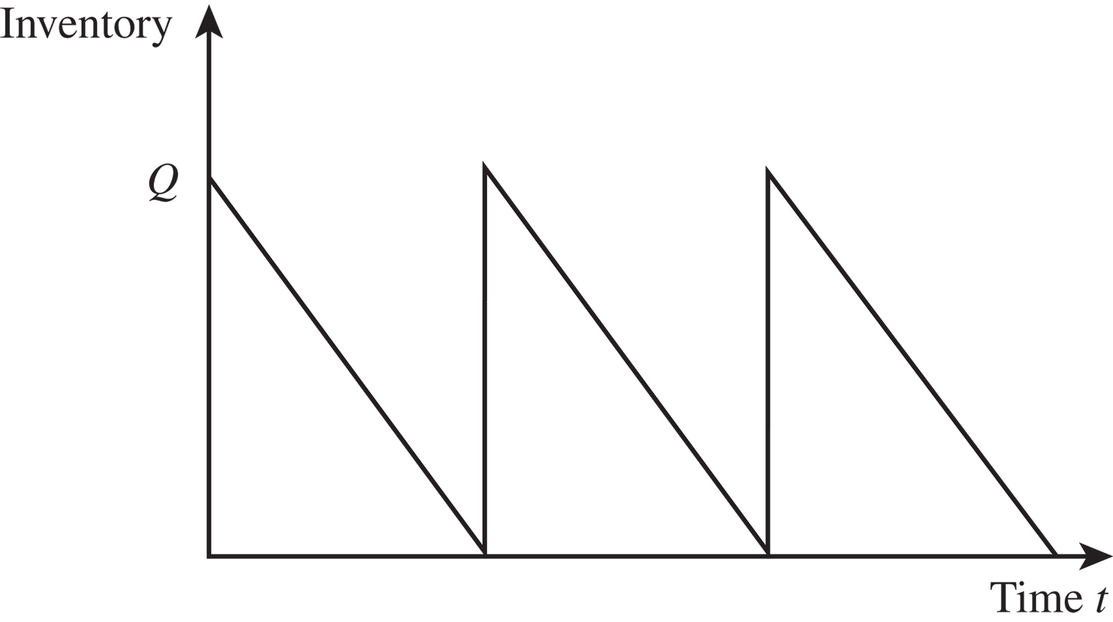
Inventory Profile
Figure 11-1

Slide 13
EOQ Model
Inventory
level
Time
Notation:
D = demand rate per unit time (year)
C = cost per unit item
S = fixed setup/order cost per order
H = holding cost per unit item per unit time
h = inventory holding percentage
(H = hC)
Q = quantity to be ordered

Slide 14
Economies of Scale to Exploit Fixed Costs
Minimize
  Annual material cost
  Annual ordering cost
  Annual holding cost

Slide 15
Lot Sizing for a Single Product

Slide 16
Total Cost (per unit time)
= purchase cost + ordering cost + holding cost
TC = DC + SD/Q + HQ/2
Best Q?
or
EOQ

Slide 17
Lot Sizing for a Single Product
Figure 11-2

Slide 18
Lot Sizing for a Single Product
The economic order quantity (EOQ)
The optimal ordering frequency

Slide 19
Role of Cycle Inventory in a Supply Chain
Lot or batch size is the quantity that a stage of a supply chain either produces or purchases at a time
Cycle inventory is the average inventory in a supply chain due to either production or purchases in lot sizes that are larger than those demanded by the customer
Q: Quantity in a lot or batch size
D: Demand per unit time

Slide 20
Role of Cycle Inventory in a Supply Chain
Average price paid per unit purchased is a key cost in the lot-sizing decision
Material cost = C
Fixed ordering cost includes all costs that do not vary with the size of the order but are incurred each time an order is placed
Fixed ordering cost = S
Holding cost is the cost of carrying one unit in inventory for a specified period of time
Holding cost = H = hC

Slide 21
Role of Cycle Inventory in a Supply Chain
Average flow time resulting from cycle inventory

Slide 22
Role of Cycle Inventory in a Supply Chain
Lower cycle inventory has
  Shorter average flow time
  Lower working capital requirements
  Lower inventory holding costs
Cycle inventory is held to
  Take advantage of economies of scale
  Reduce costs in the supply chain

Slide 23
Role of Cycle Inventory in a Supply Chain
Primary role of cycle inventory is to allow different stages to purchase product in lot sizes that minimize the sum of material, ordering, and holding costs
Ideally, cycle inventory decisions should consider costs across the entire supply chain
In practice, each stage generally makes its own supply chain decisions
Increases total cycle inventory and total costs in the supply chain

Slide 24
Economic Order Quantity (EOQ) Model
Assumptions:
  demand rate constant
  instantaneous replenishment
  price per item independent of order size
  no shortage or backorders allowed
Questions:
  When to order?
  How much to order?
X

Slide 25
Basic Fixed-Order Quantity Model with Lead Time
Order when inventory drops to
R = DL where L = lead time
Number
of units
on hand
Q
Q
Q
Q
R
L
L
L
Time

Slide 26
Inventory position = on-hand + on-order inventory
inventory
position
on-hand
inventory
R
L

Slide 27
Production Lot Sizing
The entire lot does not arrive at the same time
Production occurs at a specified rate P
Inventory builds up at a rate of P – D
Annual setup cost
Annual holding cost

Slide 28
Production lot sizing
p = replenishment rate
d = demand rate
Buildup =
Production
rate minus
usage rate
(p-d)
Production
taking place
No production;
usage only
Number
of units
on hand
R
Usage
rate d
Q
L
L

Slide 29
EOQ vs. JIT
EOQ:
  order quantity set according to EOQ formula
JIT:
  reduce inventory as much as possible
Who is right? Who is wrong?
What is the “right” order quantity?
What is the “true” cost of inventory?

Slide 30
EOQ Example
Annual demand, D = 1,000 x 12 = 12,000 units
Order cost per lot, S = $4,000
Unit cost per computer, C = $500
Holding cost per year as a fraction of unit cost, h = 0.2
Notes:
Notes:

Slide 31
EOQ Example
Notes:
Notes:

Slide 32
Example (continued)
Suppose lot size is reduced to Q=200, which would reduce flow time:
Annual ordering and holding cost =
= (12000/200)(4000) + (200/2)(0.2)(500)
= $240,000 + $10,000 = $250,000
To make it economically feasible to reduce lot size, the fixed cost associated with each lot would have to be reduced

Slide 33
Lot Size and Ordering Cost
If the lot size Q* = 200, how much should the ordering cost be reduced?
Desired lot size, Q* = 200
Annual demand, D = 1,000 × 12 = 12,000 units
Unit cost per computer, C = $500
Holding cost per year as a fraction of inventory value, h = 0.2
Use EOQ equation and solve for S:
To reduce optimal lot size by a factor of k, the fixed order cost must be reduced by a factor of k²

Slide 34
Inventory Pooling
What happens to the optimal order quantity when the demand rate doubles? Triples?
Consequences?
Large supermarkets vs. mom-&-pop stores
“backup” agreements between stores

Slide 35
Global Supply/Distribution Chains
Decentralized System:
Centralized System:
Retailers
Factory
Factory
Depot
Retailers

Slide 36
Multiple Products
EOQ system requires constant monitoring
Ordering cycle may be different for different products
Delivery cost to different retailers in same region may be shared

Slide 37
Role of Cycle Inventory in a Supply Chain
Economies of scale exploited in three typical situations
  A fixed cost is incurred each time an order is placed or produced
  The supplier offers price discounts based on the quantity purchased per lot
  The supplier offers short-term price discounts or holds trade promotions

Slide 38

All rights reserved. No part of this publication may be reproduced, stored in a retrieval system, or transmitted, in any form or by any means, electronic, mechanical, photocopying, recording, or otherwise, without the prior written permission of the publisher.
Printed in the United States of America.

