Slide 1
Managing Economies of Scale in a Supply Chain: Cycle Inventory
11

Slide 2
Learning Objectives
Balance the appropriate costs to choose the optimal lot size and cycle inventory in a supply chain.
Identify managerial levers that reduce lot size and cycle inventory in a supply chain without increasing cost.

Slide 3
Inventory System
Set of policies and controls that monitor levels of inventory (for all items)
.
determine what levels should be maintained
when stock should be replenished
how large an order should be
keep track of orders sent and received
reconcile records with physical inventory

Slide 4
Economic Order Quantity (EOQ) Model
Assumptions:
  single product
  demand rate constant
  instantaneous replenishment
  price per item independent of order size
  no shortage or backorders allowed
Questions:
  When to order?
  How much to order?

Slide 5
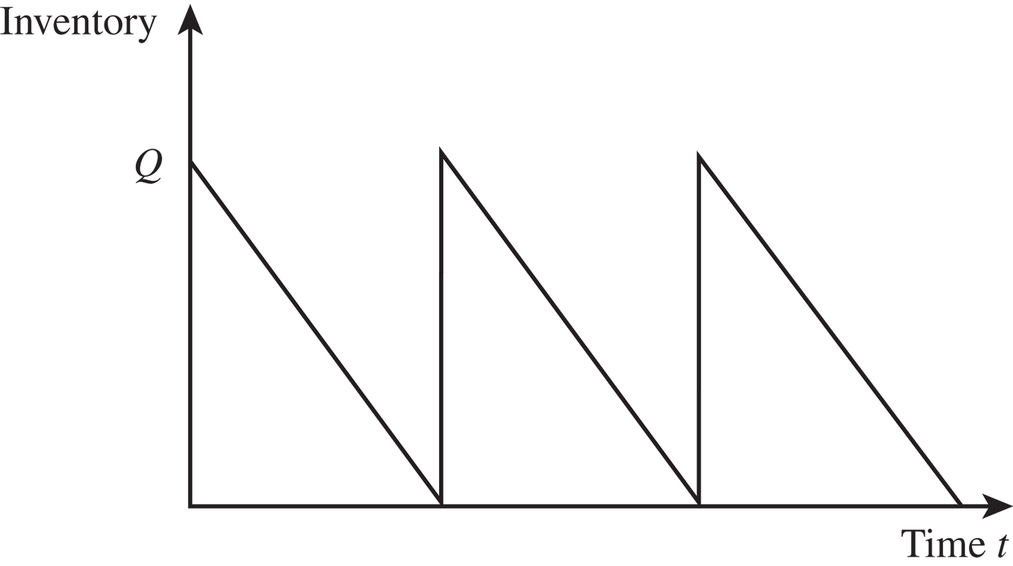
Inventory Profile
Figure 11-1

Slide 6
Lot Sizing for a Single Product
Minimize
  Annual material cost
  Annual ordering cost
  Annual holding cost
Figure 11-2

Slide 7
Lot Sizing for a Single Product
The economic order quantity (EOQ)
The optimal ordering frequency

Slide 8
Economic Order Quantity (EOQ) Model
Assumptions:
  single product
  demand rate constant
  instantaneous replenishment
  price per item independent of order size
  no shortage or backorders allowed
Questions:
  When to order?
  How much to order?
later
X
X
later

Slide 9
Multiple Products
EOQ system requires constant monitoring
Ordering cycle may be different for different products
Delivery cost to different retailers in same region may be shared

Slide 10
Aggregating Multiple Products in a Single Order
Transportation is a significant contributor to the fixed cost per order
Can possibly combine shipments of different products from the same supplier
  reduced overall fixed cost
  shared over more than one product
  effective fixed cost is reduced for each product
  lot size for each product can be reduced
Can also have a single delivery coming from multiple suppliers or a single truck delivering to multiple retailers
  Receiving and loading costs reduced
10-10

Slide 11
Aggregating Multiple Products in a Single Order
Aggregating across products, retailers, or suppliers in a single order allows for a reduction in lot size for individual products because fixed ordering and transportation costs are now spread across multiple products, retailers, or suppliers
Savings in transportation costs
  Reduces fixed cost for each product
  Lot size for each product can be reduced
  Cycle inventory is reduced

Slide 12
Lot Sizing with Multiple
Products or Customers
In practice, the fixed ordering cost is dependent at least in part on the variety associated with an order of multiple models
  A portion of the cost is related to transportation (independent of variety)
  A portion of the cost is related to loading and receiving (not independent of variety)
10-12

Slide 13
Lot Sizing with Multiple
Products or Customers
Ordering, transportation, and receiving costs grow with the variety of products or pickup points
Lot sizes and ordering policy that minimize total cost
D_{i}: Annual demand for product i
S: Order cost incurred each time an order is placed, independent of the variety of products in the order
s_{i}: Additional order cost incurred if product i is included in the order

Slide 14
Lot Sizing with Multiple
Products or Customers
Three approaches
  Each product manager orders his or her model independently
  The product managers jointly order every product in each lot
  Product managers order jointly but not every order contains every product; that is, each lot contains a selected subset of the products

Slide 15
Delivery Options
No Aggregation: Each product ordered separately
Complete Aggregation: All products delivered on each truck
Tailored Aggregation: Selected subsets of products on each truck
10-15
Notes:
15
Notes:

Slide 16
Multiple Products Ordered and Delivered Independently
Demand
D_{L} = 12,000/yr, D_{M} = 1,200/yr, D_{H} = 120/yr
Common order cost
S = $4,000
Product-specific order cost
s_{L} = $1,000, s_{M} = $1,000, s_{H} = $1,000
Holding cost
h = 0.2
Unit cost
C_{L} = $500, C_{M} = $500, C_{H} = $500
Notes:
Notes:

Slide 17
Multiple Products Ordered and Delivered Independently
 | Litepro | Medpro | Heavypro
Demand per year | 12,000 | 1,200 | 120
Fixed cost/order | $5,000 | $5,000 | $5,000
Optimal order size | 1,095 | 346 | 110
Cycle inventory | 548 | 173 | 55
Annual holding cost | $54,772 | $17,321 | $5,477
Order frequency | 11.0/year | 3.5/year | 1.1/year
Annual ordering cost | $54,772 | $17,321 | $5,477
Average flow time | 2.4 weeks | 7.5 weeks | 23.7 weeks
Annual cost | $109,544 | $34,642 | $10,954
Total annual cost = $155,140
Table 11-1
Notes:
Notes:

Slide 18
Lots Ordered and Delivered Jointly

Slide 19
Products Ordered and Delivered Jointly
Annual order cost = 9.75 x 7,000 = $68,250
Annual ordering
and holding cost = $61,512 + $6,151 + $615 + $68,250
= $136,528

Slide 20
Products Ordered and Delivered Jointly
 | Litepro | Medpro | Heavypro
Demand per year (D) | 12,000 | 1,200 | 120
Order frequency (n∗) | 9.75/year | 9.75/year | 9.75/year
Optimal order size (D/n∗) | 1,230 | 123 | 12.3
Cycle inventory | 615 | 61.5 | 6.15
Annual holding cost | $61,512 | $6,151 | $615
Average flow time | 2.67 weeks | 2.67 weeks | 2.67 weeks
Table 11-2

Slide 21
Aggregation with Capacity Constraint
W.W. Grainger example
Demand per product, D_{i} = 10,000
Holding cost, h = 0.2
Unit cost per product, C_{i} = $50
Common order cost, S = $500
Supplier-specific order cost, s_{i} = $100
Notes:
Notes:

Slide 22
Aggregation with Capacity Constraint
Annual holding cost per supplier
Notes:
Notes:

Slide 23
Aggregation with Capacity Constraint
Total required capacity per truck = 4 x 671 = 2,684 units
Truck capacity = 2,500 units
Order quantity from each supplier = 2,500/4 = 625
Order frequency increased to 10,000/625 = 16
Annual order cost per supplier increases to $3,600
Annual holding cost per supplier decreases to $3,125.
Notes:
Notes:

Slide 24
Tailored Aggregation
Select a “base” cycle length T
For each product i,
time between orders is m_{i} T
Determine T and m_{i} for each product.

Slide 25
Lots Ordered and Delivered Jointly for a Selected Subset
Step 1: Identify the most frequently ordered product assuming each product is ordered independently
Step 2: For all products i ≠ i*, evaluate the ordering frequency

Slide 26
Lots Ordered and Delivered Jointly for a Selected Subset
Step 3: For all i ≠ i*, evaluate the frequency of product i relative to the most frequently ordered product i* to be m_{i}
Step 4: Recalculate the ordering frequency of the most frequently ordered product i* to be n

Slide 27
Lots Ordered and Delivered Jointly for a Selected Subset
Step 5: Evaluate an order frequency of n_{i} = n/m_{i} and the total cost of such an ordering policy
Tailored aggregation – higher-demand products ordered more frequently and lower-demand products ordered less frequently

Slide 28
Ordered and Delivered Jointly – Frequency Varies by Order
Applying Step 1
Thus

Slide 29
Ordered and Delivered Jointly – Frequency Varies by Order
Applying Step 2
Applying Step 3

Slide 30
Ordered and Delivered Jointly – Frequency Varies by Order
 | Litepro | Medpro | Heavypro
Demand per year (D) | 12,000 | 1,200 | 120
Order frequency (n∗) | 11.47/year | 5.74/year | 2.29/year
Optimal order size (D/n∗) | 1,046 | 209 | 52
Cycle inventory | 523 | 104.5 | 26
Annual holding cost | $52,307 | $10,461 | $2,615
Average flow time | 2.27 weeks | 4.53 weeks | 11.35 weeks
Table 11-3

Slide 31
Ordered and Delivered Jointly – Frequency Varies by Order
Applying Step 4
Applying Step 5
Annual order cost Total annual cost
$130,767

Slide 32
Lessons from Aggregation
Aggregation allows firms to lower lot size without increasing cost
Complete aggregation is effective if product specific fixed cost is a small fraction of joint fixed cost
Tailored aggregation is effective if product specific fixed cost is a large fraction of joint fixed cost
10-32

Slide 33
Dependent Demand
Multi-echelon system
Demand rate for intermediate product non-constant and periodic
Separate EOQ may not be “optimal”
IC manufacturer
Computer
manufacturer

Slide 34
Managing Multiechelon
Cycle Inventory
Multi-echelon supply chains have multiple stages with possibly many players at each stage
Lack of coordination in lot sizing decisions across the supply chain results in high costs and more cycle inventory than required
The goal is to decrease total costs by coordinating orders across the supply chain

Slide 35
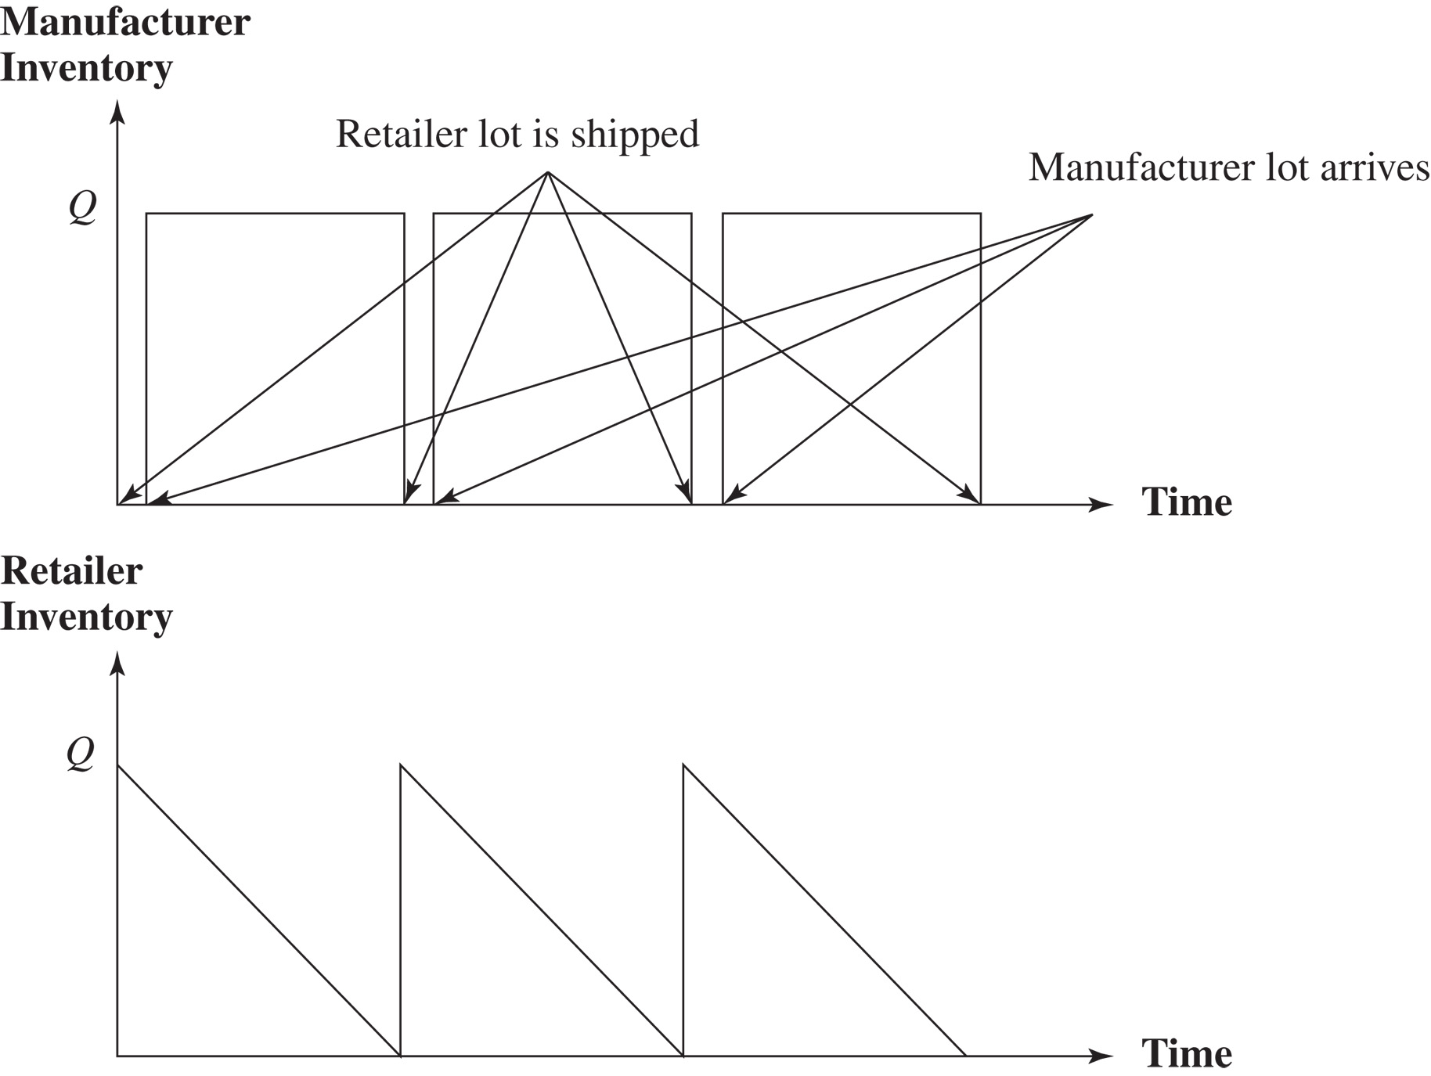
Managing Multiechelon
Cycle Inventory
Figure 11-6

Slide 36
Integer Replenishment Policy
Divide all parties within a stage into groups such that all parties within a group order from the same supplier and have the same reorder interval
Set reorder intervals across stages such that the receipt of a replenishment order at any stage is synchronized with the shipment of a replenishment order to at least one of its customers
For customers with a longer reorder interval than the supplier, make the customer’s reorder interval an integer multiple of the supplier’s interval and synchronize replenishment at the two stages to facilitate cross-docking

Slide 37
Integer Replenishment Policy
For customers with a shorter reorder interval than the supplier, make the supplier’s reorder interval an integer multiple of the customer’s interval and synchronize replenishment at the two stages to facilitate cross-docking
The relative frequency of reordering depends on the setup cost, holding cost, and demand at different parties
These polices make the most sense for supply chains in which cycle inventories are large and demand is relatively predictable

Slide 38
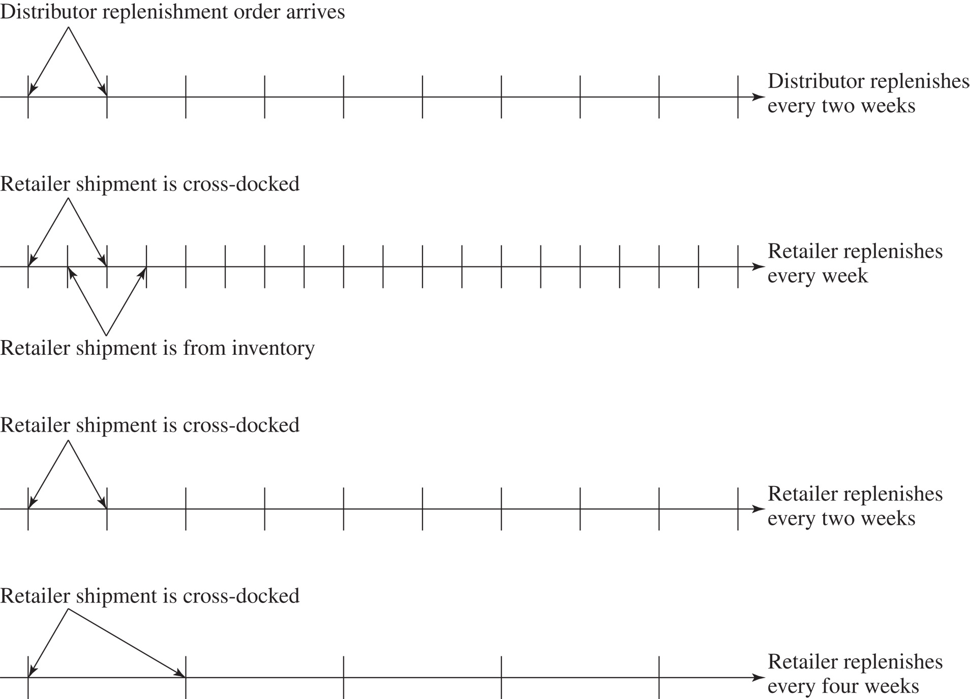
Integer Replenishment Policy
Figure 11-7

Slide 39
Integer Replenishment Policy
Figure 11-8

Slide 40
Summary of Learning Objectives
Balance the appropriate costs to choose the optimal lot size and cycle inventory in a supply chain
Understand the impact of quantity discounts on lot size and cycle inventory
Devise appropriate discounting schemes for a supply chain
Understand the impact of trade promotions on lot size and cycle inventory

Slide 41
Summary of Learning Objectives
Identify managerial levers that reduce lot size and cycle inventory in a supply chain without increasing cost
  Reduce fixed ordering and transportation costs incurred per order
  Implement volume-based discounting schemes rather than individual lot size–based discounting schemes
  Eliminate or reduce trade promotions and encourage EDLP – base trade promotions on sell-through rather than sell-in to the retailer

Slide 42
Uses and Costs of inventory
EOQ Model
  lead time OK
  non-instantaneous replenishment OK
  constant demand rate
  no backorders OK
Multiple products OK
Multi-echelon OK
Next …
Non-constant Demand Rate?
Demand Stochastic?

Slide 43

All rights reserved. No part of this publication may be reproduced, stored in a retrieval system, or transmitted, in any form or by any means, electronic, mechanical, photocopying, recording, or otherwise, without the prior written permission of the publisher.
Printed in the United States of America.

