Slide 1
Managing Uncertainty in a Supply Chain: Safety Inventory
12

Slide 2
Learning Objectives
Understand the role of safety inventory in a supply chain
Identify factors that influence the required level of safety inventory
Describe different measures of product availability
Determine the appropriate level of safety inventory
Impact of supply uncertainty on safety inventory
Impact of aggregation on safety inventory
Impact of replenishment policies on safety inventory
Utilize managerial levers available to lower safety inventory and improve product availability

Slide 3
Role of Inventory in the Supply Chain
Cost
Availability
Efficiency
Responsiveness
Notes:
Notes:

Slide 4
The Role of Safety Inventory in a Supply Chain
Forecasts are rarely completely accurate
If average demand is 1000 units per week, then half the time actual demand will be greater than 1000, and half the time actual demand will be less than 1000; what happens when actual demand is greater than 1000?
If you kept only enough inventory in stock to satisfy average demand, half the time you would run out
Safety inventory: Inventory carried for the purpose of satisfying demand that exceeds the amount forecasted in a given period

Slide 5
Role of Safety Inventory
Average inventory is therefore cycle inventory plus safety inventory
There is a fundamental tradeoff:
  Raising the level of safety inventory provides higher levels of product availability and customer service, and thus the margin captured from customer purchases
  Raising the level of safety inventory also raises the level of average inventory and therefore increases holding costs
    Very important in high-tech or other industries where obsolescence is a significant risk (where the value of inventory, such as PCs, can drop in value)

Slide 6
The Role of Safety Inventory
Three key questions
  What is the appropriate level of product availability?
  How much safety inventory is needed for the desired level of product availability?
  What actions can be taken to improve product availability while reducing safety inventory?

Slide 7
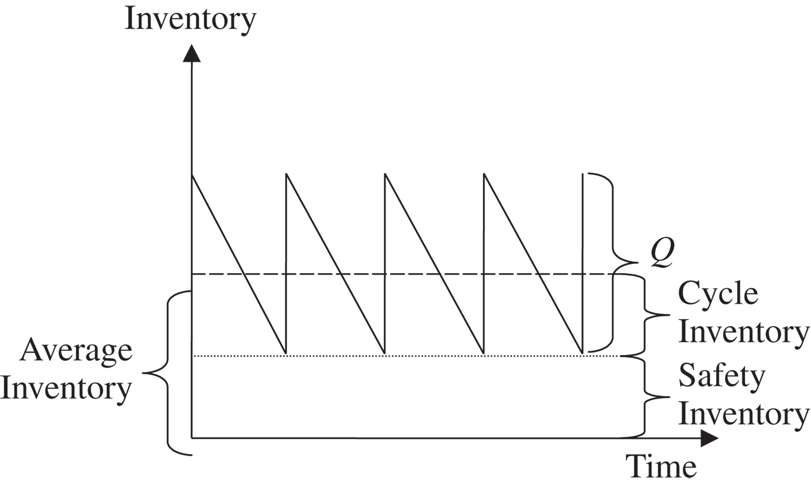
The Role of Safety Inventory
Figure 12-1

Slide 8
Determining the Appropriate
Level of Safety Inventory
Measuring demand uncertainty
Measuring product availability
Replenishment policies
Evaluating cycle service level and fill rate
Evaluating safety level given desired cycle service level or fill rate
Impact of required product availability and uncertainty on safety inventory

Slide 9
Determining the Appropriate
Level of Demand Uncertainty
Appropriate level of safety inventory determined by:
  supply or demand uncertainty
  desired level of product availability
Higher levels of uncertainty require higher levels of safety inventory given a particular desired level of product availability
Higher levels of desired product availability require higher levels of safety inventory given a particular level of uncertainty

Slide 10
Measuring Demand Uncertainty
Demand has a systematic component and a random component
The estimate of the random component is the measure of demand uncertainty
Random component is usually estimated by the standard deviation of demand
Notation:
  D = Average demand per period
  σ_{D} = standard deviation of demand per period
  L = lead time = time between when an order is placed and when it is received
Uncertainty of demand during lead time is what is important

Slide 11
Evaluating Demand Distribution Over L Periods
The coefficient of variation
= size of uncertainty relative to demand

Slide 12
Measuring Product Availability
Product availability: a firm’s ability to fill a customer’s order out of available inventory
Stockout: a customer order arrives when product is not available
Product fill rate (fr): fraction of demand that is satisfied from product in inventory
Order fill rate: fraction of orders that are filled from available inventory
Cycle service level (CSL): fraction of replenishment cycles that end with all customer demand met

Slide 13
Replenishment Policies
Replenishment policy: decisions regarding when to reorder and how much to reorder
Continuous review: inventory is continuously monitored and an order of size Q is placed when the inventory level declines to the reorder point ROP
Periodic review: inventory is checked at regular (periodic) intervals and an order is placed to raise the inventory to a specified threshold (the “order-up-to” level)

Slide 14
Evaluating Cycle Service Level and Fill Rate
Evaluating Safety Inventory Given a Replenishment Policy
Expected demand during lead time = DL
Safety inventory, ss = ROP – DL

Slide 15
Evaluating Cycle Service Level and Fill Rate
Average demand per week, D = 2,500
Standard deviation of weekly demand, σ_{D} = 500
Average lead time for replenishment, L = 2 weeks
Reorder point, ROP = 6,000
Average lot size, Q = 10,000
Safety inventory, ss = ROP – DL = 6,000 – 5,000 = 1,000
Cycle inventory = Q/2 = 10,000/2 = 5,000

Slide 16
Evaluating Cycle Service Level and Fill Rate
Average inventory = cycle inventory + safety inventory
= 5,000 + 1,000 = 6,000
Average flow time = average inventory/throughput
= 6,000/2,500 = 2.4 weeks

Slide 17
Evaluating Cycle Service Level and Fill Rate
Evaluating Cycle Service Level Given a Replenishment Policy
CSL = Prob(ddlt of L weeks ≤ ROP)
CSL = F(ROP, D_{L}, σ_{L}) = NORMDIST(ROP, D_{L}, σ_{L}, 1)
(ddlt = demand during lead time)

Slide 18
Evaluating Cycle Service Level and Fill Rate
Q = 10,000, ROP = 6,000, L = 2 weeks
D = 2,500/week, σ_{D} = 500
CSL = F(ROP,D_{L},σ_{L}) = NORMDIST(ROP,D_{L},σ_{L},1)
= NORMDIST(6000,5000,707,1) = 0.92

Slide 19
Evaluating Fill Rate Given a Replenishment Policy
Expected shortage per replenishment cycle (ESC) is the average units of demand that are not satisfied from inventory in stock per replenishment cycle
Product fill rate
fr = 1 – ESC/Q = (Q – ESC)/Q

Slide 20
Evaluating Fill Rate Given a Replenishment Policy

Slide 21
Evaluating Fill Rate Given a Replenishment Policy
Lot size, Q = 10,000
Average demand during lead time, D_{L} = 5,000
Standard deviation of demand during lead time, σ_{L} = 707
Safety inventory, ss = ROP – DL = 6,000 – 5,000 = 1,000
fr = (Q – ESC)/Q = 110,000 – 252/10,000 = 0.9975

Slide 22
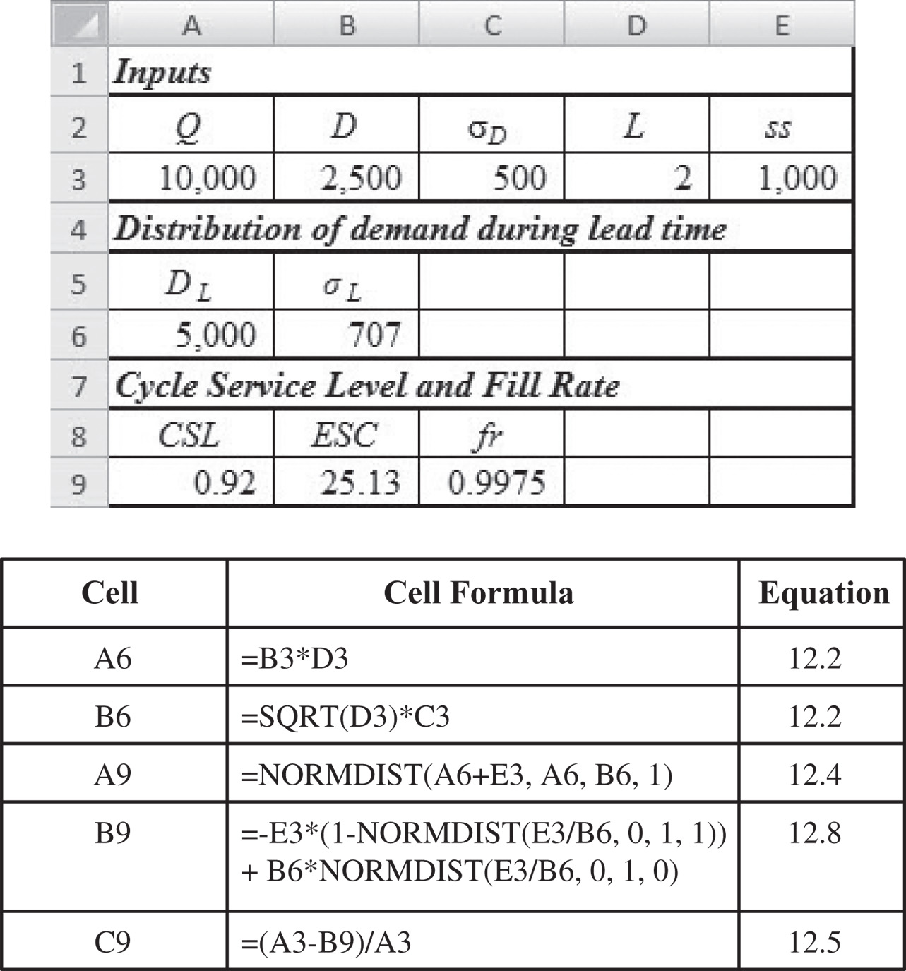
Evaluating Fill Rate Given a Replenishment Policy
Figure 12-2

Slide 23
Continuous Review Policy: Safety Inventory and Cycle Service Level
L: Lead time for replenishment
D: Average demand per unit time
σ_{D:}Standard deviation of demand per period
D_{L}: Mean demand during lead time
σ_{L}: Standard deviation of demand during lead time
CSL: Cycle service level
ss: Safety inventory
ROP: Reorder point
Average Inventory = Q/2 + ss
Notes:
Notes:

Slide 24
Evaluating Safety Inventory Given Desired Cycle Service Level
Desired cycle service level = CSL
Mean demand during lead time = D_{L}
Standard deviation of demand during lead time = σ_{L}
Probability(demand during lead time ≤ D_{L} + ss) = CSL
Identify safety inventory so that
F(D_{L} + ss, D_{L}, s_{L}) = CSL

Slide 25
Evaluating Safety Inventory Given Desired Cycle Service Level
or

Slide 26
Setting the Safety Stock level according to Cycle Service Level
Lead Time Demand DDLT ~ N(DL, σ_{L}²)
Pr(stockout)=0.15
DL
DL + zσ_{L}
units
Reorder point
= average leadtime demand + safety stock
= DL + z σ_{L}
_{where}
Pr (Z < z) = Cycle Service level Z ~ N(0,1)

Slide 27
EXAMPLE Order Quantity and Reorder Point
Daily demand for a certain product is normally distributed with a mean of 60 and standard deviation of 7. The source of supply is reliable and maintains a constant lead time of six days. The cost of placing the order is $10 and annual holding costs are $0.50 per unit. There are no stockout costs, and unfilled orders are filled as soon as the order arrives. Assume sales occur over the entire year. Find the order quantity and reorder point to satisfy a 95 probability of being in stock during the leadtime.
SOLUTION Calculate the order quantity Q as well as the reorder point R.
d = 60 S = $10
s_{d} = 7 H = $0.50
D = 60(365) L = 6/365
The optimal order quantity is

Slide 28
To compute the reorder point, we need to calculate the
amount of product used during the lead time and add
this to the safety stock.
The standard deviation of demand during the lead time
of six days is calculated from the variance of the
individual days. Since each day’s demand is
independent
Next we need to know how many standard deviations are
needed for a specified service level.
For a standard normal distribution z,
Prob(z < 1.655) = 0.95
Therefore the reorder point is:
ROP = DL + z σ_{L} = (60)(6) + (1.655)(17.2) = 388
If safety stock (z σ_{L} ) is negative, what does it mean?

Slide 29
Demand during the leadtime
(DDLT)
σ_{L} = 4
6
10
14
units
Lead Time Demand ~ N(0,1)
σ_{L} = 1
-1
0
1
units
Expected number of units short?

Slide 30
FILL RATE as the Service Level
Service level = fraction of demand met from stock
For DDLT ~ N(0,1)
E(z) = expected number of units short if reorder point is z units above the mean (per replenishment cycle)
(See tables for Normal Loss Function.)

Slide 31
Fixed Order Quantity Model with Fill Rate as Service Level (Probabilistic Demand)
Notation:
fr = service level = fraction of demand met from stock
Q = order quantity (per cycle)
D = average demand per period
L = lead time (Average Lead time demand = DL)
σ_{L} = standard deviation of demand during leadtime
(1-fr) Q = E(z) σ_{L}
ROP = DL + z σ_{L}

Slide 32
Example (revisited)
Find the order quantity and reorder point to satisfy 95 percent of the customers.
As before, Q_{opt}= 936 units, σ_{L} = 17.2
To find the safety stock needed:
From tables, at E(z) = 2.721, z = −2.72, so the reorder point is:
Verification:
We place 60(365)/936=23.4 orders per year. Each cycle experience (2.721)(17.2)=46.8 units out-of-stock, i.e., we would be out-of-stock (46.8)(23.4)=1095 units per year.
Service level is therefore (21900-1095)/21900=0.95 as intended.

Slide 33
Factors Affecting Fill Rate
Safety inventory: Fill rate increases if safety inventory is increased. This also increases the cycle service level.
Lot size: Fill rate increases on increasing the lot size even though cycle service level does not change.
Notes:
Notes:

Slide 34
Impact of Desired Product Availability and Uncertainty
As desired product availability goes up the required safety inventory increases
Fill Rate | Safety Inventory
97.5% | 67
98.0% | 183
98.5% | 321
99.0% | 499
99.5% | 767
Table 12-1

Slide 35
Impact of Desired Product Availability and Uncertainty on Safety Inventory
Desired product availability (cycle service level or fill rate) increases, required safety inventory increases
Demand uncertainty (σ_{L}) increases, required safety inventory increases
Managerial levers to reduce safety inventory without reducing product availability
  reduce supplier lead time, L (better relationships with suppliers)
  reduce uncertainty in demand, σ_{L} (better forecasts, better information collection and use)

Slide 36
Benefits of Reducing Lead Time
D = 2,500/week, σ_{D} = 800, CSL = 0.95
If lead time is reduced to one week
If standard deviation is reduced to 400

Slide 37
Impact of Supply Uncertainty on Safety Inventory
We incorporate supply uncertainty by assuming that lead time is uncertain
D: Average demand per period
σ_{D}: Standard deviation of demand per period
L: Average lead time for replenishment
σ_{L}: Standard deviation of lead time

Slide 38
Impact of Lead Time Uncertainty on Safety Inventory
Average demand per period, D = 2,500
Standard deviation of demand per period, σ_{D} = 500
Average lead time for replenishment, L = 7 days
Standard deviation of lead time, σ_{L} = 7 days
Mean ddlt, D_{L} = DL = 2,500 x 7 = 17,500

Slide 39
Impact of Lead Time Uncertainty on Safety Inventory
Required safety inventory
Table 12-2
s_{L} | σ_{L} | ss (units) | ss (days)
6 | 15,058 | 19,298 | 7.72
5 | 12,570 | 16,109 | 6.44
4 | 10,087 | 12,927 | 5.17
3 | 7,616 | 9,760 | 3.90
2 | 5,172 | 6,628 | 2.65
1 | 2,828 | 3,625 | 1.45
0 | 1,323 | 1,695 | 0.68

Slide 40
Impact of Aggregation on Safety Inventory
How does aggregation affect forecast accuracy and safety inventories
D_{i}: Mean weekly demand in region i, i = 1,…, k
σ_{i}: Standard deviation of weekly demand in region i, i = 1,…, k
ρ_{ij}: Correlation of weekly demand for regions i, j,
1 ≤ i ≠ j ≤ k

Slide 41
Impact of Aggregation on Safety Inventory
Total safety inventory
in decentralized option

Slide 42
Impact of Aggregation on Safety Inventory
Require safety inventory on aggregation
Holding-cost savings on aggregation per unit sold

Slide 43
Impact of Aggregation on Safety Inventory
The safety inventory savings on aggregation increase with the desired cycle service level CSL
The safety inventory savings on aggregation increase with the replenishment lead time L
The safety inventory savings on aggregation increase with the holding cost H
The safety inventory savings on aggregation increase with the coefficient of variation of demand
The safety inventory savings on aggregation decrease as the correlation coefficients increase

Slide 44
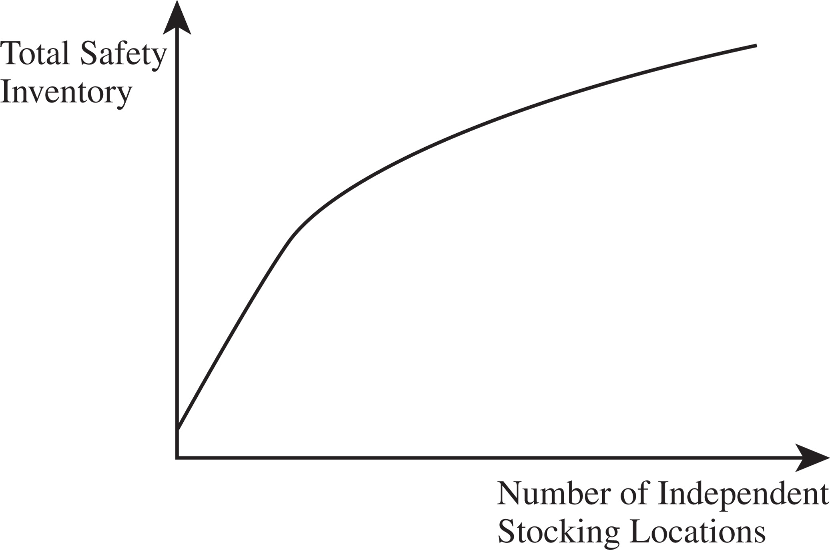
Impact of Aggregation on Safety Inventory
The Square-Root Law
Figure 12-4

Slide 45
Impact of Aggregation
(Example)
Car Dealer : 4 dealership locations (disaggregated)
D = 25 cars; σ_{D =} 5 cars; L = 2 weeks; desired CSL=0.90
What would the effect be on safety stock if the 4 outlets are consolidated into 1 large outlet (aggregated)?
At each disaggregated outlet:
For L = 2 weeks, σ_{L} = 7.07 cars
ss = F_{s}⁻¹(CSL) x σ_{L} = F_{s}⁻¹(0.9) x 7.07 = 9.06
Each outlet must carry 9 cars as safety stock inventory, so safety inventory for the 4 outlets in total is (4)(9) = 36 cars

Slide 46
Impact of Aggregation
(Example)
One outlet (aggregated option):
RC = D₁ + D₂ + D₃ + D₄ = 25+25+25+25 = 100 cars/wk
σ_{R}^{C} = Sqrt(5² + 5² + 5² + 5²) = 10
σ_{L}^{C} = σ_{D}^{C} Sqrt(L) = (10)Sqrt(2) = (10)(1.414) = 14.14
ss = F_{s}⁻¹(CSL) x σ_{L}^{C} = F_{s}⁻¹(0.9) x 14.14 =18.12
or about 18 cars
If ρ does not equal 0 (demand is not completely independent), the impact of aggregation is not as great

Slide 47
Impact of Correlation on
Value of Aggregation
ρ | Disaggregate Safety Inventory | Aggregate Safety Inventory
0 | 36.24 | 18.12
0.2 | 36.24 | 22.92
0.4 | 36.24 | 26.88
0.6 | 36.24 | 30.32
0.8 | 36.24 | 33.41
1.0 | 36.24 | 36.24
Table 12-3

Slide 48
Impact of Correlation on
Value of Aggregation
Two possible disadvantages to aggregation
  Increase in response time to customer order
  Increase in transportation cost to customer

Slide 49
Trade-offs of Physical Centralization
Use four regional or one national distribution center
D = 1,000/week, σ_{D} = 300, L = 4 weeks, CSL = 0.95
Four regional centers
Total required safety inventory,

Slide 50
Trade-offs of Physical Centralization
One national distribution center, ρ = 0
Standard deviation of weekly demand,
Decrease in holding costs = (3,948 – 1,974) $1,000 x 0.2
= $394,765
Decrease in facility costs = $150,000
Increase in transportation = 52 x 1,000 x (13 – 10)
= $624,000

Slide 51
Information Centralization
Virtual aggregation
Information system that allows access to current inventory records in all warehouses from each warehouse
Most orders are filled from closest warehouse
In case of a stockout, another warehouse can fill the order
Better responsiveness, lower transportation cost
higher product availability without adding to inventories
Reduces the amount of safety inventory
Examples: McMaster-Carr, Gap, Wal-Mart

Slide 52
Specialization
Stock all items in each location or stock different items at different locations?
  Different products may have different demands in different locations (e.g., snow shovels)
  There can be benefits from aggregation
Benefits of aggregation can be affected by:
  coefficient of variation of demand (higher cv yields greater reduction in safety inventory from centralization)
  value of item (high value items provide more benefits from centralization)
  Low demand, slow-moving items, typically have a high coefficient of variation
  High demand, fast-moving items, typically have a low coefficient of variation

Slide 53
Impact of Coefficient of Variation on Value of Aggregation
Table 12-4
 | Motors | Cleaner
Inventory is stocked in each store
Mean weekly demand per store | 20 | 1,000
Standard deviation | 40 | 100
Coefficient of variation | 2.0 | 0.1
Safety inventory per store | 132 | 329
Total safety inventory | 211,200 | 526,400
Value of safety inventory | $105,600,000 | $15,792,000
Inventory is aggregated at the DC
Mean weekly aggregate demand | 32,000 | 1,600,000
Standard deviation of aggregate demand | 1,600 | 4,000
Coefficient of variation | 0.05 | 0.0025
Aggregate safety inventory | 5,264 | 13,159
Value of safety inventory | $2,632,000 | $394,770
Savings
Total inventory saving on aggregation | $102,968,000 | $15,397,230
Total holding cost saving on aggregation | $25,742,000 | $3,849,308
Holding cost saving per unit sold | $15.47 | $0.046
Savings as a percentage of product cost | 3.09% | 0.15%

Slide 54
Product Substitution
The use of one product to satisfy demand for a different product
  Manufacturer-driven substitution (Offer customer higher-value product for lower-value product not in stock)
    Allows aggregation of demand
    Reduce safety inventories
    Influenced by the cost differential, correlation of demand
  Customer-driven substitution (Purchase alternative product, e.g. different size, different brand, etc., if desired product not in stock)
    Allows aggregation of safety inventory

Slide 55
Component Commonality
Using common components in a variety of different products
Can be an effective approach to exploit aggregation and reduce component inventories
  Without common components
    Uncertainty of demand for a component is the same as for the finished product
    Results in high levels of safety inventor
  With common components
    Demand for a component is an aggregation of the demand for the finished products
    Component demand is more predictable
    Component inventories are reduced

Slide 56
Value of Component Commonality
27 PCs, 3 components, 3 x 27 = 81 distinct components
Monthly demand = 5,000
Standard deviation = 3,000
Replenishment lead time = 1 month
CSL = 0.95
Total safety inventory required
Safety inventory per common component

Slide 57
Value of Component Commonality
With component commonality
Nine distinct components
Total safety inventory required

Slide 58
Value of Component Commonality
Number of Finished Products per Component | Safety Inventory | Marginal Reduction in Safety Inventory | Total Reduction in Safety Inventory
1 | 399,699
2 | 282,630 | 117,069 | 117,069
3 | 230,766 | 51,864 | 168,933
4 | 199,849 | 30,917 | 199,850
5 | 178,751 | 21,098 | 220,948
6 | 163,176 | 15,575 | 236,523
7 | 151,072 | 12,104 | 248,627
8 | 141,315 | 9,757 | 258,384
9 | 133,233 | 8,082 | 266,466
Table 12-5

Slide 59
Postponement
Delay product differentiation or customization until closer to the time the product is sold
  Have common components in the supply chain for most of the push phase
  Move product differentiation as close to the pull phase of the supply chain as possible
  Inventories in the supply chain are mostly aggregate
e.g. Benetton

Slide 60
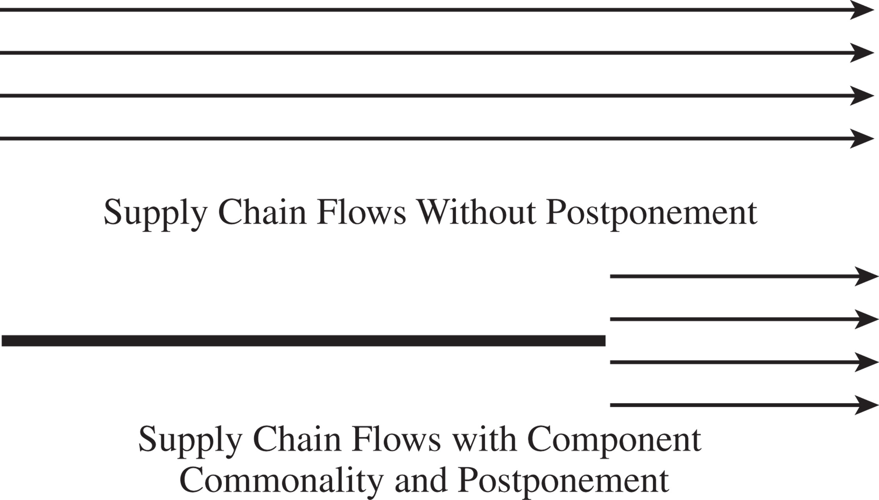
Postponement
Figure 12-5

Slide 61
Value of Postponement
100 different paint colors, D = 30/week, σ_{D} = 10,
L = 2 weeks, CSL = 0.95
Total required safety inventory,
Standard deviation of
base paint weekly demand,

Slide 62
Impact of Replenishment Policies on Safety Inventory
Continuous Review Policies
D: Average demand per period
σ_{D}: Standard deviation of demand per period
L: Average lead time for replenishment
Mean demand during lead time,
Standard deviation of demand during lead time,

Slide 63
(Periodic Review) Fixed Time Period Model
Place
order
Place
order
Inventory
on hand
(in units)
Place
order
Safety
stock
Stockout
L
T
L
T
L
T
Time
T = time between inventory review (fixed)
“Order-up-to” a target level OUL (Order quantity may differ each time)
IP = current inventory position
Order quantity = OUL − IP
OUL = D(T + L) + z σ_{T+L}
where Pr(Z < z) = cycle service level (CSL) or DL (1 − fr) = E(z) σ _{T+L}

Slide 64
Impact of Replenishment Policies on Safety Inventory
Periodic Review Policies
  Lot size determined by prespecified order-up-to level (OUL)
D: Average demand per period
σ_{D}: Standard deviation of demand per period
L: Average lead time for replenishment
T: Review interval
CSL: Desired cycle service level

Slide 65
Impact of Replenishment Policies on Safety Inventory
Probability(demand during L + T ≤ OUL) = CSL

Slide 66
Impact of Replenishment Policies on Safety Inventory
Figure 12-6

Slide 67
Evaluation Safety Inventory for a Periodic Review Policy
D = 2,500, σ_{D} = 500, L = 2 weeks, T = 4 weeks

Slide 68
Continuous Review
order quantity fixed
event-triggered
issue order when inventory drops below reorder point
continuous monitoring
lower safety stock
Periodic
Review
order frequency fixed
time-triggered
order quantity up to target stock level
simpler to manage
more safety stock needed

Slide 69
ABC classification
Pareto principle (80-20 rule)
A high value ~ 15 %
B ~ 35 %
C low value ~ 50 %

Slide 70
Inventory control systems
fixed order quantity (continuous review)
periodic review
Hybrid systems
optional replenishment (s,S)
  only order if inventory below a certain level
  periodic review
base stock system
  order replenishment every time demand is depleted

Slide 71
How to set the service level ?
Let b = unit cost of shortage
Stock r
Change in profit
0
DDLT > r
-H+b D/Q
Stock r+1
DDLT ≤ r
-H

Slide 72
How to set the service level ? (con't)
On the margin,
want expected change in profit = 0

Slide 73
"Implicit" cost of shortage
Cycle Service level = CSL
For our example:
"Implicit"
Useful to gauge subjective measures of cost and probabilities.

Slide 74
Expected Total Inventory Costs (with safety stock)
ROP−DL
Backorder
cost
Safety
Stock
Expected
# shortages
per cycle
[Safety stock inventory counted as carried for entire period,
actual cost is less if items sold during leadtime.
Implicit assumption here is that backorders are not very frequent.]

Slide 75
Setting service levels
1. Compute (basic) EOQ.
2. Use Pr(stockout during L) = HQ/Db to find z and E(z).
3. Use formula for Q to set new order quantity.
4. Iterate from Step 2 until no change.

Slide 76
Managing Safety Inventory in a Multi-echelon Supply Chain
In multiechelon supply chains stages often do not know demand and supply distributions
Inventory between a stage and the final customer is called the echelon inventory
Reorder points and order-up-to levels at any stage should be based on echelon inventory
Decisions must be made about the level of safety inventory carried at different stages

Slide 77
The Role of IT in
Inventory Management
IT systems can help
  Improve inventory visibility
  Coordination in the supply chain
  Track inventory (RFID)
Value tightly linked to the accuracy of the inventory information

Slide 78
Estimating and Managing Safety Inventory in Practice
Account for the fact that supply chain demand is lumpy
Adjust inventory policies if demand is seasonal
Use simulation to test inventory policies
Start with a pilot
Monitor service levels
Focus on reducing safety inventories

Slide 79
Summary of Learning Objectives
Understand the role of safety inventory in a supply chain
Identify factors that influence the required level of safety inventory
Describe different measures of product availability
Utilize managerial levers available to lower safety inventory and improve product availability

Slide 80

All rights reserved. No part of this publication may be reproduced, stored in a retrieval system, or transmitted, in any form or by any means, electronic, mechanical, photocopying, recording, or otherwise, without the prior written permission of the publisher.
Printed in the United States of America.

