Slide 1
Pricing and Revenue Management in a Supply Chain
16

Slide 2
Learning Objectives
Understand the role of revenue management in a supply chain
Identify conditions under which revenue management tactics can be effective
Describe trade-offs that must be considered when making revenue management decisions

Slide 3
Outline
Pricing and Revenue Management for Multiple Customer Segments
Pricing and Revenue Management for Perishable Assets
Dynamic Pricing
Pricing and Revenue Management for Seasonable Demand
Pricing and Revenue Management for Bulk and Spot Customers
The Role of IT in Pricing and Revenue Management
Using Pricing and Revenue Management in Practice
Summary of Learning Objectives

Slide 4
The Role of Pricing and Revenue Management in the Supply Chain
So far …
we take demand as exogenous, and focus on:
  Forecasting demand accurately,
  Managing cost of availability (e.g. location, production process, inventory, etc.)
In fact …
Demand depends on price, promotion, marketing, etc.
Revenue management is the use of pricing to increase the profit generated from a limited supply of supply chain assets
Supply assets exist in two forms: capacity and inventory

Slide 5
Revenue Management Strategies
Revenue management may also be defined as the use of differential pricing based on customer segment, time of use, and product or capacity availability to increase supply chain profits
  Low price for early commitment, high price for last minute purchase (e.g. moon cakes)
  High price for high demand season, low price when demand is low (e.g. hotels, tours)
Dynamic pricing: continuously adapt price, based on availability, demand, remaining time in selling season
  e.g. airline pricing
15-5

Slide 6
Conditions Under Which Revenue Management Has the Greatest Effect
The value of the product varies in different market segments
  (Example: airline seats)
The product is highly perishable or product waste occurs
  (Example: fashion and seasonal apparel)
Demand has seasonal and other peaks
  (Example: products ordered at Amazon.com)
The product is sold both in bulk and on the spot market

Slide 7
Pricing and Revenue Management for Multiple Customer Segments
Differential pricing increases total profits for a firm
Two fundamental issues must be handled in practice
  How can the firm differentiate between the two segments and structure its pricing to make one segment pay more than the other?
  How can the firm control demand such that the lower-paying segment does not utilize the entire availability of the asset?

Slide 8
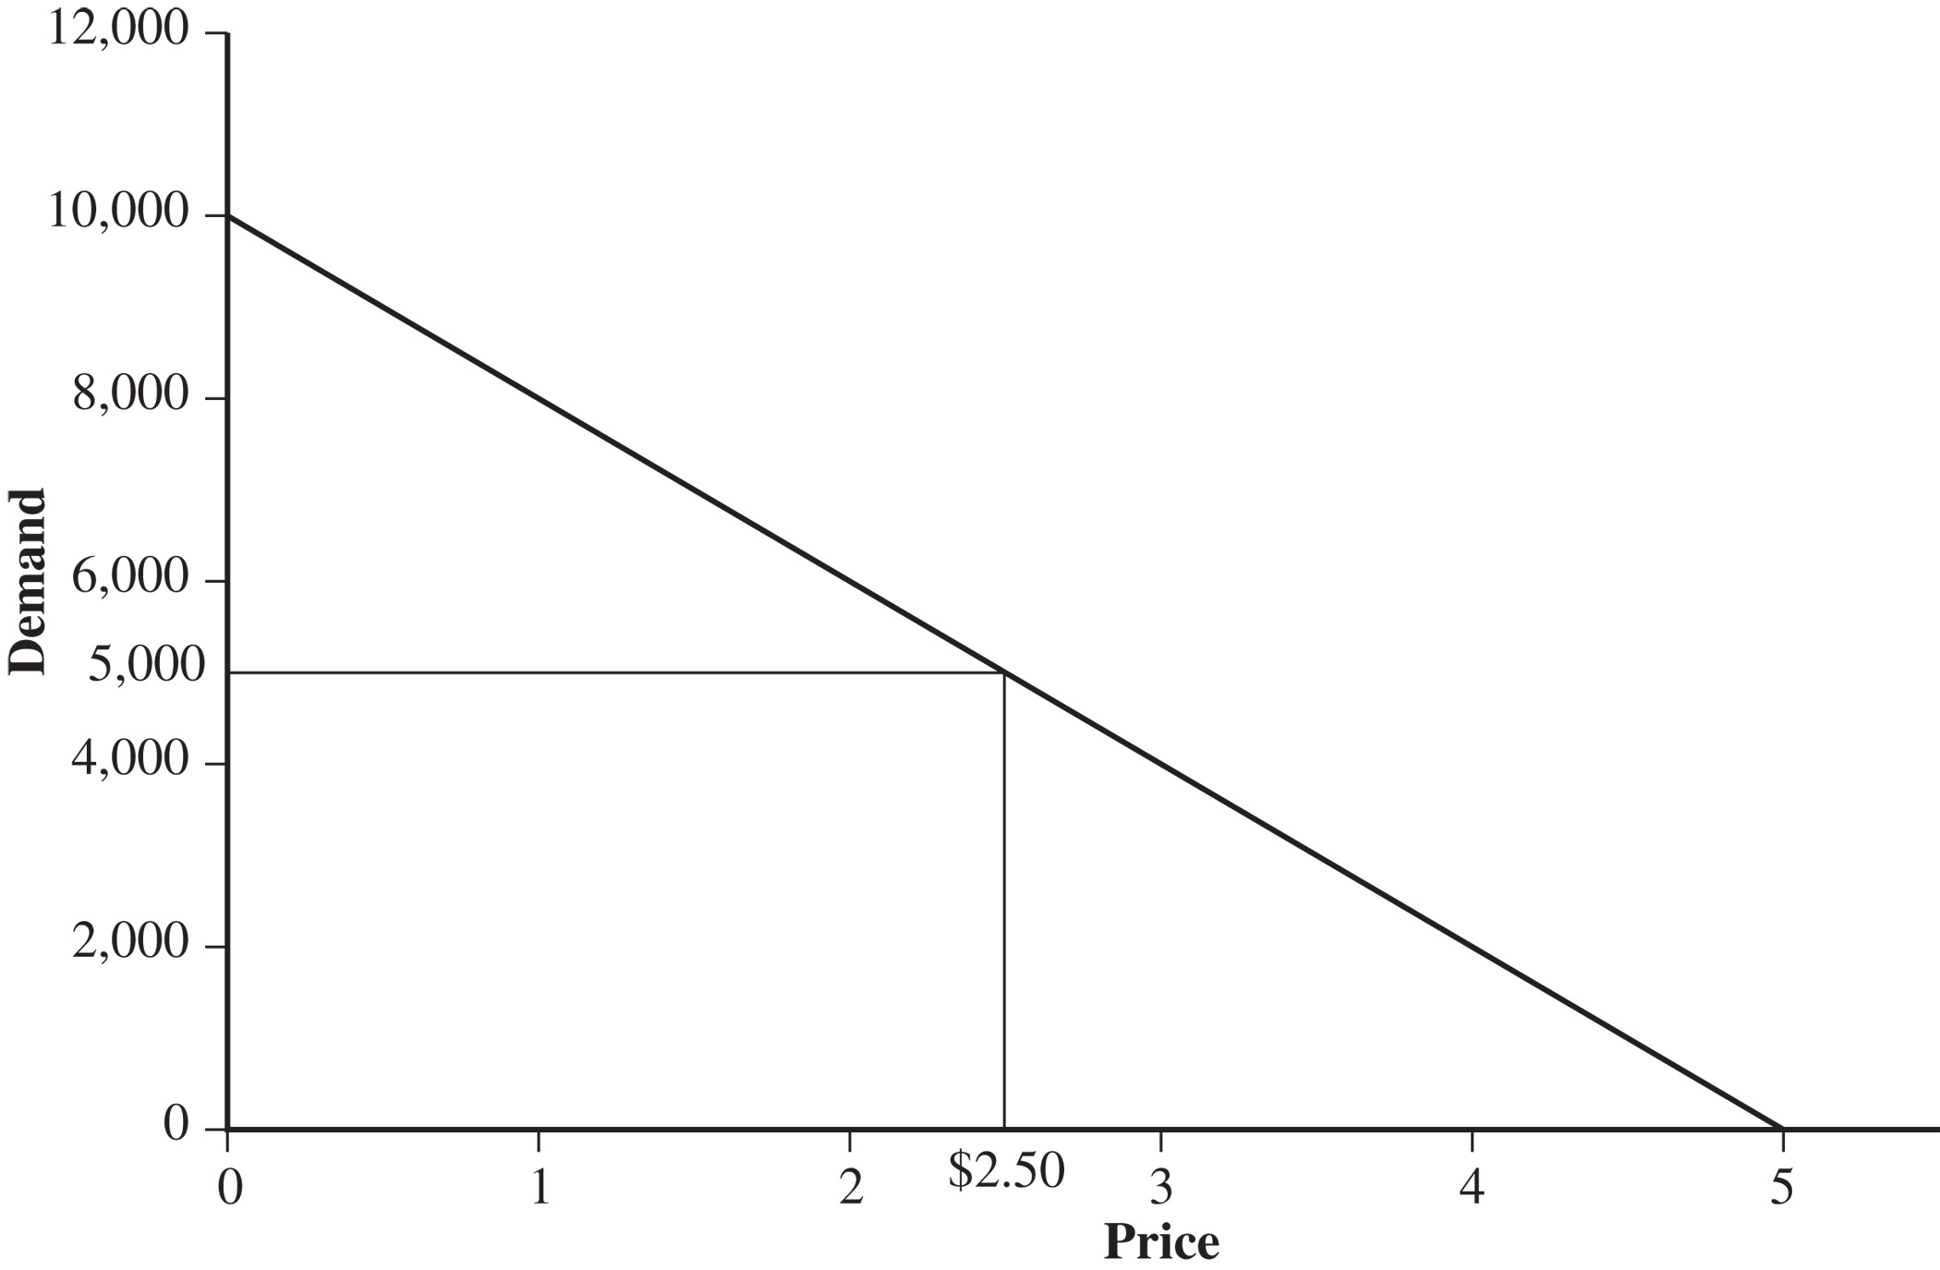
Pricing and Revenue Management for Multiple Customer Segments
Figure 16-1

Slide 9
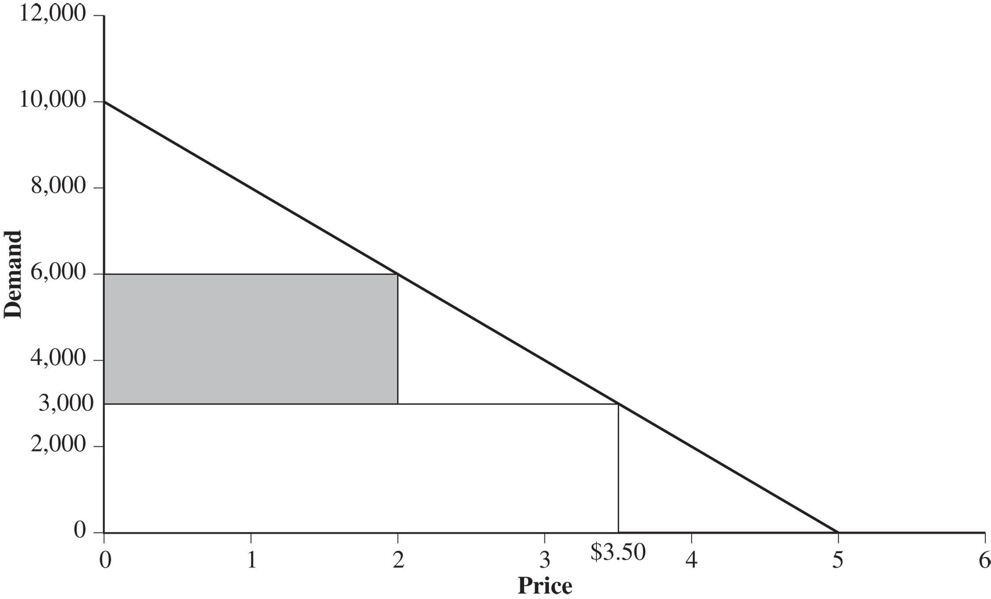
Pricing and Revenue Management for Multiple Customer Segments
Figure 16-2

Slide 10
Differential Pricing in Practice
How to identify the different market segments?
How to be able to offer different prices?
How to segment the market?
How to allocate (limited) assets to the different segments?

Slide 11
Pricing and Revenue Management for
Multiple Customer Segments
If a supplier serves multiple customer segments with a fixed asset, the supplier can improve revenues by setting different prices for each segment
Prices must be set with barriers such that the segment willing to pay more is not able to pay the lower price
The amount of the asset reserved for the higher price segment is such that the expected marginal revenue from the higher priced segment equals the price of the lower price segment (see derivation later).

Slide 12
Pricing to Multiple Segments
For capacity constrained by Q
Subject to

Slide 13
Pricing to Multiple Segments
Without capacity limitations:

Slide 14
Pricing to Multiple Segments
Same price to both segments
Lower profit

Slide 15
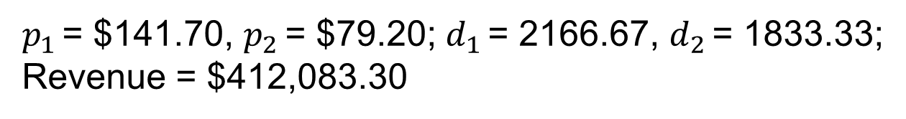
Pricing to Multiple Segments
Total production capacity is limited to 4,000 units
Subject to
$p_{1 }$= $141.70, $p_{2 }$= $79.20; $d_{1 }$= 2166.67, $d_{2 }$= 1833.33;
Revenue = $412,083.30
Higher prices,
lower profit

Slide 16
Allocating Capacity Under Uncertainty
Supplier charge lower price to customers willing to commit in advance, and higher price to customers purchasing at the last minute.
How much capacity to reserve for the higher-price segment?
Uncertainty: sell at lower price or wait for higher-price customer to arrive later?
Tradeoff:
  Spoilage : reserved capacity wasted when higher-price buyer do not materialise
  Spill : higher-price customer turned away because capacity committed to lower-price buyer

Slide 17
Pricing and Revenue Management for
Multiple Customer Segments
p_{L} = the price charged to the lower price segment
p_{H} = the price charged to the higher price segment
D_{H} = mean demand for the higher price segment
σ_{H} = standard deviation of demand for the higher price segment
C_{H} = capacity reserved for the higher price segment
R_{H}(C_{H}) = expected marginal revenue from reserving more capacity
= Probability(demand from higher price segment > C_{H}) x p_{H}
Optimality: R_{H}(C_{H}) = p_{L}
Probability(demand from higher price segment > C_{H}) = p_{L} / p_{H}
C_{H} = F⁻¹(1- p_{L}/p_{H}, D_{H},σ_{H}) = NORMINV(1- p_{L}/p_{H}, D_{H},σ_{H})

Slide 18
Example 15.2: ToFrom Trucking
Revenue from segment A = p_{A} = $3.50 per cubic ft
Revenue from segment B = p_{B} = $2.00 per cubic ft
Mean demand for segment A = D_{A} = 3,000 cubic ft
Std dev of segment A demand = σ_{A} = 1,000 cubic ft
C_{A} = NORMINV(1- p_{B}/p_{A}, D_{A},σ_{A})
= NORMINV(1- (2.00/3.50), 3000, 1000)
= 2,820 cubic ft
If pA increases to $5.00 per cubic foot, then
C_{A} = NORMINV(1- p_{B}/p_{A}, D_{A},σ_{A})
= NORMINV(1- (2.00/5.00), 3000, 1000)
= 3,253 cubic ft

Slide 19
Allocating Capacity to a Segment Under Uncertainty
Effective use of revenue management increases firm profits and improves service for the more valuable customer segment
Amount of asset reserved for higher-price segment is such that the expected marginal revenue from higher-price segment is equal to price of lower-price segment
  Ideally, demand forecast should be updated and reserved capacity recalculated every time an order is processed. Practically, forecast and reservation quantity updated periodically.
Market segmentation can also be done by differentiation the product, e.g. hardcover vs. paperback books; Toyota vs. Lexus.
Practical considerations:
  Price based on value to customer segment
  Set barriers so segment willing to pay more not able to pay lower price
  Forecast at the segment level

Slide 20
Pricing and Revenue Management for Perishable Assets
Any asset that loses value over time is perishable
  Examples: high-tech products such as computers and cell phones, high fashion apparel, fruits and vegetables; underutilized capacity, hotel rooms, airline seats, concert tickets.
Two basic approaches
  Vary price dynamically over time to maximize expected revenue
  Overbook sales of the asset to account for cancellations

Slide 21
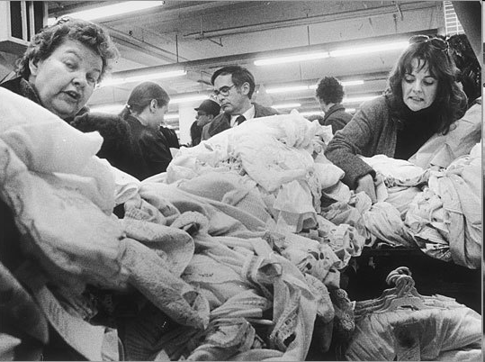
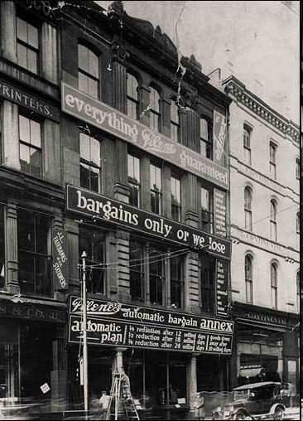
Filene’s Basement .
Filene's Basement was founded in Boston in 1909 by Edward A. Filene as a way to sell off excess merchandise from his father's department store upstairs
Automatic Markdown system (1/4 off after 12 days, ½ after 18, ¾ after 24 days)
http://www.filenesbasement.com/our_story.php
15-21

Slide 22
Dynamic Pricing
Varying price over time
For assets that loses value over time (e.g. fashion items, Rugby 7s tickets, ski jackets)
? High price initially, then more to sell later at lower price.
? Lower price earlier, with less to be sold at discount past deadline.
Goal: increase availability for customers willing to pay higher price.

Slide 23
Dynamic Pricing with Multiple Periods
Seller has Q units at beginning of selling season,
Selling season divided into k periods.
Demand in period i : d_{i} = A_{i} − B_{i} p_{i}
Pricing Problem:

Slide 24
Dynamic Pricing
Effective differential pricing increases the level of product availability for the consumer willing to pay full price and total profits for the retailer
Dynamic pricing is a powerful tool to increase profits if the customers’ sensitivity to price changes in the course of the selling season.
For example, customers of fashion products are less price-sensitive early in the season and more price-sensitive towards the end of the season.
Dynamic pricing should carefully consider strategic behaviour by customers who may anticipate future price drops. [Luxury brands?]

Slide 25
Pricing and Revenue Management for Perishable Assets
Overbooking or overselling of a supply chain asset is valuable if order cancellations occur and the value of asset drops sharply after a deadline.
The level of overbooking is based on the trade-off between the cost of wasting the asset if too many cancellations lead to unused assets and the cost of arranging a backup if too few cancellations lead to committed orders being larger than the available capacity

Slide 26
Pricing for Overbooking Perishable Assets
p = price at which each unit of the asset is sold
c = cost of using or producing each unit of the asset
b = cost per unit at which a backup can be used in the case of asset shortage
C_{w} = p – c = marginal cost of wasted capacity
C_{s} = b – c = marginal cost of a capacity shortage
O* = optimal overbooking level
s* = Probability(cancellations < O*) = C_{w} / (C_{w} + C_{s})

Slide 27
Pricing for Overbooking Perishable Assets with Uncertainty
If the distribution of cancellations is known to be normal with mean μ_{c} and standard deviation σ_{c} then
O* = F⁻¹(s*, μ_{c}, σ_{c}) = NORMINV(s*, μ_{c}, σ_{c})
If the distribution of cancellations is known only as a function of the booking level (capacity L + overbooking O) to have a mean of μ(L+O) and std deviation of σ(L+O), the optimal overbooking level is the solution to the following equation:
O = F⁻¹(s*,μ(L+O),σ(L+O))
= NORMINV(s*,μ(L+O),σ(L+O))

Slide 28
Example 15.5 - Overbooking
Dresses with a Christmas motif. Production capacity = 5000.
Cost of wasted capacity = C_{w} = $10 per dress
Cost of capacity shortage = C_{s} = $5 per dress
s* = C_{w} / (C_{w} + C_{s}) = 10/(10+5) = 0.667
μ_{c} = 800; σ_{c} = 400
O* = NORMINV(s*, μ_{c},σ_{c})
= NORMINV(0.667,800,400) = 973
If the mean is 15% of the booking level and the coefficient of variation is 0.5, then the optimal overbooking level is the solution of the following equation:
O = NORMINV(0.667,0.15(5000+O),0.075(5000+O))
Using Excel Solver, O* = 1,115

Slide 29
Pricing and Revenue Management for Seasonal Demand
Seasonal peaks of demand are common in many supply chains
Examples: Most retailers achieve a large portion of total annual demand in December (Amazon.com)
Off-peak discounting can shift demand from peak to non-peak periods
Charge higher price during peak periods and a lower price during off-peak periods
Changing capacity over time in (production/transportation/ storage) is expensive
Off-peak discounting increases profit for owners of assets, decreases price for some customers, and may attract new customers at the off-peak discount period

Slide 30
Pricing and Revenue Management for Bulk and Spot Contracts
Problems constructing a portfolio of long-term bulk contracts and short-term spot market contracts
Decide what fraction of the asset to sell in bulk and what fraction of the asset to save for the spot market
The fundamental trade-off is between wasting a portion of the low-cost bulk contract and paying more for the asset on the spot market
The amount reserved for the spot market should be such that the expected marginal revenue from the spot market equals the current revenue from a bulk sale

Slide 31
Pricing and Revenue Management for
Bulk and Spot Customers
For the simple case where the spot market price is known but demand is uncertain, a formula can be used
c_{B} = bulk rate
c_{S} = spot market price
Q* = optimal amount of the asset to be purchased in bulk
p* = probability that the demand for the asset does not exceed Q*
Marginal cost of purchasing another unit in bulk is c_{B}. The expected marginal cost of not purchasing another unit in bulk and then purchasing it in the spot market is (1-p*)c_{S}.

Slide 32
Pricing and Revenue Management for
Bulk and Spot Customers
If the optimal amount of the asset is purchased in bulk, the marginal cost of the bulk purchase should equal the expected marginal cost of the spot market purchase, or c_{B} = (1-p*)c_{S}
Solving for p* yields p* = (c_{S} – c_{B}) / c_{S}
If demand is normal with mean μ and std deviation σ, the optimal amount Q* to be purchased in bulk is
Q* = F⁻¹(p*,μ,σ) = NORMINV(p*,μ,σ)

Slide 33
Long-term Transportation Bulk Contracts versus the Spot Market
Bulk contract cost = c_{B} = $10,000 per million units
Spot market cost = c_{S} = $12,500 per million units
μ = 10 million units
σ = 4 million units
p* = (c_{S} – c_{B}) / c_{S} = (12,500 – 10,000) / 12,500 = 0.2
Q* = NORMINV(p*,μ,σ) = NORMINV(0.2,10,4) = 6.63
The manufacturer should sign a long-term bulk contract for 6.63 million units per month and purchase any transportation capacity beyond that on the spot market

Slide 34
Using Pricing and Revenue Management in Practice
Evaluate your market carefully
Quantify the benefits of revenue management
Implement a forecasting process
Optimize revenue management decisions!
Involve both sales and operations
Understand and inform the customer
Integrate supply planning with revenue management

Slide 35
Summary of Learning Objectives
Understand the role of revenue management in a supply chain
Identify conditions under which revenue management tactics can be effective
Describe trade-offs that must be considered when making revenue management decisions

Slide 36

All rights reserved. No part of this publication may be reproduced, stored in a retrieval system, or transmitted, in any form or by any means, electronic, mechanical, photocopying, recording, or otherwise, without the prior written permission of the publisher.
Printed in the United States of America.

