Slide 1
Sourcing Decisions in a Supply Chain
15

Slide 2
Learning Objectives
Understand the role of sourcing in a supply chain
Discuss factors that affect the decision to outsource a supply chain function
Identify dimensions of supplier performance that affect total cost
Structure successful auctions and negotiations
Describe the impact of risk sharing on supplier performance and information distortion
Understand contracts and their impact on SC performance
Design a tailored supplier portfolio
Risk management in sourcing
Sourcing decisions in practice

Slide 3
Procurement/Sourcing/Purchasing
Process by which a company acquires raw materials, components, products, services, or other resources from (outside) suppliers in order to execute its own operations.
Out-sourced vs. In-house
Out-sourcing vs. Off-shoring
Costs vs. Risks

Slide 4
The Role of Sourcing in a Supply Chain
Outsourcing questions
  Will the third party increase the supply chain surplus relative to performing the activity in-house?
  How much of the increase in surplus does the firm get to keep?
  To what extent do risks grow upon outsourcing?

Slide 5
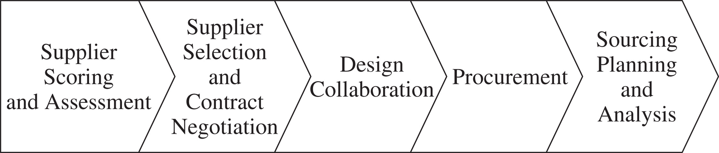
The Role of Sourcing in a Supply Chain
Sourcing is the set of business processes required to purchase goods and services
Figure 15-1

Slide 6
Supplier Scoring and Assessment
Supplier performance should be compared on the basis of the supplier’s impact on total cost
There are several other factors besides purchase price that influence total cost

Slide 7
Supplier Selection
Identify one or more appropriate suppliers
Contract should account for all factors that affect supply chain performance
Should be designed to increase supply chain profits in a way that benefits both the supplier and the buyer

Slide 8
Design Collaboration
About 80% of the cost of a product is determined during design
Suppliers should be actively involved at this stage

Slide 9
Procurement
A supplier sends product in response to orders placed by the buyer
Orders placed and delivered on schedule at the lowest possible overall cost

Slide 10
Sourcing Planning and Analysis
Analyze spending across various suppliers and component categories
Identify opportunities for decreasing the total cost

Slide 11
Cost of Goods Sold
Cost of goods sold (COGS) represents well over 50 percent of sales for most major manufacturers
Purchased parts a much higher fraction than in the past
Companies have reduced vertical integration and outsourced

Slide 12
Benefits of Effective
Sourcing Decisions
Better economies of scale can be achieved if orders are aggregated
More efficient procurement transactions can significantly reduce the overall cost of purchasing
Design collaboration can result in products that are easier to manufacture and distribute, resulting in lower overall costs
Good procurement processes can facilitate coordination with suppliers
Appropriate supplier contracts can allow for the sharing of risk
Firms can achieve a lower purchase price by increasing competition through the use of auctions

Slide 13
In-House or Out-source
Third parties increase supply-chain surplus by increasing value to buyer and/or seller or decreasing supply-chain costs
Capacity aggregation
Inventory aggregation
Transportation aggregation
  Order consolidation (savings in transport and storage)
Warehouse aggregation
Procurement aggregation
Information aggregation
Receivables aggregation
Relationship aggregation
Lower costs and higher quality

Slide 14
Factors Influencing Growth of Surplus by a Third Party
Scale
  Large scale it is unlikely that a third party can achieve further scale economies and increase the surplus
Uncertainty
  If requirements are highly variable over time, third party can increase the surplus through aggregation
Specificity of assets
  If assets required are specific to a firm, a third party is unlikely to increase the surplus

Slide 15
Factors Influencing Growth of Surplus by a Third Party
 |  | Specificity of Assets Involved in Function
 |  | Low | High
Firm scale | Low | High growth in surplus | Low to medium growth in surplus
 | High | Low growth in surplus | No growth in surplus unless cost of capital is lower for third party
Demand uncertainty for firm | Low | Low to medium growth in surplus | Low growth in surplus
 | High | High growth in surplus | Low to medium growth in surplus
Table 15-1

Slide 16
Risks of Using a Third Party
The process is broken
Underestimation of the cost of coordination
Reduced customer/supplier contact
Loss of internal capability and growth in third-party power
Leakage of sensitive data and information
Ineffective contracts
Loss of supply chain visibility
Negative reputational impact

Slide 17
Third- and Fourth-Party
Logistics Providers
Third-party logistics (3PL) providers performs one or more of the logistics activities relating to the flow of product, information, and funds that could be performed by the firm itself
A 4PL (fourth-party logistics) designs, builds and runs the entire supply chain process

Slide 18
Third- and Fourth-Party
Logistics Providers
Service Category | Basic Service | Some Specific Value-Added Services
Transportation | Inbound, outbound by ship, truck, rail, air | Tendering, track/trace, mode conversion, dispatch, freight pay, contract management
Warehousing | Storage, facilities management | Cross-dock, in-transit merge, pool distribution across firms, pick/pack, kitting, inventory control, labeling, order fulfillment, home delivery of catalog orders
Information technology | Provide and maintain advanced information/computer systems | Transportation management systems, warehousing management, network modeling and site selection, freight bill payment, automated broker interfaces, end-to-end matching, forecasting, EDI, worldwide track and trace, global visibility
Reverse logistics | Handle reverse flows | Recycling, used-asset disposition, customer returns, returnable container management, repair/refurbish
Other 3PL services |  | Brokering, freight forwarding, purchase-order management, order taking, loss and damage claims, freight bill audits, consulting, time-definite delivery
International |  | Customs brokering, port services, export crating, consolidation
Special skills/handling |  | Hazardous materials, temperature controlled, package/parcel delivery, food-grade facilities/equipment, bulk
Table 15-2

Slide 19
Supplier Scoring and Assessment
Supplier performance should be compared on the basis of the supplier’s impact on total cost
There are several other factors besides purchase price that influence total cost
  Cost
  Time? [ leadtime? on-time? ]
  Quality? [ defects? reliability?]
  Customisation? [ flexibility? volume discount? ]

Slide 20
Supplier Assessment Factors
Replenishment Lead Time
On-Time Performance
Supply Flexibility
Delivery Frequency / Minimum Lot Size
Supply Quality
Inbound Transportation Cost
Pricing Terms
Information Coordination Capability
Design Collaboration Capability
Exchange Rates, Taxes, Duties
Supplier Viability

Slide 21
Using Total Cost to
Score and Assess Suppliers
Performance Category | Category Components | Quantifiable?
Supplier price | Labor, material, overhead, local taxes, and compliance costs | Yes
Supplier terms | Net payment terms, delivery frequency, minimum lot size, quantity discounts | Yes
Delivery costs | All transportation costs from source to destination, packaging costs | Yes
Inventory costs | Supplier inventory, including raw material, in process and finished goods, in-transit inventory, finished goods inventory in supply chain | Yes
Warehousing cost | Warehousing and material handling costs to support additional inventory | Yes
Quality costs | Cost of inspection, rework, product returns | Yes
Reputation | Reputation impact of quality problems | No
Other costs | Exchange rate trends, taxes, duties | Yes
Support | Management overhead and administrative support | Difficult
Supplier capabilities | Replenishment lead time, on-time performance, flexibility, information coordination capability, design coordination capability, supplier viability | To some extent
Table 15-3

Slide 22
Comparing Suppliers
Based on Total Cost
Annual material cost = 1,000 x 52 x 1 = $52,000
Average cycle inventory = 2,000/2 = 1,000
Annual cost of holding cycle
inventory = 1,000 x 1 x 0.25 = $250
Standard deviation of ddlt =
Safety inventory required
with current supplier =
Annual cost of holding safety
inventory = 1,787 x 1 x 0.25 = $447
Annual cost of using current
supplier = 52,000 + 250 + 447 = $52,697

Slide 23
Comparing Suppliers
Based on Total Cost
Annual material cost = 1,000 x 52 x 0.97 = $50,440
Average cycle inventory = 8,000/2 = 4,000
Annual cost of holding cycle
inventory = 4,000 x 0.97 x 0.25 = $970
Standard deviation of ddlt =
Safety inventory required
with current supplier =
Annual cost of holding safety
inventory = 6,690 x 0.97 x 0.25 = $1,622
Annual cost of using current
supplier = 50,440 + 970 + 1,622 = $53,032

Slide 24
Example: Transportation vs. Inventory Cost Tradeoff
The Carry-All Luggage Company produces a line of luggage goods. The typical distribution plan is to produce a finished goods inventory located at the plant site. Goods are then shipped to company-owned field warehouses by way of common carriers. Rail is currently used to ship between the East Coast plant to a West Coast warehouse. The average transit time for rail shipment is T=21 days. At each stocking point, there is an average of 100,000 units of luggage having an average value of C=$30 per unit. Inventory carrying costs are I=30 percent per year.
The company wishes to select the mode of transportation that will minimize total costs. It is estimated that for every day that transit time can be reduced from the current 21 days, average inventory levels can be reduced by 1 percent, which represents a reduction in a safety stock. There are D=700,000 units sold per year out of the West Coast warehouse. The company can use the following transportation services:
Transportation Service | Rate ($/unit) | Door-to-door Transit Time (days) | No. of shipments per year
Rail | 0.10 | 21 | 10
Piggyback | 0.15 | 14 | 20
Truck | 0.20 | 5 | 20
Air | 1.40 | 2 | 40

Slide 25
Example (continued)
A diagram of the company’s current distribution is shown below. By selecting alternate modes of transportation, the length of time that inventory is in transit will be affected. Annual demand (D) will be in transit by the fraction of the year represented by T/365 days, where T is average transit time. The annual cost of carrying this in-transit inventory is ICDT/365.
The average inventory at both ends of the distribution channel can be approximated as Q/2, where Q is the shipment size. The holding cost per unit is I×C, but the item value C must reflect where the inventory is in the channel. For example. The value of C at he plant is the price, but at the warehouse it is the price plus the transportation rate.
East Coast Plant
21days
West Coast Warehouse
Inventory = 100,000 units
Inventory = 100,000 units

Slide 26
 |  | Modal Choices
Cost Type | Method of Computat-ionª | Rail | Piggyback | Truck | Air
Transportation | R×D | (0.10)(700,000) = 70,000 | (0.15)(700,000) = 105,000 | (0.2)(700,000) = 140,000 | (1.4)(700,000) = 980,000
In-transit Inventory | ICDT/365 | [(0.30)(30) (700,000)(21)]/ 365 = 363,465 | [(0.30)(30) (700,000)(14)]/ 365 = 241,644 | [(0.30)(30) (700,000)(5)]/ 365 = 86,301 | [(0.30)(30) (700,000)(2)]/ 365 =34,521
Plant Inventory | ICQ/2 | [(0.30)(30) (100,000)^{b}] = 900,000 | [(0.30)(30) (50,000)(0.93)^{c}] = 418,500 | [(0.30)(30) (50,000)(0.84)^{c}] = 378,000 | [(0.30)(30) (25,000)(0.81)^{c}] = 182,500
Field Inventory | IC’DQ/2 | [(0.30)(30.1) (100,000)] = 900,300 | [(0.30)(30.15) (50,000)(0.93)^{c}] = 420,593 | [(0.30)(30.2) (50,000)(0.84)^{c}] = 380,250 | [(0.30)(31.4) (25,000)(0.81)^{c}] = 190,755
 | Total | $2,235,465 | $1,185737 | $984,821 | $1,387,526
ªR = transport rate; D = annual demand; I = carry cost (%/yr); C = product value at plant; C’=product value at warehouse (C+R); T = time in transit; and Q = shipment size.
^{b}100,000 is more than the shipping quantity/2 to account for safety stock..
^{c}Accounts for improved transport service and number of shipments per year.

Slide 27
Tradeoffs in Transportation Design
Transportation, facility, and inventory cost tradeoff
  Choice of transportation mode
  Inventory aggregation
Transportation cost and responsiveness tradeoff
Similarly, lead-time and lead-time variability has an impact on inventory and hence overall costs

Slide 28
Single vs. Multiple Sourcing
Single sourcing guarantees the supplier sufficient business when supplier has to make buyer-specific investment
Competitive situation of multiple sourcing provide “value” for buyer, and also ensures back-ups available if one source fails

Slide 29
Supplier Selection –
Auctions and Negotiations
Supplier selection can be performed through competitive bids, reverse auctions, and direct negotiations
Supplier evaluation is based on total cost of using a supplier
Auctions:
  Sealed-bid first-price auctions
  English auctions
  Dutch auctions
  Second-price (Vickery) auctions

Slide 30
Supplier Selection –
Auctions and Negotiations
Factors influence the performance of an auction
  Is the supplier’s cost structure private (not affected by factors that are common to other bidders)?
  Are suppliers symmetric or asymmetric; that is, ex ante, are they expected to have similar cost structures?
  Do suppliers have all the information they need to estimate their cost structure?
  Does the buyer specify a maximum price it is willing to pay for the supply chain?

Slide 31
Supplier Selection –
Auctions and Negotiations
Collusion among bidders
Second-price auctions are particularly vulnerable
Can be avoided with any first-price auction

Slide 32
Basic Principles of Negotiation
The difference between the values of the buyer and seller is the bargaining surplus
The goal of each negotiating party is to capture as much of the bargaining surplus as possible
  Have a clear idea of your own value and as good an estimate of the third party’s value as possible
  Look for a fair outcome based on equally or equitably dividing the bargaining surplus
  A win-win outcome

Slide 33
Contracts, Risk Sharing, and
Supply Chain Performance
How will the contract affect the firm’s profits and total supply chain profits?
Will the incentives in the contract introduce any information distortion?
How will the contract influence supplier performance along key performance measures?

Slide 34
Supply Chain Contracts
Manufacturer
Retailer
A contract specifies the terms of the orders and deliveries between the buyer and the supplier
  Quantity, Price, Delivery lead time, Quality
Over/under-stocking risks?
  Fixed quantity, long lead time → buyer bears risk
  Short lead time → supplier bears risk
    (buyer can wait until demand known)
Each link in the supply chain optimises based on its own profit/cost margins (without considering other links in the supply chain)
May reduce profits of the entire supply chain

Slide 35
Double Marginalisation -Example
Manufacturer (TechFibre):
  Production cost v=$10, charges Wholesale price c=$100
Retailer (Ski Adventure):
  Selling price p=$200, Salvage value s=$0
Demand (at p=$200):
  Normally distributed ~ N(1000, 300²)
Retailer (solves a newsvendor problem):
  CSL*=(200-100)/(200-0)=0.5
  Orders 1000
  Expected profit = $76063
Manufacturer:
  Produces and sells 1000 units
  Profit = (100-10)*1000 = $90000

Slide 36
Double Marginalisation Example
With retailer doing own optimisation, 1000 units produced, and total supply chain profit is $76,063 + $90,000 = $166,063
In fact, for the supply chain (as a whole):
  C_{u} =200-10, C_{o}=10
  CSL* = 190/200=0.95
  Optimal production level = 1493
  Total supply chain profit = $183,812
Considering Manufacturer and retailer TOGETHER, the supply chain profit is higher!

Slide 37
Double Marginalisation
If each party makes decisions considering only a part of the supply chain, the decisions may not maximize profits for the whole supply chain!
Could contracts be designed to encourage retailer to purchase more to increase product availability
Supplier must share in the retailer’s demand uncertainty

Slide 38
Contracts for Product Availability and Supply Chain Profits
Independent actions taken by two parties in a supply chain often result in profits that are lower than those that could be achieved if the supply chain were to coordinate its actions
Three contracts that increase overall profits by making the supplier share some of the buyer’s demand uncertainty are
  Buyback or returns contracts
  Revenue-sharing contracts
  Quantity flexibility contracts

Slide 39
Buyback Contracts
Allows a retailer to return unsold inventory up to a specified amount at an agreed upon price
The manufacturer specifies a wholesale price c and a buyback price b
The manufacturer can salvage $s_{M} for any units that the retailer returns
The manufacturer has a cost of v per unit produced and the retail price is p

Slide 40
Buyback Contracts
Wholesale Price c | Buyback Price b | Optimal Order Size for Music Store | Expected Profit for Music Store | Expected Returns to Supplier | Expected Profit for Supplier | Expected Supply Chain Profit
$5 | $0 | 1,000 | $3,803 | 120 | $4,000 | $7,803
$5 | $2 | 1,096 | $4,090 | 174 | $4,035 | $8,125
$5 | $3 | 1,170 | $4,286 | 223 | $4,009 | $8,295
$6 | $0 | 924 | $2,841 | 86 | $4,620 | $7,461
$6 | $2 | 1,000 | $3,043 | 120 | $4,761 | $7,804
$6 | $4 | 1,129 | $3,346 | 195 | $4,865 | $8,211
$7 | $0 | 843 | $1,957 | 57 | $5,056 | $7,013
$7 | $4 | 1,000 | $2,282 | 120 | $5,521 | $7,803
$7 | $6 | 1,202 | $2,619 | 247 | $5,732 | $8,351
Table 15-4

Slide 41
Buyback Contracts
Holding-cost subsidies
  Manufacturers pay retailers a certain amount for every unit held in inventory over a given period
  Encourage retailers to order more
Price support
  Manufacturers share the risk of product becoming obsolete
  Guarantee that in the event they drop prices they will lower prices for all current inventories
Increasing wholesale price (and buyback price by a larger amount) can increase manufacturer’s profit
Cost of returning goods?

Slide 42
Contracts for Product Availability and Supply Chain Profits: Buyback Contracts
Allows a retailer to return unsold inventory up to a specified amount at an agreed upon price
Increases the optimal order quantity for the retailer, resulting in higher product availability and higher profits for both the retailer and the supplier
Most effective for products with low variable cost, such as music, software, books, magazines, and newspapers
Downside is that buyback contract results in surplus inventory that must be disposed of, which increases supply chain costs
Can also increase information distortion through the supply chain because the supply chain reacts to retail orders, not actual customer demand

Slide 43
Revenue-Sharing Contracts
Manufacturer charges the retailer a low wholesale price c and shares a fraction f of the retailer’s revenue
  Allows both the manufacturer and retailer to increase their profits
  Results in lower retailer effort
  Decreases the cost per unit charged to the retailer, which effectively decreases the cost of overstocking
  Requires an information infrastructure
  Information distortion results in excess inventory in the supply chain and a greater mismatch of supply and demand

Slide 44
Revenue Sharing Contracts
Retailer:
  C_{u} = (1-f)p - c, C_{o}= c - s_{R}
  CSL* = [(1-f)p-c ]/[(1-f)p-s_{R}]
  Let ES = Expected Overstock at retailer
  Expected profit = (1-f)p(Q-ES) + s_{R}(ES) - cQ
Manufacturer:
  Expected profit = (c-v)Q + fp(Q-ES)

Slide 45
Revenue-Sharing Contracts
Wholesale Price c | Revenue-Sharing Fraction f | Optimal Order Size for Music Store | Expected Overstock at Music Store | Expected Profit for Music Store | Expected Profit for Supplier | Expected Supply Chain Profit
$1 | 0.30 | 1,320 | 342 | $5,526 | $2,934 | $8,460
$1 | 0.45 | 1,273 | 302 | $4,064 | $4,367 | $8,431
$1 | 0.60 | 1,202 | 247 | $2,619 | $5,732 | $8,350
$2 | 0.30 | 1,170 | 223 | $4,286 | $4,009 | $8,295
$2 | 0.45 | 1,105 | 179 | $2,881 | $5,269 | $8,150
$2 | 0.60 | 1,000 | 120 | $1,521 | $6,282 | $7,803
Table 15-5

Slide 46
Quantity Flexibility Contracts
Allows the buyer to modify the order (within limits) after observing demand
Better matching of supply and demand
Increased overall supply chain profits if the supplier has flexible capacity
Lower levels of information distortion than either buyback contracts or revenue sharing contracts

Slide 47
Quantity Flexibility contracts
Manufacturer allows retailer to adjust quantity ordered after observing demand
  Retail orders O
  Manufacturer commits to deliver Q=(1+α)O, 0< α < 1
  Retailer commits to buying at least q=(1-β)O, 0< β < 1
  Manufacturers share risk with retailers
  No returns required

Slide 48
Quantity Flexibility Contracts

Slide 49
Quantity Flexibility Contracts

Slide 50
Quantity Flexibility Contracts
α | β | Wholesale Price c | Order Size O | Expected Purchase by Retailer | Expected Sale by Retailer | Expected Profits for Retailer | Expected Profits for Supplier | Expected Supply Chain Profit
0.00 | 0.00 | $5 | 1,000 | 1,000 | 880 | $3,803 | $4,000 | $7,803
0.05 | 0.05 | $5 | 1,017 | 1,014 | 966 | $4,038 | $4,004 | $8,416
0.20 | 0.20 | $5 | 1,047 | 1,023 | 967 | $4,558 | $3,858 | $8,416
0.00 | 0.00 | $6 | 924 | 924 | 838 | $2,841 | $4,620 | $7,461
0.20 | 0.20 | $6 | 1,000 | 1,000 | 955 | $3,547 | $4,800 | $8,347
0.30 | 0.30 | $6 | 1,021 | 1,006 | 979 | $3,752 | $4,711 | $8,463
0.00 | 0.00 | $7 | 843 | 843 | 786 | $1,957 | $5,056 | $7,013
0.20 | 0.20 | $7 | 947 | 972 | 936 | $2,560 | $5,666 | $8,226
0.40 | 0.40 | $7 | 1,000 | 1,000 | 987 | $2,873 | $5,600 | $8,473
Table 15-6

Slide 51
Contracts for Product Availability and Supply Chain Profits: Quantity Flexibility Contracts
Allows the buyer to modify the order (within limits) as demand visibility increases closer to the point of sale
Better matching of supply and demand
Increased overall supply chain profits if the supplier has flexible capacity
Lower levels of information distortion than either buyback contracts or revenue sharing contracts

Slide 52
Contracts to Coordinate
Supply Chain Costs
Differences in costs at the buyer and supplier can lead to decisions that increase total supply chain costs
Example: Replenishment order size placed by the buyer. The buyer’s EOQ does not take into account the supplier’s costs.
A quantity discount contract may encourage the buyer to purchase a larger quantity (which would be lower costs for the supplier), which would result in lower total supply chain costs [but higher inventory levels]
Quantity discounts lead to information distortion because of order batching

Slide 53
Contracts to Increase Agent Effort
There are many instances in a supply chain where an agent acts on the behalf of a principal and the agent’s actions affect the reward for the principal
Example: A car dealer who sells the cars of a manufacturer, as well as those of other manufacturers
Examples of contracts to increase agent effort:
  two-part tariffs: franchise fee and then fixed margin per unit sales
  threshold contracts: margin increases when a sales quota reached
Threshold contracts increase information distortion, however [e.g. forward selling]
Offer threshold incentives over a rolling horizon

Slide 54
Contracts to Induce
Performance Improvement
A buyer may want performance improvement from a supplier who otherwise would have little incentive to do so
A shared-savings contract provides the supplier with a fraction of the savings that result from performance improvement
Effective in aligning supplier and buyer incentives when the supplier is required to improve performance and most of the benefits of improvement accrue to the buyer

Slide 55
Design Collaboration
50-70% of spending at a manufacturer comes from procurement
80% of the cost of a purchased part is fixed in the design phase
Design collaboration with suppliers can result in reduced cost, improved quality, and decreased time to market
Design for logistics, design for manufacturability
Modular, adjustable, dimensional customization

Slide 56
The Procurement Process
Two main categories of purchased goods:
  Direct materials: components used to make finished goods
  Indirect materials: goods used to support the operations of a firm
 | Direct Materials | Indirect Materials
Use | Production | Maintenance, repair, support operations
Accounting | Cost of goods sold | General administrative expense
Impact on production | High, delays production | Less direct impact
Order/Transaction Cost vs. Value of item | Low | High
Number of Transactions | High | Low
14-56

Slide 57
The Procurement Process
The process in which the supplier sends product in response to orders placed by the buyer
Procurement process for direct materials should be designed to ensure that components are available in the right place, in the right quantity, and at the right time
Goal is to enable orders to be placed and delivered on schedule at the lowest possible overall cost
Focus for direct materials should be on improving coordination and visibility with supplier
Focus for indirect materials should be on decreasing the transaction cost for each order
Procurement for both should consolidate orders where possible to take advantage of economies of scale and quantity discounts

Slide 58
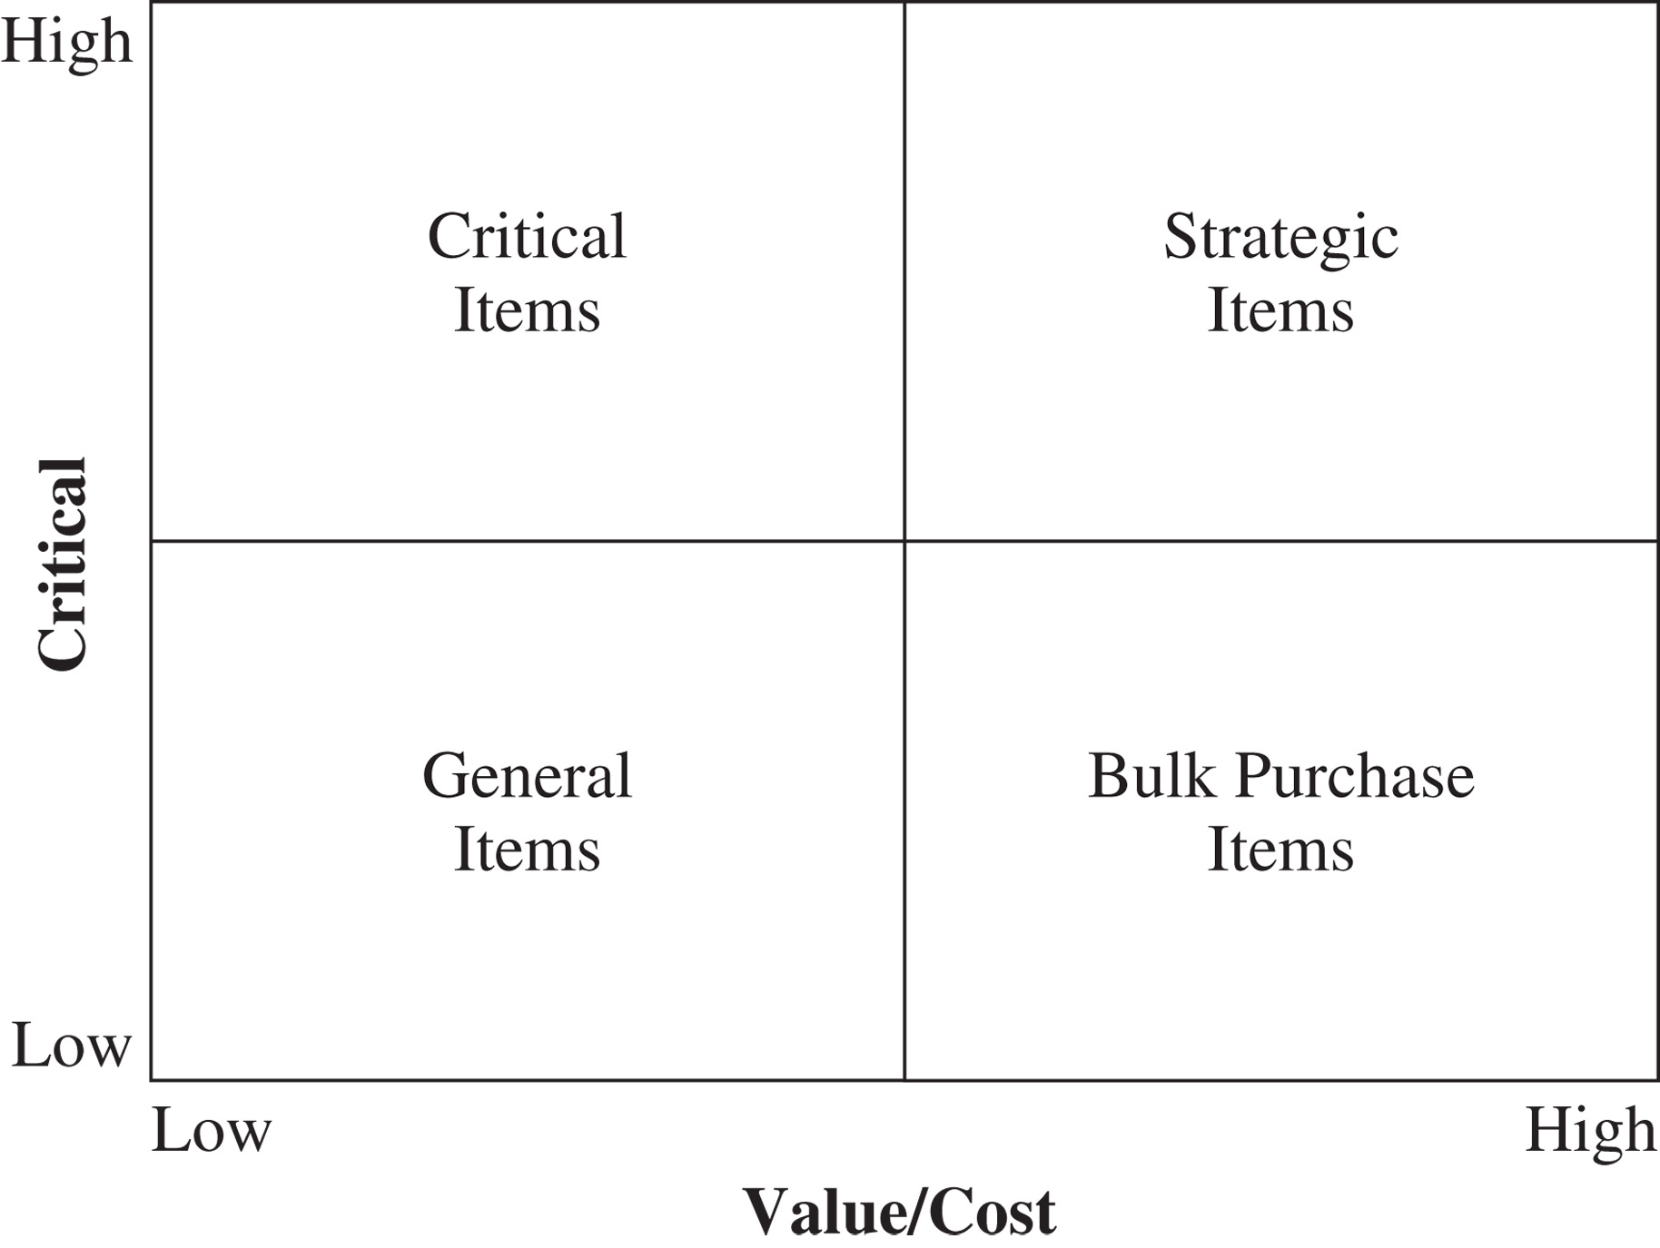
Product Categorization
Figure 15-2

Slide 59
Sourcing Planning and Analysis
A firm should periodically analyze its procurement spending and supplier performance and use this analysis as an input for future sourcing decisions
Procurement spending should be analyzed by part and supplier to ensure appropriate economies of scale
Supplier performance analysis should be used to build a portfolio of suppliers with complementary strengths
  Cheaper but lower performing suppliers should be used to supply base demand
  Higher performing but more expensive suppliers should be used to buffer against variation in demand and supply from the other source

Slide 60
Designing a Sourcing Portfolio: Tailored Sourcing
Options with regard to whom and where to source from
  Produce in-house or outsource to a third party
  Will the source be cost efficient or responsive
  Onshoring, near-shoring, and offshoring
Tailor supplier portfolio based on a variety of product and market characteristics

Slide 61
Designing a Sourcing Portfolio: Tailored Sourcing
 | Responsive Source | Low-Cost Source
Product life cycle | Early phase | Mature phase
Demand volatility | High | Low
Demand volume | Low | High
Product value | High | Low
Rate of product obsolescence | High | Low
Desired quality | High | Low to medium
Engineering/design support | High | Low
Table 15-8

Slide 62
Designing a Sourcing Portfolio: Tailored Sourcing
 | Onshore | Near-shore | Offshore
Rate of innovation/product variety | High | Medium to High | Low
Demand volatility | High | Medium to High | Low
Labor content | Low | Medium to High | High
Volume or weight-to-value ratio | High | High | Low
Impact of supply chain disruption | High | Medium to High | Low
Inventory costs | High | Medium to High | Low
Engineering/management support | High | High | Low
Table 15-9

Slide 63
Risk Management in Sourcing
Supply disruption
Inability to meet demand on time
An increase in procurement costs
Loss of intellectual property

Slide 64
Making Sourcing
Decisions in Practice
Use multifunction teams
Ensure appropriate coordination across regions and business units
Always evaluate the total cost of ownership
Build long-term relationships with key suppliers

Slide 65
Summary of Learning Objectives
Understand the role of sourcing in a supply chain
Discuss factors that affect the decision to outsource a supply chain function
Identify dimensions of supplier performance that affect total cost
Structure successful auctions and negotiations
Describe the impact of risk sharing on supplier performance and information distortion
Design a tailored supplier portfolio

Slide 66
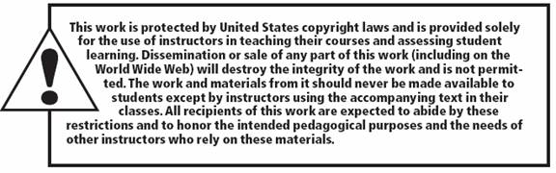
All rights reserved. No part of this publication may be reproduced, stored in a retrieval system, or transmitted, in any form or by any means, electronic, mechanical, photocopying, recording, or otherwise, without the prior written permission of the publisher.
Printed in the United States of America.

