Slide 1
Efficient Route Planning on Public Transportation Networks: A Labelling Approach
Sibo Wang, Wenqing Lin, Yi Yang,
Xiaokui Xiao, Shuigeng Zhou

Slide 2
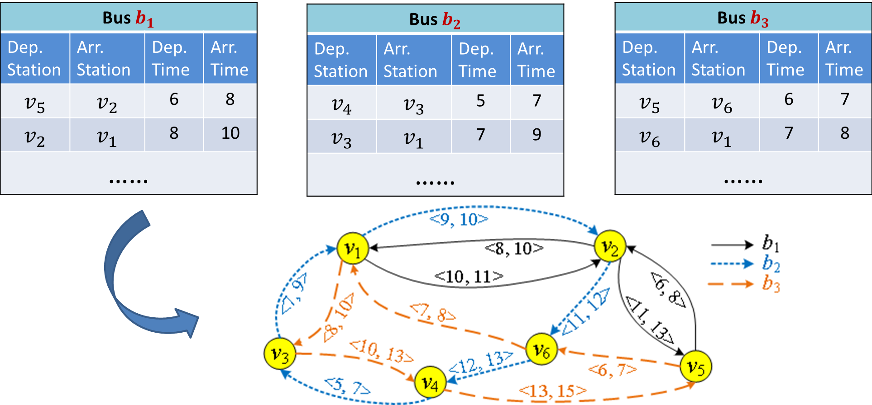
Public Transportation Network
Each edge $\left\langle u,v, t_{d}, t_{a}, b\right\rangle$ denotes that bus $b$ departs from station $u$ at timestamp $t_{d}$ and arrives at station $v$ at timestamp $t_{a}$ without any stop.
Notes:
In a public transportation network, we have a set of timetables for several public transports. Such public transportation network can be modeled as a multi-graph, we call it timetable graph, where each node represents a stop, and each edge denotes

Slide 3
Route planning queries
Earliest Arrival Path (EAP)
Depart from $v_{5}$ after time 6, how to arrive at $v_{1}$ ASAP?
Latest Departure Path (LDP)
Arrive at $v_{4}$ before time 13, how to depart from $v_{1}$ ALAP?
Shortest Duration Path (SDP)
Depart from $v_{5}$ at time 6, how to arrive at $v_{1}$ before time 10, while minimizing the travel duration?
Notes:
We hava three typical type of queries in public transportations.
For example, we may ask..

Slide 4
Online search: Dijkstra’s variant
Example: EAP query
Traverse from the node $v$
with the smallest distance $→$ with smallest arrival time $t_{min}$.
Expand from $v$
with outgoing edges $→$ with outgoing edges whose departure timestamp $t_{d}≥t_{min}$

Slide 5
State-of-the-art solutions
Pre-arrange edges in a certain order
CSA [Dibbelt et al. SEA’13, Wu et al. VLDB’14];
E.g. Sort edges in ascending order of departure timestamp for EAP queries.
Use a linear scan of the edges in the time range.
Augment graph with important routes
CHT [Geisberger et al. SEA’10]；
Create shortcuts
Considerable query overheads
Notes:
The state-of-the-art solutions can be divided into two categories. The first category tries to …

Slide 6
Contributions
Timetable Labeling (TTL)
Index structure
Efficient query processing
${10}^{2}\sim {10}^{3}$times faster than state-of-the-art solution
Preprocessing Algorithms
Index construction algorithm
Index size: approximation guarantee
Optimizations
Index size: compressing labels
Query time: concise representation
Notes:
So we present our solution, TTL, which is 10 to the power of 2 and 10 to the power of 3 times faster than …
Afterward, we would present preprocessing algorithms and optimization techniques.

Slide 7
Timetable Labelling

Slide 8
Overview
A total ordering
1. for any $u$ and $v$, $o\left(u\right)>o\left(v\right)$ or $o\left(u\right)<o\left(v\right)$.
2. $u$ has a higher rank than $v$ if $o\left(u\right)<o\left(v\right)$.
Each vertex $v$ contains an in-label set $L_{in}(v)$ and an out-label set $L_{out}(v)$
Any query starting from $u$and ending at $w$ can be answered by checking $L_{out}(u)$ and $L_{in}(w)$
Notes:
In TTL, we have a total ordering for all nodes.

Slide 9
Index Structure
Query processing

Slide 10
Index Structure
Each label in $L_{in}(v)$ is a tuple $l=〈x, t_{d}, t_{a}, b,p〉$, where
$x:$ the staring node of a path $P$ from $x$ to $v$. Among all nodes on $P$, $x$ has the highest rank.
$$x$$
$$w$$
$$v$$
$o\left(x\right)<o\left(w\right)$ for any node $w≠x$ on $P$
Notes:
Here we only explain in-label sets and out-label sets can be explained similarly.

Slide 11
Index Structure
Each label in $L_{in}(v)$ is a tuple $l=〈x, t_{d}, t_{a}, b,p〉$, where
$x:$ the staring node of a path $P$ from $x$ to $v$. Among all nodes on $P$, $x$ has the highest rank.
$p:$ among all nodes on $P$ except $x$ and $v$, $p$ is the node with the highest rank. This node is called the pivot of the label.

Slide 12
Index Structure
Each label in $L_{in}(v)$ is a tuple $l=〈x, t_{d}, t_{a}, b,p〉$, where
$x:$ the staring node of a path $P$ from $x$ to $v$. Among all nodes on $P$, $x$ has the highest rank.
$p:$ among all nodes on $P$ except $x$ and $v$, $p$ is the node with the highest rank. This node is called the pivot of the label.
$t_{d},t_{a}, b$: path $P$ departs at time $t_{d}$, and arrives at time $t_{a}$, by taking bus $b$. If bus transfer is required, $b$ is $null$.
$$x$$
$$w$$
$$v$$
$$t_{d}$$
$$t_{a}$$

Slide 13
Index Structure
Each label in $L_{in}(v)$ is a tuple $l=〈x, t_{d}, t_{a}, b,p〉$, where
$x:$ the staring node (resp. ending node) of a path $P$ from $x$ to $v$ (resp. $v$ to $x$ ). Among all nodes on $P$, $x$ has the highest rank.
$p:$ among all nodes on $P$ except $x$ and $v$, $p$ is the node with the highest rank. This node is called the pivot of the label.
$t_{d},t_{a}, b$: path $P$ departs at time $t_{d}$, and arrives at time $t_{a}$, by taking bus $b$. If bus transfer is required, $b$ is $null$.
$P$is a non-dominated path: there does not exist another path $P^{′}$such that $P′$ has the same starting node and ending node as $P$ with departure time ${t′}_{d}$ and arrival time ${t′}_{a}$, but ${[t′}_{d}$, ${t′}_{a}] ⊂[t_{d},t_{a}]$. We say $P′$ is a dominated path.

Slide 14
Dominated path
Any dominated path $P′$ will not be the query answer for EAP/LDP/SDP query.
We can always find a non-dominated path $P$ to replace it
E.g. EAP ($v_{2},v_{4},3)$
$P^{′}: v_{2}→v_{4}, t_{d}^{′}=4, t_{a}^{′}=7$
$P:{ v}_{2}→v_{4}, t_{d}=4, t_{a}=6$

Slide 15
Index Structure
Query processing

Slide 16
Query Processing
Example, SDP query: ( $v_{4},v_{2},4, 12)$
$$〈v_{1}, 5, 9,b_{2},v_{3}〉$$
$$〈v_{3}, 5, 7,b_{2},null〉$$
$$〈v_{1}, 8, 9,b_{2},null〉$$
$$〈v_{1}, 9, 10,b_{2},null〉$$
$$〈v_{1}, 10, 11,b_{1},null〉$$
$$v_{4}$$
$$v_{2}$$
$$L_{out}\left(v_{4}\right)$$
$$L_{in}\left(v_{2}\right)$$
Recap: each label corresponds to a non-dominated path.

Slide 17
Query Processing: Candidate generation
Example, SDP query: ( $v_{4},v_{2},4, 12)$
$$〈v_{1}, 5, 9,b_{2},v_{3}〉$$
$$〈v_{3}, 5, 7,b_{2},null〉$$
$$〈v_{1}, 8, 9,b_{2},null〉$$
$$〈v_{1}, 9, 10,b_{2},null〉$$
$$〈v_{1}, 10, 11,b_{1},null〉$$
$$v_{4}$$
$$v_{2}$$
$$L_{out}\left(v_{4}\right)$$
$$L_{in}\left(v_{2}\right)$$
$$t_{a}$$
$$v_{1}$$
$$t_{d}$$
$$v_{4}$$
$$v_{2}$$
$$t_{a}>t_{d}$$
Notes:
Add animation

Slide 18
Query Processing: Candidate generation
Example, SDP query: ( $v_{4},v_{2},4, 12)$
$$〈v_{1}, 5, 9,b_{2},v_{3}〉$$
$$〈v_{3}, 5, 7,b_{2},null〉$$
$$〈v_{1}, 8, 9,b_{2},null〉$$
$$〈v_{1}, 9, 10,b_{2},null〉$$
$$〈v_{1}, 10, 11,b_{1},null〉$$
$$v_{4}$$
$$v_{2}$$
$$L_{out}\left(v_{4}\right)$$
$$L_{in}\left(v_{2}\right)$$
$$t_{a}$$
$$v_{1}$$
$$t_{d}$$
$$v_{4}$$
Might be an SDP.
$$v_{2}$$
$$t_{d}≥t_{a}$$
Notes:
Add animation

Slide 19
Query Processing: Candidate generation
Example, SDP query: ( $v_{4},v_{2},4, 12)$
$$〈v_{1}, 5, 9,b_{2},v_{3}〉$$
$$〈v_{3}, 5, 7,b_{2},null〉$$
$$〈v_{1}, 8, 9,b_{2},null〉$$
$$〈v_{1}, 9, 10,b_{2},null〉$$
$$〈v_{1}, 10, 11,b_{1},null〉$$
$$v_{4}$$
$$v_{2}$$
$$L_{out}\left(v_{4}\right)$$
$$L_{in}\left(v_{2}\right)$$
$$t_{a}$$
$$t_{d}$$
$$v_{2}$$
$$v_{4}$$
$$v_{3}$$
$$v_{1}$$

Slide 20
Query Processing: Refinement
Example, SDP query: ( $v_{4},v_{2},4, 12)$
$$〈v_{1}, 5, 9,b_{2},v_{3}〉$$
$$〈v_{3}, 5, 7,b_{2},null〉$$
$$〈v_{1}, 8, 9,b_{2},null〉$$
$$〈v_{1}, 9, 10,b_{2},null〉$$
$$〈v_{1}, 10, 11,b_{1},null〉$$
$$v_{4}$$
$$v_{2}$$
$$L_{out}\left(v_{4}\right)$$
$$L_{in}\left(v_{2}\right)$$
$$〈 〈v_{1}, 5, 9,b_{2},v_{3}〉\text{, }〈v_{1}, 9, 10,b_{2},null〉 〉$$
$$〈 〈v_{1}, 5, 9,b_{2},v_{3}〉\text{,} 〈v_{1}, 10, 11,b_{1},null〉 〉$$
$$S_{v_{4}v_{2}}$$

Slide 21
Query Processing: Path reconstruction
Example, SDP query: ( $v_{4},v_{2},4, 12)$
$$〈v_{1}, 5, 9,b_{2},v_{3}〉$$
$$〈v_{1}, 9, 10,b_{2},null〉$$
$$〈v_{3}, 5, 7,b_{2},null〉$$
$$〈v_{1}, 7, 9,b_{2},null〉$$
$$v_{1}\frac{b_{2}}{ }v_{2}$$
$$9→10$$
$$v_{4}\frac{b_{2}}{ }v_{3}$$
$$5→7$$
$$v_{3}\frac{b_{2}}{ }v_{1}$$
$$7→9$$
$$v_{4}\frac{ b_{2} }{ } v_{3}\frac{ b_{2} }{ } v_{1}\frac{ b_{2} }{ }v_{2}$$
Notes:
The high level idea is that, by using the pivot information, we can recursively unfold the path by inspecting the labels pertinent to the pivot.

Slide 22
Query processing
$\left|L_{in}\left(u\right)\right|⋅|L_{out}\left(v\right)|$ paths in the worst case
Quadratic
Linear-time algorithm
Exploiting node ordering and timestamp information to prune non-dominated paths.
Notes:
Notice that, during label scanning, there might exist ||\cdot || valid paths in the worst case.
In our paper, we devise a linear-time query algorithm by exploiting ….

Slide 23
Preprocessing Algorithms
Notes:
So after the introduction of TTL, an immediate question is how to construct a TTL index and how to order the nodes. Next we answer these two questions.

Slide 24
Index construction
How to generate indices that satisfy the constraints?

Slide 25
Index construction
Iteratively choose $v$ with the highest node order
Forward EAP traversal
from largest timestamp t: non-dominance guarantee $→P_{t}$
Next largest timestamp $t^{′}$: not dominated by $P_{t}→$ non-dominance guarantee
Can be retrieved by querying with existing label?
No: add to label
Yes: discard.
Backward LDP traversal, from smallest timestamp

Slide 26
Index construction
$o\left(v_{2}\right)<o\left(v_{3}\right)<o\left(v_{1}\right)<o\left(v_{4}\right)$
$$b_{1}$$
$$b_{2}$$
$$b_{1}$$
(1,2)
(2,3)
(3,4)
$$v_{1}$$
$$v_{2}$$
$$v_{3}$$
$$v_{4}$$
(2,3)
(4,5)
(6,7)
(3,4)
(4,6)
Choose the node $v$ with highest rank: $v_{2}$
Notes:
Next, let’s see an example

Slide 27
Index construction
$o\left(v_{2}\right)<o\left(v_{3}\right)<o\left(v_{1}\right)<o\left(v_{4}\right)$
$$b_{1}$$
$$b_{2}$$
$$b_{1}$$
(1,2)
(2,3)
(3,4)
$$v_{1}$$
$$v_{2}$$
$$v_{3}$$
$$v_{4}$$
(2,3)
(4,5)
(6,7)
(3,4)
(4,6)
Traversed edges
Traverse from the edges with largest timestamps, obtain all EAPs from $v_{2}$ at timestamp 4.

Slide 28
Index construction
$o\left(v_{2}\right)<o\left(v_{3}\right)<o\left(v_{1}\right)<o\left(v_{4}\right)$
$$b_{1}$$
$$b_{2}$$
$$b_{1}$$
(1,2)
(2,3)
(3,4)
$$v_{1}$$
$$v_{2}$$
$$v_{3}$$
$$v_{4}$$
(2,3)
(4,5)
(6,7)
(3,4)
(4,6)
Traversed edges
EAP from $v_{2}→v_{3}$ @4: << $v_{2}, v_{3}, 4,5, b_{2}$>>
EAP from $v_{2}→v_{4}$ @4: << $v_{2}, v_{4}, 4,6, b_{3}$>>

Slide 29
Index construction
$o\left(v_{2}\right)<o\left(v_{3}\right)<o\left(v_{1}\right)<o\left(v_{4}\right)$
$$b_{1}$$
$$b_{2}$$
$$b_{1}$$
(1,2)
(2,3)
(3,4)
$$v_{1}$$
$$v_{2}$$
$$v_{3}$$
$$v_{4}$$
(2,3)
(4,5)
(6,7)
(3,4)
(4,6)
Traversed edges
Traverse from the edges with the next largest timestamps: 2
Retrieve all EAPs starting from $v_{2}$ at timestamp 2

Slide 30
Index construction
$o\left(v_{2}\right)<o\left(v_{3}\right)<o\left(v_{1}\right)<o\left(v_{4}\right)$
$$b_{1}$$
$$b_{2}$$
$$b_{1}$$
(1,2)
(2,3)
(3,4)
$$v_{1}$$
$$v_{2}$$
$$v_{3}$$
$$v_{4}$$
(2,3)
(4,5)
(6,7)
(3,4)
(4,6)
Traversed edges
EAP from $v_{2}→v_{3}$ @2: << $v_{2}, v_{3}, 2,3, b_{1}$>>
EAP from $v_{2}→v_{4}$ @2: << $v_{2}, v_{3}, 2,3, b_{1}>,<v_{3}, v_{4},3,4,b_{1}$> >

Slide 31
Index Construction
The index constructed by the algorithm produces correct TTL index
The size is minimal
Removing any label would cause some incorrect query result.
Notes:
Proof & size is minimal

Slide 32
TTL Index size
TTL index size
solely decided by node ordering
NP-hard to find the order that minimizes the index size. [D. Delling et al. SEA 2014]
Notes:
Observe that when constructing the index, there is a node ordering as an input. The node ordering actually uniquely decide the TTL index and it is proved that it is NP-hard to find the order…

Slide 33
Node ordering
An $\sqrt{m}$-Approximation Algorithm
$$b_{1}$$
$$b_{2}$$
$$b_{1}$$
(1,2)
(2,3)
(3,4)
$$v_{1}$$
$$v_{2}$$
$$v_{3}$$
$$v_{4}$$
(2,3)
(4,5)
(6,7)
(3,4)
(4,6)
Coverage: #of non-dominated paths that passes a vertex.
Adaptive coverage: $R_{i}\left(v\right):$ # of non-dominated paths not covered by ordered vertices $u_{1},u_{2}, u_{i−1}.$
$R_{1}\left(v_{1}\right)=$7, $R_{1}\left(v_{2}\right)=$9, $R_{1}\left(v_{3}\right)=$6, $R_{1}\left(v_{4}\right)=$6
Notes:
So we present a sqrt(m)-approximation algorithm.We first define the coverage of each node as …
Then we define the adaptive coverage for each vertex as …
So here consider R_1, we calculate the adaptive coverage for all nodes.

Slide 34
Node ordering
An $\sqrt{m}$-Approximation Algorithm
$$b_{1}$$
$$b_{2}$$
$$b_{1}$$
(3,4)
$$v_{1}$$
$$v_{3}$$
$$v_{4}$$
(6,7)
Choose the node with highest adaptive coverage and order it to $i$ in the $i$-th iteration: $o\left(v_{2}\right)=1$
$R_{2}\left(v_{1}\right)=$0, $R_{2}\left(v_{3}\right)=$2, $R_{2}\left(v_{4}\right)=$2
Notes:
Then we select the node with hightest adaptive coverage and order it to the ….
Afterward, we remove v_2 and the incident edges.

Slide 35
Node ordering
Time complexity of the approximation algorithm
$O(n^{2}⋅m)$, where $n$ and $m$ are numbers of nodes and edges respectively.
A Heuristic algorithm
Estimate adaptive coverage with sampling.
Notes:
Unfortunately, the approximation algorithm incurs prohibitive preprocessing cost

Slide 36
Optimizations

Slide 37
Optimizations
Compression techniques
Route-based compression
The non-dominated paths between two nodes requires no bus transfer.
Pivot-based compression
Using pivot information, we can recover the original label
Concise path representation
User friendly
Improve query efficiency

Slide 38
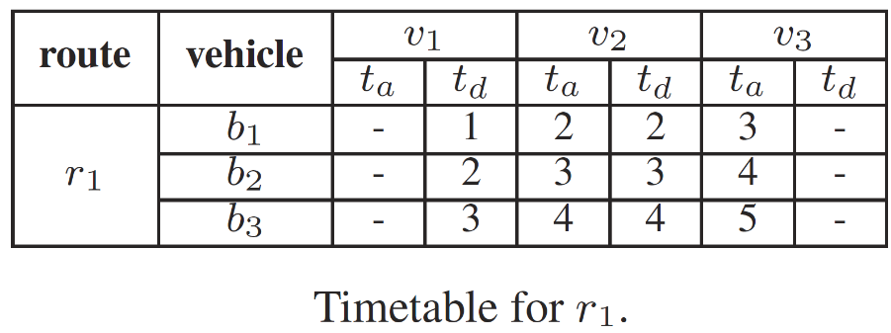
Label Compression
Route-based compression: label with vehicle info
$$b_{1}$$
$$b_{2}$$
$$b_{1}$$
(1,2)
(2,3)
$$〈v_{1},null,null, r_{1}, v_{2}〉$$
$$〈v_{2}, null,null, r_{1}, null〉$$
$$v_{1}$$
(2,3)
$$v_{2}$$
(3,4)
$$v_{3}$$
$L_{in}(v_{3})$ after compression
(3,4)
(4,5)
$$〈v_{1},null,null, r_{1}, null〉$$
$L_{in}(v_{3})$ after compression
$$〈v_{1}, 1,3, b_{1}, null〉$$
$$〈v_{1}, 2,4, b_{2}, null〉$$
$$〈v_{1}, 3,5, b_{3}, null〉$$
$$〈v_{2}, 2,3, b_{1}, null〉$$
$$〈v_{2}, 3,4, b_{2}, null〉$$
$$〈v_{2}, 4,5, b_{3}, null〉$$
$$〈v_{1}, 1,2, b_{1}, null〉$$
$$〈v_{1}, 2,3, b_{2}, null〉$$
$$〈v_{1}, 3,4, b_{3}, null〉$$
$$L_{in}(v_{2})$$
$$L_{in}(v_{3})$$
Notes:
Here we have a set of non-dominated paths from v_1 to v_3 that passes through the same set of vertices and requires no bus transfer. We call such a repetitive pattern as a route. Notice that, in original label, we store lot of timestamps for the same route, which has a lot of redundancy. So, we can first create a timetable for the route, and then compress the original labels into labels without timestamp information to reduce the redundancy. .
The compression is only applicable only when the shortest path between the two nodes requires no bus transfer.
If the path incurs a bus transfer, the compression scheme would not be applicable. So we have the next compression scheme.

Slide 39
Label Compression
Pivot-based compression: label without vehicle info
$o\left(u\right)<o\left(p\right)<o(v)$
$$〈u, 1,5, null, p〉$$
$$〈u, 2,6, null p〉$$
$$〈u, 3,7, null, p〉$$
…
$$〈u, null,null, null, p〉$$
$$L_{in}(v)$$
$$〈u, 1,2, b_{1}, null〉$$
$$〈u, 2,3, b_{1} null〉$$
$$〈u, 3,4, b_{1}, null〉$$
$$〈p, 2,5, null, null〉$$
$$〈p, 3,6, null, null〉$$
$$〈p, 4,7, null, null〉$$
$$L_{in}(p)$$
$${ L}_{in}(v)$$
Notes:
The main observation is that there are a certain of paths that go through the same pivot and only differs in terms of timestamps. As we have seen in path reconstruction, we can recover the three label by using labels that are pertinent to the pivots. So by checking L_in P and L_in v, we can recover the original label without extra space.

Slide 40
Label Compression
Pivot-based compression: label without vehicle info
$o\left(u\right)<o\left(p\right)<o(v)$
$$〈u, 1,5, null, p〉$$
$$〈u, 2,6, null p〉$$
$$〈u, 3,7, null, p〉$$
…
$$〈u, null,null, null, p〉$$
$$L_{in}(v)$$
Label dependency
$$〈u, 1,2, b_{1}, null〉$$
$$〈u, 2,3, b_{1} null〉$$
$$〈u, 3,4, b_{1}, null〉$$
…
$$〈p, 2,5, null, null〉$$
$$〈p, 3,6, null, null〉$$
$$〈p, 4,7, null, null〉$$
…
Notes:
However, there is label dependency between different set of labels. If we also compress the labels below, we will need to recover in a recursive manner, which incurs high query overhead.

Slide 41
Label Compression
Objective
Compress labels as much as possible without significant overheads on query processing.
We formulate it as a weighted maximum independent set problem
Solve it using the standard linear-time (1/maximum degree)-approximation algorithm.

Slide 42
Concise representation of query results
Concise Path
$P=〈 〈v_{3},v_{1},7,9, b_{2}〉, 〈v_{1},v_{2},9,10, b_{2}〉, 〈v_{2},v_{5},11, 13,b_{1}〉〉$
$P_{c}=〈〈v_{3}, 7,b_{2}〉, 〈v_{2}, 11, b_{1}〉 〉$
Easily cooperated into index construction, query processing and label compression.
Reduce path unfolding cost.
Improve query efficiency
Notes:
In most cases, people will only be interested in when and where to take the bus and transfer bus, while not interested in the intermediate stops when taking the same bus. So we provide a concise representation for a path, where each hop only includes
Easily cooperated into index construction, query processing and label compression.

Slide 43
Summary
Timetable Labeling (TTL)
Index structure
Linear query algorithm
Preprocessing Algorithms
Index construction algorithm
$\sqrt{m}$-approximation
Optimizations
Index size: Route-based/Pivot-based compression
Query time: concise path

Slide 44
Experiments

Slide 45
Experimental setup
Running Environment
Intel E5-2650V2 2.60GHz CPU and 64GB RAM, Ubuntu 14.04.1.
C++ implementation.
Query generation:
Randomly generated
${10}^{5}$ queries
Different variations of TTL
TTL, C-TTL, TTL with concise path, C-TTL with concise path
Competitors:
CSA [Dibbelt et al. SEA’13, Wu et al. VLDB’14]
CHT [Geisberger et al. SEA’10]

Slide 46
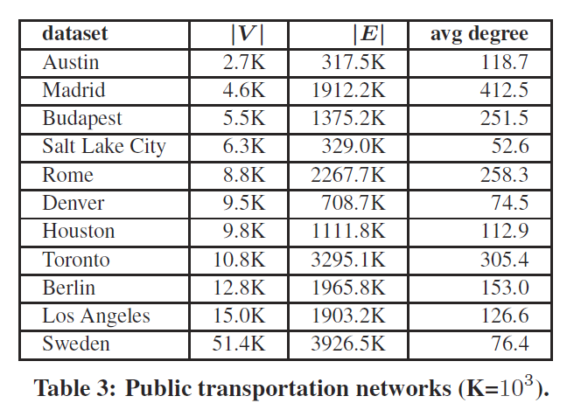
Datasets
11 public available datasets

Slide 47
Query performance
Average query time for SDP queries
Notes:
The first observation is that, TTL and C-TTL are orders of magnitude faster than CSA and CHT. In addition, when concise path is returned, we have noticeable improve for query performance.

Slide 48
Index size
Index size.
Notes:
The index size of TTL and C-TTL are larger than that of CSA and CHT. However, it is justified by the superior query performance. Furthermore, even on the largest dataset Sweden, the index size is only a few hundred mega bytes. The space overhead of TTL and C-TTL are still acceptable for practical applications. We note that, C-TTL can reduce index size by 40%-60% without significant overhead in query performance. Actually, it is still orders of magnitude faster than CSA and CHT. So in scenarios where space consumption is a concern, C-TTL would be a favorable choice compared to TTL.

Slide 49
Preprocessing time
Total preprocessing time.
Notes:
The preprocessing time of TTL and C-TTL are higher than the other two. However, the preprocessing time of TTL and C-TTL is still below 17 minutes even on the largest dataset Sweden.

Slide 50
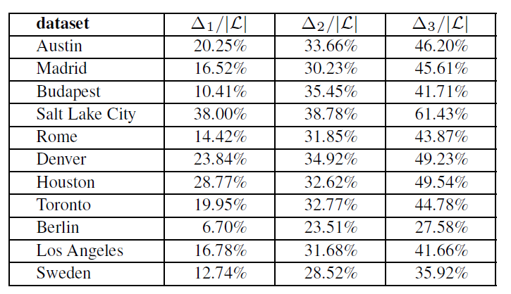
Compression Ratio
$∆_{1}$: Route-based compression.
$∆_{2}$: Pivot-based compression.
$∆_{3}$: Route-based and Pivot-based compression.
Notes:
Finally, we compare the compression ratio of our compression techniques.
Delta_1 denote the reduced index size by using route-based compression, …
By adopting route-based compression, the saved space is up to 38 percent.
By adopting pivot-based compression, the saved space is also up to 38%

Slide 51
Conclusion
We present TTL, an efficient indexing technique for route planning on public transportations
We propose advanced algorithms for query processing, index construction, and label compression

Slide 52
Thanks
Q&A

