Slide 1
Reachability Queries on Large Dynamic Graphs: A Total Order Approach
Diwen Zhu, Wenqing Lin, Sibo Wang, Xiaokui Xiao
School of Computer Engineering
Nanyang Technological University
Singapore

Slide 2
Reachability queries on Graph
Given a directed graph G=(V,E) answer whether s$⇝$t.
a$⇝$b ? Yes, a$→$h$→b$
d $⇝$g? No.
d
a
g
c
e
f
h
b
Social networks
XML documents
Semantic Web
Road networks
…

Slide 3
Existing solutions
Preprocessing time
Index size
Query performance
Most techniques focus on static graphs
Goal: good trade-off
Existing state-of-the-art static techniques:
TF-Label (TF) [Cheng et al. SIGMOD 2013];
Distribution Labeling (DL) [Jin et al. VLDB 2013];
Pruned Landmark Labeling (PLL) [Yano et al. CIKM 2013].
Notes:
There have been a lot of existing solutions to solve reachability queries. Most of them focus on static graphs.
In particular, for those techniques focus on static graph, the objective is to achieve a good trade-off between preprocessing time and index size plus query performance. In particular, the state-of-the-art static techniques include: TF-label, Distribution labeling, and pruned landmark labeling.

Slide 4
Dynamic graphs
Handling updates with static techniques
Rebuild index from scratch
Social networks
XML documents
Semantic Web
Road networks
…
Notes:
However, in many application scenario, the underlying graph is actually dynamic. For example: social networks…
But the problem is: existing static techniques for reachability queries does not provide an incremental update algorithms. So in other words, if we are to handle updates in graphs using these techniques, the only way is to rebuild the whole index from scratch. That obviously incurs too much update overhead.

Slide 5
Existing dynamic graph solutions
Scalability
Transitive closure solutions < 10⁴ nodes
[Bramandia TKDE 2010] < 10⁶ nodes
Generality
[Schenkel ICDE 2005]: only for XML graphs;
Preprocessing time
Path-tree ([Jin. TODS 2011])
Query time
Dagger ([Yildirim. CoRR 2013])
Notes:
On the other hand, there do exist a few reachability techniques that can handle dynamic graphs. But they have severe deficiencies.
In particular, some of the techniques are not scalable. They cannot even handle graphs with more than one million vertices.
Some of them are designed for specific graphs like XML but not for the others. Some of them incurs prohibitively preprocessing time.
The only technique that can scale to large dynamic graphs is the Dagger approach. We will compare with DAGGER in our experiment.

Slide 6
Contributions
Total Order Labeling (TOL) framework+ dynamic updates on TOL
Butterfly: devising a good reachability index under TOL
Notes:
So in our paper, we propose a new technique to answer reachability queries on dynamic graphs. Our contribution is twofold.

Slide 7
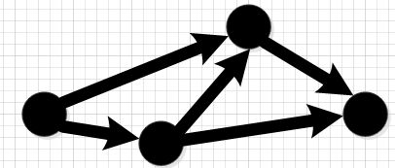
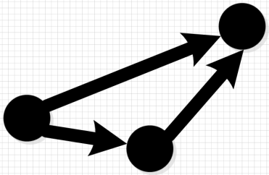
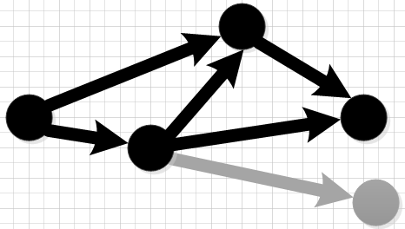
Contribution 1: TOL framework+ dynamic updates on TOL
Total order Labeling (TOL)
TF-Label
DL
PLL
Graph
TOL index
Delete
Insert
update
TOL index
Notes:
First, we formulate a framework called total order labeling. This framework actually summarizes the three state-of-the-art reachability techniques on static graphs: namely TF-label, distribution labeling, and pruned landmark labeling. Under this framework, we investigate how we can do incremental updates. Our results are an incremental insertion algorithm and an incremental deletion algorithm. These two algorithms can be applied on any TOL index. In other words, our algorithm can actually be used to do incremental updates on any of the three algorithms for static graphs that just mentioned.
framework that summarizing the existing static reachability techniques. Under this framework, we will investigate how we can incrementally perform updates. In other words, our update algorithm is general, it can be used to incrementally update any of the three state-of-the-art.

Slide 8
Contribution 2: Butterfly
Total order Labeling (TOL)
TF-Label
DL
PLL
Butterfly
Notes:
In addition to the first contribution, we also investigated how we can devise a good reachability index under the TOL framework. This result in our new reachability technique called Butterfly. As we will show in the experiments, this reachability techniques actually outperforms all of the three reachability techniques that we just mentioned.

Slide 9
Contributions 1: TOL Framework+ update algorithms

Slide 10
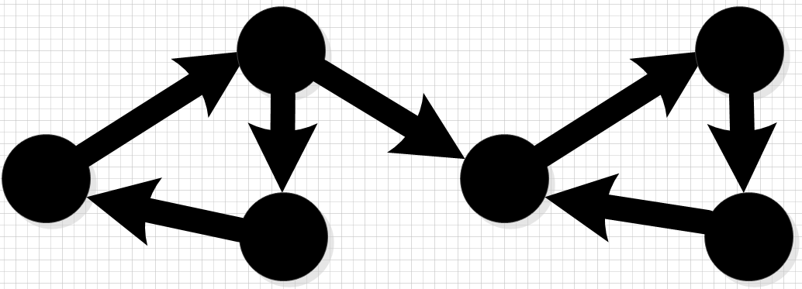
Assumption
Directed acyclic graph (DAG)
We can easily convert a directed G to a DAG G*
Notes:
In our TOL framework, we assume that the graph is a DAG. For the case that the graph is not a DAG, we can easily convert the directed graph to a DAG. The basic idea is that we can first compute the strongly connected components of the graph. Then transfer each strongly connected component into a vertex. For the interest of time, we are not going to the details here.

Slide 11
TOL Framework
Notes:
Now let me introduce our TOL framework.

Slide 12
TOL: Total order
Total order $l$ for all vertices:
$l$(u)< $l$(v):
vertex u has higher relative importance than vertex v in reachability queries
a
e
b
d
f
Graph G
c
g
Notes:
So in our TOL framework, we assume that we have a total order for the vertices. This total order actually captures the relative importance of each vertex for reachability queries. For example, here we have this graph G. You can see that this node d is very important for reachability queries because if we remove this node, then vertices on the two sides will not be reachable. Given that node d is so important, we assume that in our TOL index, we are given a total order where this node d actually will be given high order with small order value.
In general, we want to have a good ordering such that if a node has a higher level than another node, then this node would have higher importance for reachability queries than the other nodes. Of course, how to come up with this ordering is a big problem. We will discuss this later.

Slide 13
TOL: index structure (i)
2-hop labeling index
In-Label: $L_{in}$($v$)
Out-Label: $L_{out}$($v$)
Query:
$c⇝a$? ${(L}_{out}(c)\bigcup{ \{c\}) }$= {c}, $(L_{in}(a)∪\{a\})$={a}: {c}$∩${a}=$∅.$
Answer: No.
a$⇝c$? ${(L}_{out}(a)\bigcup{ \{a\}) }$= {a}, $(L_{in}(c)∪\{c\})$={a,c}: {a}$∩${a,c} $≠∅$
Answer: Yes.
v | L_{in}(v) | L_{out}(v)
a | ∅ | ∅
c | {a} | ∅
Notes:
Given this total order of all vertices, the index structure for our TOL index is as follows. First of all, it’s a two-hop labeling index.
The query algorithm is conducted by inspecting the in-label sets and out-label sets. We illustrate with the following example. Given the in-label sets and out-label sets for two vertices a and c, and we want to check whether c can reach a. To do this, we first obtain the out-label set of vertex c and then add vertex c into this set. Then we obtain the in-label set of vertex a and then add vertex a into this set. Given these two sets, we do intersection and the intersection for these two sets in this example is empty. So c cannot reach a.

Slide 14
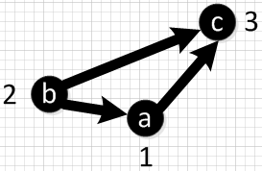
TOL: index structure (ii)
Index: $L_{in}$($v$) contains all vertices u satisfying:
Reachability Constraint， $u⇝$ $v$
Order Constraint, l($u$) < l($v$);
Path Constraint, ∄w, $u⇝$w, w$⇝v$, l(w)<l($u$).
Example
$L_{in}$(c) : = {a}
Reachability Constraint: {a,b}
Order Constraint: {a,b}
Path Constraint: {a,d}
l(a)=1, l(b)=2, l(c)=3,l(d)=4
d
4
Notes:
Each label set of our TOL index satisfy three different kinds of constraints.
Firstly,

Slide 15
Instantiation of TOL index
TF/DL/PLL
Implicitly define a total order
Label sets constructed satisfying three constraints.
Notes:
The three state-of-the-art static techniques are all instantiations of the TOL index. Specifically, they all implicitly define a total order for all vertices. The label sets constructed by those techniques would actually satisfy the three constraints that we have mentioned

Slide 16
Dynamic Updates on TOL Indices
Notes:
Now that we have defined TOL framework, I am going to talk about how we can do incremental updates on this framework.

Slide 17
Problem Definition: Dynamic updates on TOL indices
Definition:
Input: total order $l$, TOL index $ℒ$, and a vertex u to be inserted/deleted
Output: a new total order $l^{′}$ and TOL index $ℒ′$.
Why Maintaining TOL:
Efficient for static graph
Update the indices to still be TOL
Notes:
The main idea is as follows:
1.Given a toal order l, the corresponding TOL index L, and a vertex u to be inserted/deleted, what we want to do is revise the original total order l associated with the TOL index and come up with a new total order that includes/ does not include the vertex u. Based on the new total order, we will have a new TOL index.
2.The reason why we want to maintain a TOL index is that TOL index has shown to be efficient on TOL index.

Slide 18
TOL insertion: deciding total order
Imposed constraints:
$l$($c$)< $l$($b$)< $l$($a$) <$l$($d$)
After insertion of vertex u, new total order $l′$ satisfies
$l′$($c$)< $l′$($b$)< $l′$($a$) <$l′$($d$)
New vertex $u$:
E.g. $l′$($c$)< $l′$($b$) <$l′$($u$)< $l′$($a$)<$l′$($d$)
b
2
3
a
c
1
d
4
b
2
4
a
$$u$$
c
1
3
d
5
Notes:
1.OK, let’s first talk about insertion. As we have said, we have the new total order after the insertion of vertex.
2.It should not change the relative order relation of existing vertices. For example, given the order relation of vertex a,b,c,d. in the new total order, the order relation of these four vertices should remain the same.
3.As for the new vertex, it will be inserted into a certain place in between the sequence of existing nodes. In other words,
For those nodes that ranked lower than the new node, their level will be increased by one.
4.Why do we want to do this. The intuition is that if the existing index is a good one. Then the existing total order should already be good one. In other words, it already captured the relative importance of existing nodes. So when we insert the new vertex, we do not want to change the order of other vertices, our intuition is that this would help us maintain the good performance for previous index.

Slide 19
TOL insertion: choosing $l′(u)$ (i)
n+1 choices. n=|V|.
$l$($c$)< $l$($b$)< $l$($a$) <$l$($d$)
Each choice of $l′(u)→$ new TOL index
Provides the best index: minimize the total index size.
Intuition: index size $→$ average query performance
…
$$l′(u)$$
Notes:
So, given a graph with n vertices, u has n+1 places to be inserted. Which choice should we choose? As each choice will correspond to a new TOL index. We want to choose the l’(u) that provides the best index.
What is the best index? As a common practice in the literature, we are trying to minimize the number of vertices in the label sets, in other words, the total index size. The intuition is that: if the number of vertices in the label set is small, then when we do queries, the label sets that we need to deal with to do intersection will be small, and that will give us better query performance.
But now the question is that how do we choose the position of l’(u) that give us the minimal index size.

Slide 20
TOL insertion: choosing $l′(u)$ (ii)
Naïve approach:
Set $l′\left(u\right)$ from 1 to n+1
Construct index for each case & then choose the minimal one.
Our light weighted incremental approach:
Set $l′\left(u\right)$ to n+1, calculate the index size
Set $l′\left(u\right)$ to n, calculate the change of index size.
Repeat the above process.
Notes:
1.A naïve approach is to insert the vertex in each position and then look at the resulting index. After that we choose the one provides the minimize size. This approach will inucr high cost.
2. We first set l’(u) to n+1, and in this case, we can calculate the index size without constructing the index. To explain, when the l’(u) is set to the lowest order, we can do some minimal change to the index to convert it into a TOL index. Because the convertion is so easy, we can actually do the calculation without actually performing the insertion.
3. After that, we set l’(u) to n, and calculate the change of index size. Again this computation is done without doing the insertion. As we already know the index size when we set l’(u) to n+1, so we can calculate the size of index when we set l’(u) to n.
4. Given the n+1 sizes, we can choose the one that minimizes the index size.
That’s how we decide the order of newly inserted vertex.

Slide 21
TOL Insertion: updating TOL indices
Step 1: Construct $L_{in}$($u$) and $L_{out}$($u$) for newly inserted vertex $u$.
Insert $u$
$L_{in} \text{(}u\text{)}$
$$L_{out} \text{(}u\text{)}$$
$L_{in} \text{(}u\text{)}$
$$L_{out} \text{(}u\text{)}$$
_{v}
+
TOL index $ℒ′$
Update $ℒ$
$$v1$$ | $L_{in}$($v1$) | $L_{out}$($v1$)
$v$₂ | $L_{in}$($v$₂) | $L_{out}$($v$₂)
… | … | …
TOL index $ℒ$
Temp index
Step 2: Update label set of other vertices
$$v1$$ | ${L′}_{in}$($v1$) | ${L′}_{out}$($v1$)
$v$₂ | ${L′}_{in}$($v$₂) | ${L′}_{out}$($v$₂)
… | … | …
Notes:
Step 1: construct $L_{in}(v)$ and $L_{out}\left(v\right)$
generate candidates $C_{in}\left(u\right)⊇L_{in}\left(u\right)$ and $C_{out}\left(u\right)⊇L_{out}\left(u\right)$
prune candidates by checking constraints
Step 2: update label sets of vertices in $V$
New paths: add vertices to label set.
Prune vertices violating constraints

Slide 22
TOL insertion: update TOL indices
Cases that the insertion of vertex u impact other label sets.
$$u$$
v_{i}
$$u$$
v_{k}
v_{i}
v_{k}
(i)
(ii)
Notes:
When we update TOL index, there exist several cases that the insertion of the new vertex u will impact the label set of other vertices.
1.One case is that the vertex is not reachable before the insertion but after the insertion they are reachable. Then we need to add some vertex into the label sets of such impacted vertices.
2.Another trick case is that they already exist a path from the vertex vi to vj. The insertion of vertex u add more paths from vi to vj.
Then the insertion will also be able to impact the label set and we need to do update for such vertices. Our algorithm can handle these cases and I am not going to talk about the details here.

Slide 23
TOL Deletion
Delete vertex $u$
Deciding new total order.
$l$($c$)< $l$($b$) <$l$($u$)< $l$($a$) <$l$($d$)
Update label sets:
Remove $L_{in}$($u$) and $L_{out}$($u$) & remove $u$ from other label sets.
Update other label sets
Complementary cases
Notes:
For deletion, it is more or less the same.
First we decide the new total order. We want to guarantee that the relative order relation of the vertices remains are still the same. We can do this by just removing the vertex u and decrement the total order of vertices after it by one.
To update the label set, we first remove the label set of vertex u and remove it from the other label sets. Then we also need to update the other label sets. The cases are complementary to the insertion and we omit the discuss here.

Slide 24
Summary: TOL updates
Insertion/deletion
Maintain the total order of existing vertices.
Still satisfy the three constraints after updates

Slide 25
An interesting Observation
Improve existing TOL index
TF/DL/PLL
remove a vertex $u∈V$
Temp index
re-insert $u$
TOL index
Notes:
After we devise the insertion and deletion algorithms, we actually have an interesting observation of these algorithms. The update algorithms can actually be used to improve the performance of the three static reachability index under TOL framework. The idea is as follows. Given a TF/DL/PLL index, we can first remove a vertex using our deletion algorithm and then we can re-insert it into the TOL index. Why this works? Remember that our insertion algorithm would actually find a place for this vertex such that it will minimize the TOL index size. The size of the resulting index would never be larger than the original one. So if we do this again and again, we would be able to improve the TOL index that is smaller than the original one. That would actually lead to better query performance as we explained.
When we try this process on existing TOL index, we find that we can significantly reduce the index size and improve the query performnce. This motivates us to devise a new TOL index than is even better than existing static techniques.

Slide 26
Contribution 2: Butterfly
Butterfly:
Choosing better total order with score function f
Iterative approach
Select vertex v₁ with highest $f$(v₁),
Set l(v₁)=1, remove v₁ from G
G
G
Select vertex v₂ with highest $f$(v₂),
Set l(v₂)=2, remove v₂ from G
G= ∅
……
Notes:
1. Our result is a new TOL index called Butterfly. In Butterfly, we devise a new technique that can choose better total order for the vertices than existing static techniques. The high level approach for choosing the total order for all vertices is an iterative approach.
First we compute the score function f for all the vertices and then choose the one with the highest score function. Then we choose the one with the highest score function and set it as the highest order.
2. Then we remove the vertex and update the score function of other vertices. After that, we choose the one with the highest score from remaining vertices and repeat the process.

Slide 27
Two score functions
Butterfly-U (BU)
Butterfly-L (BL)
Index construction on the fly:
Calculate order of a vertex;
Remove the vertex;
Add the removed vertex to label sets of other vertices.
Notes:
1. So we investigate two different score functions. We identify two score functions that can be efficiently computed and updated. One of them is called Butterfly-U, shorten as BU. And one…
2. Given the ordering, we actually construct the TOL index along with the calculation of the total order. Whenever we remove a node, we add the node to the label set of .

Slide 28
Experimental Evaluation

Slide 29
Experiment setup
Running Environment
Intel Xeon 2.4GHz CPU 48GB RAM, Ubuntu 12.04.
C++ implementation.
Query generation:
Random queries
Updates generation:
randomly remove 10⁴ vertices, insert back in reverse order of their removal

Slide 30
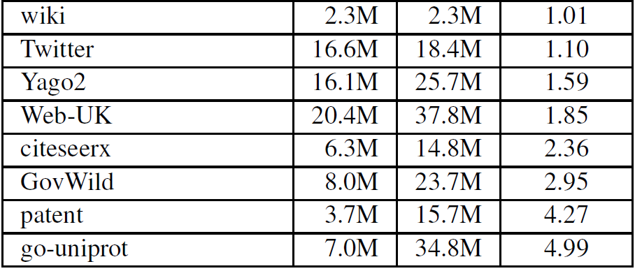
Datasets

Slide 31
Dynamic Graphs: insertion
Competitor
Dagger ([Yildirim. CoRR 2013])
Insertion can be done in milliseconds
Notes:
1. For this experiment we choose Dagger as our competitor. Because this is the only solution that can handle dynamic updates on large graphs. In this diagram here, the x-axis shows different datasets. Y axis shows the insertion time in log scale.
2. The black bar here denote our first solution BU, the grey bar here denotes our second solution BL.

Slide 32
Dynamic Graphs: deletion
Comparable performance as Dagger in deletion
Notes:
For deletion, Dagger actually outperforms our algorithms. You may wonder that Dagger seems to have better performance than our techniques. However, this is at the cost of query performance.

Slide 33
Dynamic Graphs: query performance
More efficient query performance
Notes:
Dagger does not gain a good trade-off between query performance and update time. Our solution achieves orders of less query time than BFS and Dagger in all datasets. Although we have higher update cost than Dagger, we actually provide much better query performance and gain a better trade-off than Dagger.

Slide 34
Static Graphs: index size
smaller size than other indices in almost all cases
Notes:
For the second set of experiment, we compare our techniques with existing state-of-the-art static solutions.

Slide 35
Static graph: preprocessing time
less preprocessing time in almost all cases

Slide 36
Static graph: query time
less query time in all cases

Slide 37
Conclusion
Propose TOL framework and update algorithms on TOL framework.
Construct a good initial TOL indices.

Slide 38
Thanks
Q&A

Slide 39
Complexity
…
$$x_{1}$$
$$y_{1}$$
TOL insertion
Worst case: O(n³$)$
TOL deletion
Worst case: O(n³$)$
Efficient in practice
$$u$$
…
…
$$x_{k}$$
$$y_{w}$$
…
$${L′}_{out}(u)$$
$${L′}_{in}(u)$$
$$L_{out}(x_{i})∩L_{in}(y_{j})$$

Slide 40
Improvement on existing TOL indices

Slide 41
TOL updates
DAG g $→$ Graph g’
g’ might not be DAG
Adopting the solution in [Yildirim. CoRR 2013]
Incrementally maintaining strongly connected components (SCC).

Slide 42
Difference of BU and BL
Differs in the way that they quantify the importance of each vertex.
Both of them use some heuristics to derive the total order that tries to capture the relative importance as accurate as possible
Using different heuristics.

Slide 43
TOL Insertion 1: deciding vertex level
v_{i} | l(v_{i})
v₁ | 1
v₂ | 2
… | …
v_{n-1} | n-1
v_{n} | n
v_{i} | l(v_{i})
v₁ | 1
v₂ | 2
… | …
v_{n-1} | n-1
v_{n} | n
l(v)=1 or 2 or… or n+1?
Insert v
G=(V,E),
|V|=n.
v_{i} | l’(v_{i})
v₁ | 1
… | …
v | k
v_{k} | k+1
… | …
v_{n-1} | n
v_{n} | n+1
TOL index

Slide 44
TOL Insertion 1: deciding vertex level
v_{i} | l(v_{i})
v₁ | 1
… | …
v_{k} | k
v | k+1
… | …
v_{n-1} | n
v_{n} | n+1
v_{i} | l(v_{i})
v₁ | 1
… | …
v | k
v_{k} | k+1
… | …
v_{n-1} | n
v_{n} | n+1
Swap level of v and v_{k}
TOL index L_{k+1}
Δ_{u}=|L_{k+1}|-|L_{k}|
TOL index L_{k}

Slide 45
TOL Insertion 1: deciding vertex level
Let ${θ_{k}=∆}_{n}+∆_{n−1}+…+∆_{k}$, set $l\left(v\right)=\arg{\min_{k}\{θ_{k}\}}$.
TOL index L_{n+1}
Δ_{n}
TOL index L_{n-1}
Δ_{n-1}
TOL index L₁
Δ₁
…
Δ_{n-2}
TOL index L_{n-2}

Slide 46
TOL deletion
Level relation unchanged for remaining vertices.
Step 1:
Remove v (the vertex to be deleted) from all label set
Step 2:
Retrieve all vertices v can reach: B⁺(v)
L_{out}(v) unchanged
Construct candidate sets of L_{in}(v):
In-neighbor and in-label set of in-neighbor
Prune pairs violating constraints
Step 3:
retrieve all vertices can reach v: B⁻(v)
…

Slide 47
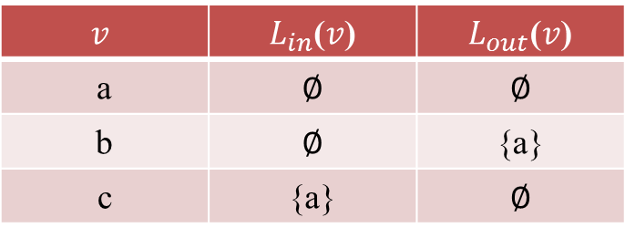
Total Order Labeling: Query Algorithm
$W$($s$,$t$) = $(L_{out}(s)\bigcup{ \{s\}) \bigcap{ (L_{in}\left(t\right)\bigcup{ \left\{t\right\}})}}$.
s$⇝$t $⇔$ $W$($s$,$t$) ≠ $∅$.
Minimal size: query correctness.
Example
$W$(c,a)={c} ∩{a}= $∅$
$W$(a,c)={a} ∩{a,c}$≠$ $∅$
$$v$$ | $L_{in}$($v$) | $L_{out}$($v$)
a | ∅ | ∅
b | ∅ | {a}
c | {a} | ∅

Slide 48
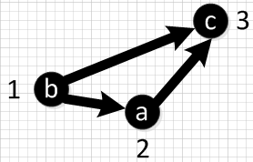
Total Order Labeling: Ordering Impact
$$v$$ | $L_{in}$($v$) | $L_{out}$($v$)
a | ∅ | ∅
b | ∅ | {a}
c | {a} | ∅
$$v$$ | $L_{in}$($v$) | $L_{out}$($v$)
a | {b} | ∅
b | ∅ | ∅
c | {a, b} | ∅

Slide 49
TOL Insertion: updating TOL indices
Step 2.1: Construct label set L_{in}(v) and L_{out}(v) for newly inserted vertex v.
Step 2.2: Update label set of other vertices.
New paths
Add v to label sets of vertices u where l(u)<l(v)
Possible violation of constraints:
Path Constraint

Slide 50
Contribution 3: Butterfly
Butterfly:
Choosing good vertex level order
Score function $f$
Construct TOL indices based on the level order
Select vertex v₁ with highest $f$(v₁),
Set l(v₁)=1, remove v₁ from G
G
G
G= ∅
……
Select vertex v₂ with highest $f$(v₂),
Set l(v₂)=2, remove v₂ from G

Slide 51
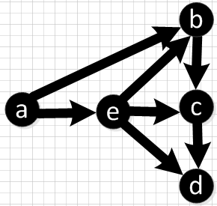
Score function
$\operatorname{Sin}\left(v\right)$: set of vertex can reach $v$
$Sout(v)$: set of vertex $v$ can reach
$f\left(v\right)=\frac{|Sin\left(v\right)|∗|Sout\left(v\right)|+|Sin\left(v\right)|+|Sout(v)|}{|Sin\left(v\right)|+|Sout(v)|}$
$$v$$ | $$\operatorname{Sin}\left(v\right)$$ | $$Sout(v)$$ | $f$($v$)
a | 0 | 4 | 1
b | 2 | 2 | 2
c | 3 | 1 | 1.75
d | 4 | 0 | 1
e | 1 | 3 | 1.75

Slide 52
TOL updates: deciding vertex order
Maintaining old vertex order relation:
$l$($vi$)< $l$($vj$) after update, $l$’($vi$)< $l$’($vj$).
Insert $u$:
$$l′(v)=\left\{\begin{aligned}l\left(v\right), l\left(v\right)<l^{′}\left(u\right) \\ &l(v)+1, otherwise\end{aligned}\right.$$
$l$(e)< $l$(c)< $l$(b)< $l$(d)< $l$(a)
How to choose $l^{′}\left(u\right)? n+1$ choices
Delete $u$
$$l′\left(v\right)=\left\{\begin{aligned}l(v), l(v)<l′(u) \\ &l(v)−1, otherwise\end{aligned}\right.$$
…
$$l′(u)$$

Slide 53
TOL insertion: choosing $l′(u)$ (ii)
Incremental approach
$∆_{k}=|ℒ_{k}|−|ℒ_{k+1}|$
Let ${θ_{k}=∆}_{n}+∆_{n−1}+…+∆_{k}$ , set $l′\left(u\right)=\arg{\min_{k}\{θ_{k}\}}$.
$|ℒ_{k}|$ = $θ_{k}$ + $|ℒ_{n+1}|$

